Slide 1
REFINED BY FIRE
JoLynn Gower
493-6151 352-2458
jgower@guardingthetruth.org

Slide 2
WORD FOR THE JOURNEY
Jeremiah 1:4-8 Now the word of the LORD came to me saying, "Before I formed you in the womb I knew you, and before you were born I consecrated you; I have appointed you a prophet to the nations." Then I said, "Alas, Lord GOD! Behold, I do not know how to speak, Because I am a youth." But the LORD said to me, "Do not say, 'I am a youth,' Because everywhere I send you, you shall go, And all that I command you, you shall speak. Do not be afraid of them, for I am with you to deliver you," declares the LORD.

Slide 3
THE JOY OF THE LORD
Our choice:
difficult circumstances ---- joy
difficult circumstances ---- bitterness
Hebrews 12:15 See to it that no one comes short of the causes grace of God; that no root of bitterness springing up causes trouble and by it many be defiled;
Hebrews 12:11 All discipline for the moment seems not to be joyful, but sorrowful; yet to those who have been trained by it, afterwards it yields the peaceful fruit of righteousness.
The difference between acquiescence and acceptance;
resignation to circumstances or belief in the midst of circumstances

Slide 4
RULES OF THE ROAD
ACCEPT GOD’S CHARACTER AND SOVEREIGNTY
If God is not in charge, then who is?
If God is unaware of our circumstances, would He be sovereign?
Jeremiah 31:3 The LORD appeared to him from afar, saying, "I have loved you with an everlasting love; Therefore I have drawn you with lovingkindness.
ACCEPT GOD’S GRACE
We are saved by grace; grace gives us all we need to handle any circumstances that come up
Genesis 25:32 Esau said, "Behold, I am about to die; so of what use then is the birthright to me?"
WHAT IS YOUR BIRTHRIGHT?
HOW MIGHT YOU GIVE IT UP?

Slide 5
WHO ARE YOU?
WE NEED TO LEARN TO ACCEPT WHO GOD INTENDS FOR US TO BE, WHO WE ARE AND WHAT WE ARE IN HIM
1 Corinthians 15:5-10 … and that He appeared to Cephas, then to the twelve. After that He appeared to more than five hundred brethren at one time, most of whom remain until now, but some have fallen asleep;
then He appeared to James, then to all the apostles;
and last of all, as to one untimely born, He appeared to me also. For I am the least of the apostles, and not fit to be called an apostle, because I persecuted the church of God. But by the grace of God I am what I am, and His grace toward me did not prove vain; but I labored even more than all of them, yet not I, but the grace of God with me.

Slide 6
WHO CHOSE YOU?
John 15:14-16 "You are My friends if you do what I command you. No longer do I call you slaves, for the slave does not know what his master is doing; but I have called you friends, for all things that I have heard from My Father I have made known to you. You did not choose Me but I chose you, and appointed you that you would go and bear fruit, and that your fruit would remain, so that whatever you ask of the Father in My name He may give to you.
Choose: eklego: to select out of a larger group
Appointed: tithemi: to commission
In My name: by my authority
Jesus has all authority; He gives us what we need to be able to accomplish the work He has for us

Slide 7
ALL ABOUT WORKS
Ephesians 2:8-10 For by grace you have been saved through faith; and that not of yourselves, it is the gift of God; not as a result of works, so that no one may boast.
For we are His workmanship, created in Christ Jesus for good works, which God prepared beforehand so that we would walk in them.
We are not saved by doing good things; we are saved and expected to do the good things that God has prepared
James 2:26 For just as the body without the spirit is dead, so also faith without works is dead.
Galatians 2:16 …nevertheless knowing that a man is not justified by the works of the Law but through faith in Christ Jesus, even we have believed in Christ Jesus, so that we may be justified by faith in Christ and not by the works of the Law; since by the works of the Law no flesh will be justified.

Slide 8
WHOSE LOVE CAME FIRST?
Psych classes tell us that we have to love ourselves in order to be able to love others
That leaves a piece of the puzzle on the table!
Because God loves us, we can love ourselves and others
Without the “God piece” of the puzzle, nothing works
Mark 8:35-36 “For whoever wishes to save his life will lose it, but whoever loses his life for My sake and the gospel's will save it. For what does it profit a man to gain the whole world, and forfeit his soul?”
Soul: psuche: that part of you that makes you distinctly you!
God desires that our soul be completely in tune with what He saved and appointed us to do

Slide 9
LOVE NEIGHBOR AS OURSELVES?
Romans 13:8-10 Owe nothing to anyone except to love one another; for he who loves his neighbor has fulfilled the law. For this, "YOU SHALL NOT COMMIT ADULTERY, YOU SHALL NOT MURDER, YOU SHALL NOT STEAL, YOU SHALL NOT COVET," and if there is any other commandment, it is summed up in this saying, “YOU SHALL LOVE YOUR NEIGHBOR AS YOURSELF.” Love does no wrong to a neighbor; therefore love is the fulfillment of the law.
Love: agapao: the sort of love that puts another person’s best interest first
Because God put our best interest first, we can have the security provided by being what God desires
Then the natural outflow is putting other people’s interests first

Slide 10
APPROPRIATE LOVE OF SELF
Philippians 2:3-8 Do nothing from selfishness or empty conceit, but with humility of mind regard one another as more important than yourselves; do not merely look out for your own personal interests, but also for the interests of others. Have this attitude in yourselves which was also in Christ Jesus, who, although He existed in the form of God, did not regard equality with God a thing to be grasped, but emptied Himself, taking the form of a bond-servant, and being made in the likeness of men. Being found in appearance as a man, He humbled Himself by becoming obedient to the point of death, even death on a cross.
Kenosis of Christ emptied: kenoo: to empty or vacate
Christ emptied himself: it was a voluntary action

Slide 11
PROFOUND FORECAST
2 Timothy 3:1-5 But realize this, that in the last days difficult times will come. For men will be lovers of self, lovers of money, boastful, arrogant, revilers, disobedient to parents ungrateful, unholy, unloving, irreconcilable, malicious gossips, without self-control, brutal, haters of good, treacherous, reckless, conceited, lovers of pleasure rather than lovers of God, holding to a form of godliness, although they have denied its power; Avoid such men as these.
FORM: morphosis: appearance
DENIED: arneomai: refused to accept
Acts 1:8 “…but you will receive power when the Holy Spirit has come upon you; and you shall be My witnesses both in Jerusalem, and in all Judea and Samaria, and even to the remotest part of the earth."
Power: dunamis: the ability to act

Slide 12
MERCY PERSONIFIED
Grace: charis: receiving something good that you don’t deserve
Mercy: eleos: when you don’t receive something bad (i.e. punishment) that you do deserve
We are saved because of God’s grace
We aren’t sent to hell because of God’s mercy
The Ark of the Covenant presents the perfect picture:
Inside the Ark were the tablets of the Law
The lid of the Ark was a “seat” with covering cherubim
Exodus 25:22 "There I will meet with you; and from above the mercy seat, from between the two cherubim which are upon the ark of the testimony, I will speak to you about all that I will give you in commandment for the sons of Israel.”

Slide 13
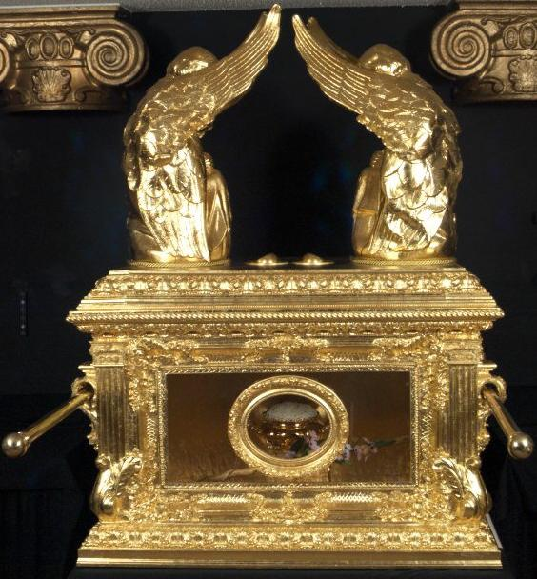
THE MERCY SEAT
The Law demanded
punishment for sin
But God’s great
mercy, through
Christ, took the
punishment (hell; eternal separation from God) away
At the cross, mercy triumphed over judgment

Slide 14
FORMER LIFE
Romans 11:28-32 From the standpoint of the gospel they are enemies for your sake, but from the standpoint of God's choice they are beloved for the sake of the fathers; for the gifts and the calling of God are irrevocable. For just as you once were disobedient to God, but now have been shown mercy because of their disobedience, so these also now have been disobedient, that because of the mercy shown to you they also may now be shown mercy.
For God has shut up all in disobedience so that He may show mercy to all.
Romans 9:16 So then it does not depend on the man who wills or the man who runs, but on God who has mercy.

Slide 15
HOW WE ARE SAVED
Ephesians 2:3-10 Among them we too all formerly lived in the lusts of our flesh, indulging the desires of the flesh and of the mind, and were by nature children of wrath, even as the rest. But God, being rich in mercy, because of His great love with which He loved us, even when we were dead in our transgressions, made us alive together with Christ (by grace you have been saved), and raised us up with Him, and seated us with Him in the heavenly places in Christ Jesus, so that in the ages to come He might show the surpassing riches of His grace in kindness toward us in Christ Jesus. For by grace you have been saved through faith; and that not of yourselves, it is the gift of God; not as a result of works, so that no one may boast. For we are His workmanship, created in Christ Jesus for good works, which God prepared beforehand so that we would walk in them.

