Slide 1
THE GREAT EXCHANGE The Emerging Church
JoLynn Gower
352-2458 493-6151
jgower@guardingthetruth.org

Slide 2
BABYLON RISING
Genesis 10:8-14 Now Cush became the father of Nimrod; he became a mighty one on the earth. He was a mighty hunter before the Lord; therefore it is said, "Like Nimrod a mighty hunter before the Lord.” The beginning of his kingdom was Babel and Erech and Accad and Calneh, in the land of Shinar. From that land he went forth into Assyria, and built Nineveh and Rehoboth-Ir and Calah, and Resen between Nineveh and Calah; that is the great city. Mizraim became the father of Ludim and Anamim and Lehabim and Naphtuhim and Pathrusim and Casluhim (from which came the Philistines) and Caphtorim.
Genesis 11:3-4 They said to one another, "Come, let us make bricks and burn them thoroughly." And they used brick for stone, and they used tar for mortar. They said, "Come, let us build for ourselves a city, and a tower whose top will reach into heaven, and let us make for ourselves a name, otherwise we will be scattered abroad over the face of the whole earth."

Slide 3
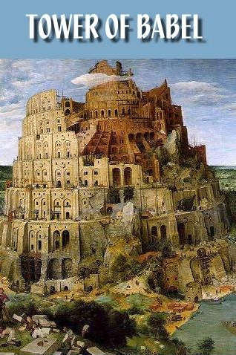
THE TOWER OF BABEL

Slide 4
PAINTING/EU HEADQUARTERS

Slide 5
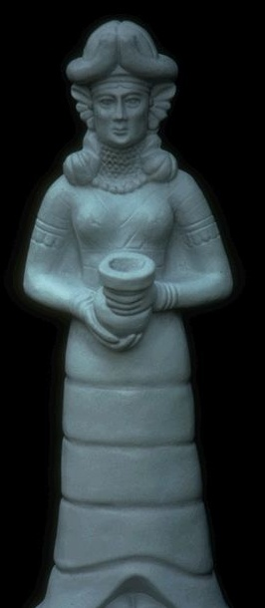
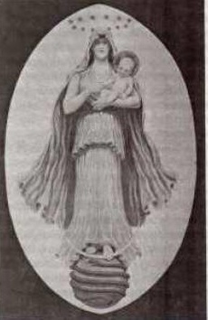
STATUE OUTSIDE EU HEADQUARTERS
Europa = Astarte = Ishtar

Slide 6
THE HARLOT
Revelation 17:1-6 Then one of the seven angels who had the seven bowls came and spoke with me, saying, "Come here, I will show you the judgment of the great harlot who sits on many waters, with whom the kings of the earth committed acts of immorality, and those who dwell on the earth were made drunk with the wine of her immorality." And he carried me away in the Spirit into a wilderness; and I saw a woman sitting on a scarlet beast, full of blasphemous names, having seven heads and ten horns. The woman was clothed in purple and scarlet, and adorned with gold and precious stones and pearls, having in her hand a gold cup full of abominations and of the unclean things of her immorality, and on her forehead a name was written, a mystery, "BABYLON THE GREAT, THE MOTHER OF HARLOTS AND OF THE ABOMINATIONS OF THE EARTH.” And I saw the woman drunk with the blood of the saints, and with the blood of the witnesses of Jesus. When I saw her, I wondered greatly.

Slide 7
MORE ON BABYLON
Revelation 18:9-10 And the kings of the earth, who committed acts of immorality and lived sensuously with her, will weep and lament over her when they see the smoke of her burning, standing at a distance because of the fear of her torment, saying, 'Woe, woe, the great city, Babylon, the strong city! For in one hour your judgment has come.'
Revelation 18:21 Then a strong angel took up a stone like a great millstone and threw it into the sea, saying, "So will Babylon, the great city, be thrown down with violence, and will not be found any longer.

Slide 8
THE BEAST SHE RIDES
Revelation 17:8-13 "The beast that you saw was, and is not, and is about to come up out of the abyss and go to destruction. And those who dwell on the earth, whose name has not been written in the book of life from the foundation of the world, will wonder when they see the beast, that he was and is not and will come. Here is the mind which has wisdom. The seven heads are seven mountains on which the woman sits, and they are seven kings; five have fallen, one is, the other has not yet come; and when he comes, he must remain a little while. The beast which was and is not, is himself also an eighth and is one of the seven, and he goes to destruction. The ten horns which you saw are ten kings who have not yet received a kingdom, but they receive authority as kings with the beast for one hour. These have one purpose, and they give their power and authority to the beast.

Slide 9
SEVEN ORE (HILLS OR MTS) SEVEN KINGS
The woman sits on (rules) seven mountains
The seven mountains are also seven kings:
Fallen: Egypt, Assyria, Babylon, Medo-Persia,
Greece Is: Rome Not yet: arises from Rome
Daniel 7:23-25 Thus he said: 'The fourth beast will be a fourth kingdom on the earth, which will be different from all the other kingdoms and will devour the whole earth and tread it down and crush it. As for the ten horns, out of this kingdom ten kings will arise; and another will arise after them, and he will be different from the previous ones and will subdue three kings. He will speak out against the Most High and wear down the saints of the Highest One, and he will intend to make alterations in times and in law; and they will be given into his hand for a time, times, and half a time.

Slide 10
ABOUT THE HARLOT
Harlot and mother of harlots
Riding a beast (world system)
Punished for immorality
Attired like a goddess (Ishtar) including golden cup
She is a city/used in sense of people who knew God but worshipped otherwise
Revelation 17:15-18 And he said to me, "The waters which you saw where the harlot sits, are peoples and multitudes and nations and tongues. And the ten horns which you saw, and the beast, these will hate the harlot and will make her desolate and naked, and will eat her flesh and will burn her up with fire. For God has put it in their hearts to execute His purpose by having a common purpose, and by giving their kingdom to the beast, until the words of God will be fulfilled. The woman whom you saw is the great city, which reigns over the kings of the earth.”

