Slide 1
THE GREAT EXCHANGE The Emerging Church
JoLynn Gower
352-2458 493-6151
jgower@guardingthetruth.org

Slide 2
EMERGING MUSIC
The emerging church has it’s musical element
Much of this comes out of California
Some emergent worship leaders:
Emerging Voices The antidote movement:
Derek Johnson 268 Generation
Mary Kat Ehrenmzeller Isaiah 26:8
Nate Ward Indeed while following
Justin Jarvis the way of your judg-
Jonny Baker ments, Oh Lord, we
Brian and Jenn Johnson have waited for you
Jeremy Riddle eagerly; your name,
Steffany Frizzell even your memory is
Hunter Thompson the desire of our souls
Matt Stenton

Slide 3
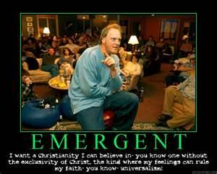
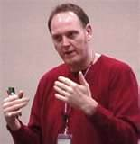
DOUG PAGITT
a

Slide 4
HERESY #6: UNIVERSALISM
Doug Pagitt is an author and head pastor of Solomon’s Porch in South Minneapolis. He is a senior fellow with the emergent village and a leader of the emergent church discussion.
“There’s going to be no difference between the way God is going to interact with you when you die and the way God’s going to interact with a Muslim when a Muslim dies.” Doug Pagitt
“I want a Christianity I can believe in, you know, one without the exclusivity of Christ. The kind where my feelings can rule my faith, you know, universalism.” Doug Pagitt
“Salvation is the entire universe being brought back into harmony with its maker.” Rob Bell
Rather than the exclusive revelation of God, Jesus is one of many mediators of the sacred. Marcus Borg

Slide 5
DEFINITIONS
Pluralism: all world religions are a path to God whereby one can be saved
Exclusivism: Only those who came to God during the OT era, such as Abraham, and all Christians since the time of Christ can be saved. There is salvation in no other name but that of Christ; those who live and die without accepting Christ will go to Hell whether or not they ever had the opportunity to hear about Him
Inclusivism: There is salvation in no other name but Christ and those finally saved will be saved through Him, but they don’t have to have known/accepted Him while living on earth
Christian Universalism: combination of #1 and #3
Notes:
No

Slide 6
THE DOCTRINE
Acts 4:12 "And there is salvation in no one else; for there is no other name under heaven that has been given among men by which we must be saved.“
No other name: oude gar onoma estin heteron
Romans 1:16 For I am not ashamed of the gospel, for it is the power of God for salvation to everyone who believes, to the Jew first and also to the Greek.
God is very consistent: His salvation model (Kinsman Redeemer), His worship model (Tabernacle), His celebration model (feasts) all point to Christ
Ephesians 1:10 …with a view to an administration suitable to the fullness of the times, that is, the summing up of all things in Christ, things in the heavens and things on the earth.

Slide 7
GOD WANTS PEOPLE TO BE SAVED
1 Timothy 2:3-6 This is good and acceptable in the sight of God our Savior, who desires all men to be saved and to come to the knowledge of the truth. For there is one God, and one mediator also between God and men, the man Christ Jesus, who gave Himself as a ransom for all, the testimony given at the proper time.
Desire: from thelo: to be willing; thelei, indicative mood
active option requiring a subjective impulse
Matthew 28:18-20 And Jesus came up and spoke to them, saying, "All authority has been given to Me in heaven and on earth. Go therefore and make disciples of all the nations, baptizing them in the name of the Father and the Son and the Holy Spirit, teaching them to observe all that I commanded you; and lo, I am with you always, even to the end of the age.”

Slide 8
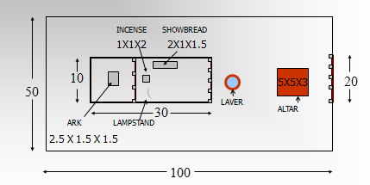
GOD PROVIDED THE MEANS
Redemption model:
1. 3.
2. 4.
Tabernacle model

Slide 9
REQUIREMENTS OF THE LAW
Romans 8:1-4 Therefore there is now no condemnation for those who are in Christ Jesus. For the law of the Spirit of life in Christ Jesus has set you free from the law of sin and of death. For what the Law could not do, weak as it was through the flesh, God did: sending His own Son in the likeness of sinful flesh and as an offering for sin, He condemned sin in the flesh, so that the requirement of the Law might be fulfilled in us, who do not walk according to the flesh but according to the Spirit.
Salvation from the pleasure of sin
Salvation from the penalty of sin
Salvation from the power of sin
Salvation from the presence of sin

Slide 10
ASSURANCE OF SALVATION
Romans 8:16 The Spirit Himself testifies with our spirit that we are children of God…
1 John 2:3 By this we know that we have come to know Him, if we keep His commandments.
1 John 4:6 We are from God; he who knows God listens to us; he who is not from God does not listen to us. By this we know the spirit of truth and the spirit of error.
Romans 8:35 Who will separate us from the love of Christ? Will tribulation, or distress, or persecution, or famine, or nakedness, or peril, or sword?
Matthew 7:17-20 "So every good tree bears good fruit, but the bad tree bears bad fruit. A good tree cannot produce bad fruit, nor can a bad tree produce good fruit. Every tree that does not bear good fruit is cut down and thrown into the fire. So then, you will know them by their fruits.”

Slide 11
SUMMARY
2 Thessalonians 2:7-12 For the mystery of lawlessness is already at work; only he who now restrains will do so until he is taken out of the way. Then that lawless one will be revealed whom the Lord will slay with the breath of His mouth and bring to an end by the appearance of His coming; that is, the one whose coming is in accord with the activity of Satan, with all power and signs and false wonders, and with all the deception of wickedness for those who perish, because they did not receive the love of the truth so as to be saved. For this reason God will send upon them a deluding influence so that they will believe what is false, in order that they all may be judged who did not believe the truth, but took pleasure in wickedness.

