Slide 1
THE GREAT EXCHANGE The Emerging Church
JoLynn Gower
352-2458 493-6151
jgower@guardingthetruth.org

Slide 2
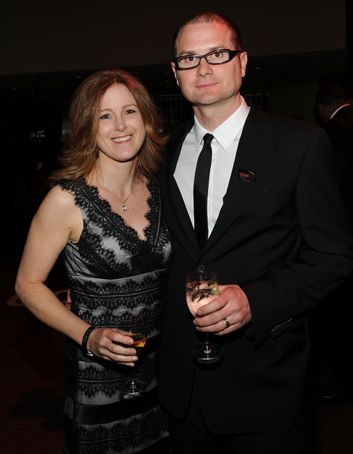
ROB BELL
a

Slide 3
HERESY #5: THERE IS NO LITERAL HELL
Hell is disconnection and disintegration with God… you will not find statements of what our community be-lieves on this site. Belief is a dynamic lived reality and doesn’t lend itself to website statements. Doug Pagitt
Heaven and hell are choices we make and live with right now. God gives us what we want….at the center of the Christian tradition since the first church has been the insistence that history is not tragic, hell is not forever, and love, in the end, wins. Rob Bell
Bell doesn’t believe that death cuts off the ability to repent. He doesn’t believe there is eternal torment for things people did in their few finite years of life.
Bell also believes that Jesus makes salvation possible even for people who never knew his name.

Slide 4
WHAT THE BIBLE SAYS
Hell: sheol (Hebrew): underworld; a place where people descend at death.
Hell: hades (Greek): the place or state of departed souls
Hell: gehenna (common but Hebrew roots) valley immediately south of city of David; used as synonym for place of fire and final judgment
Hell: tartarus: from Greek tartaros: the lowest part of hell; sometimes taken to be the abyss (2 Peter 2:4)
Notes:
No

Slide 5
THE DOCTRINE
Matthew 25:45-46 "Then He will answer them, 'Truly I say to you, to the extent that you did not do it to one of the least of these, you did not do it to Me.’ These will go away into eternal punishment, but the righteous into eternal life.”
Eternal: aionios: forever, agelong
Punishment: kolasis: penal infliction, torment
Romans 1:18-19 For the wrath of God is revealed from heaven against all ungodliness and unrighteousness of men who suppress the truth in unrighteousness, because that which is known about God is evident within them; for God made it evident to them.
Wrath: orge: violent passion; vengeance
Romans 12:19 Never take your own revenge, beloved, but leave room for the wrath of God, for it is written, "Vengeance is Mine, I will repay," says the Lord.

Slide 6
WHAT IS SEPARATION FROM GOD ABOUT?
2 Thessalonians 1:6-9 For after all it is only just for God to repay with affliction those who afflict you, and to give relief to you who are afflicted and to us as well when the Lord Jesus will be revealed from heaven with His mighty angels in flaming fire, dealing out retribution to those who do not know God and to those who do not obey the gospel of our Lord Jesus. These will pay the penalty of eternal destruction, away from the presence of the Lord and from the glory of His power…
Retribution: ekdikesis: vindication; revenge
Penalty: dike: justice
Destruction: olethros: ruin, death
JUSTICE VS FAIRNESS
Isaiah 11:4 But with righteousness He will judge the poor, and decide with fairness for the afflicted of the earth; and He will strike the earth with the rod of His mouth, and with the breath of His lips He will slay the wicked.

Slide 7
ETERNAL FIRE
Jude 1:6-7 And angels who did not keep their own domain, but abandoned their proper abode, He has kept in eternal bonds under darkness for the judgment of the great day, just as Sodom and Gomorrah and the cities around them, since they in the same way as these indulged in gross immorality and went after strange flesh, are exhibited as an example in undergoing the punishment of eternal fire.
Strange: heteros: different (in the sense of comparison—not the same but same typology)
Matthew 25:41 "Then He will also say to those on His left, 'Depart from Me, accursed ones, into the eternal fire which has been prepared for the devil and his angels;”
Matthew 18:8 "If your hand or your foot causes you to stumble, cut it off and throw it from you; it is better for you to enter life crippled or lame, than to have two hands or two feet and be cast into the eternal fire.”

Slide 8
LAKE OF FIRE
Revelation 19:20 And the beast was seized, and with him the false prophet who performed the signs in his presence, by which he deceived those who had received the mark of the beast and those who worshiped his image; these two were thrown alive into the lake of fire which burns with brimstone.
Revelation 20:10 And the devil who deceived them was thrown into the lake of fire and brimstone, where the beast and the false prophet are also; and they will be tormented day and night forever and ever.
Revelation 20:14-15 Then death and Hades were thrown into the lake of fire. This is the second death, the lake of fire. And if anyone's name was not found written in the book of life, he was thrown into the lake of fire.

Slide 9
ORDER OF EVENTS FOR SATAN’S FALSE TRINITY
Satan’s false trinity rises after the 7th trumpet; consists of Satan as false father; antichrist as beast empowered from the abyss; false prophet as false holy spirit
Antichrist and false prophet thrown into lake of fire at Jesus’ second coming
Satan bound in abyss at Jesus’ second coming
Satan freed from abyss at the end of Jesus’ 1000 year reign on earth
Satan up to same tricks and is defeated again and this time goes into lake of fire with others

Slide 10
ORDER OF EVENTS FOR PEOPLE
Sometime during the last 7 years (right before, during, at the end??) the church is raptured
Believers are given rewards
Jesus comes to earth to reign for 1000 years at the end of the tribulation period (fights Armageddon)
At end of 1000 years, unsaved dead are raised from hell (white throne judgment)
Unsaved dead are judged and thrown into lake of fire
New heaven, new earth, New Jerusalem – the eternal abode of believers

