Slide 1
REVERENCE FOR GOD’S PROMISES
JoLynn Gower
352-2458 cell 493-6151
jgower@guardingthetruth.org

Slide 2
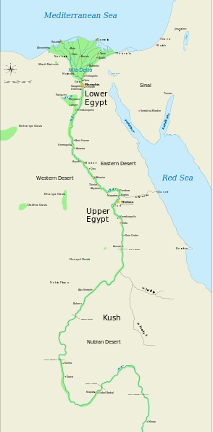
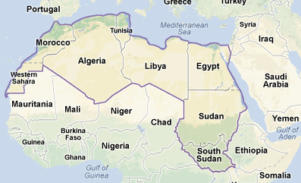
ABOUT EGYPT
EGYPT WAS SETTLED BY HAMITIC PEOPLE
Genesis 10:6 The sons of Ham were Cush,
Mizraim, Put and Canaan.
Cush = Ethiopia; Cush was father of Nimrod
Mizraim = Egypt
Put = Libya and Tunisia and Algeria??
Canaan = Israel
a

Slide 3
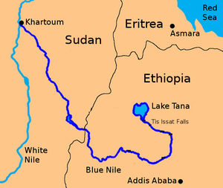
CONFLUENCE
There are political problems
With Ethiopia’s current building
of a dam that Egypt fears will stop some of the Nile water flow; irrigation and hydroelectric power production would be affected

Slide 4
PROPHECY AGAINST EGYPT
10TH YEAR = 587
Claims to control the Nile
Pharoah called the monster of the river
Fish will cling to his scales
Egypt abandoned to wilderness along with fish
Egypt a staff of reed for Israel
Judah and Egypt had made an alliance that caused Zedekiah to have enough nerve to rebel against Nebuchadnezzar; Egypt hadn’t been much help

Slide 5
BAD ALLY
Ezekiel 29:8-9 'Therefore thus says the Lord God, "Behold, I will bring upon you a sword and I will cut off from you man and beast. The land of Egypt will become a desolation and waste. Then they will know that I am the Lord. Because you said, 'The Nile is mine, and I have made it…‘
After conquering Judah, Nebuchadnezzar turned to a 13 year seige of Tyre, which capitulated and made peace
Nebuchadnezzar then turned to Egypt in 568 BC but died in 562 BC without fully conquering it

Slide 6
WHAT PROPHETS SEE
Prophets frequently see events without seeing the time frame or spacing between the events
Example:
Isaiah 61:2
To proclaim the favorable year of the Lord
and the day of vengeance of our God;
The first part of the sentence was fulfilled with Jesus’ 1st coming
The second part, concerning vengeance, will be fulfilled at Jesus’ 2nd coming
Jesus stopped reading in mid-sentence and then said, “today this prophecy is fulfilled in your hearing.”

Slide 7
WHAT DID EZEKIEL SEE?
Ezekiel 29:10-12 …therefore, behold, I am against you and against your rivers, and I will make the land of Egypt an utter waste and desolation, from Migdol to Syene and even to the border of Ethiopia. A man's foot will not pass through it, and the foot of a beast will not pass through it, and it will not be inhabited for forty years. So I will make the land of Egypt a desolation in the midst of desolated lands. And her cities, in the midst of cities that are laid waste, will be desolate forty years; and I will scatter the Egyptians among the nations and disperse them among the lands."

Slide 8
WHERE ARE THESE PLACES?
Syene: a trading city near the modern-day southern border of Egypt
Sometimes seen as Assouan or Aswan
Migdol: more problematic; means a fortification, a raised earthen area, an earthen fortification, a tower or watchtower; several are mentioned in the Bible, some in Israel
Textual problem: Is the correct reading:
Migdol Syene
Migdol to Syene
Migdol of Syene

Slide 9
MAP OF EGYPT
x
x
x

Slide 10
THE ASWAN DAM
Earth and rock dam completed in 1970, dedicated in 1971; lake Nasser behind it filled by 1973
Migdol Syene or Migdol of Syene could be referring to this dam
If the correct rendering is Midgol to Syene, then it could be referring to the entire length of the Nile river
Fate of Egypt after this judgment: Ezekiel 29:15-16 "It will be the lowest of the kingdoms, and it will never again lift itself up above the nations. And I will make them so small that they will not rule over the nations. And it will never again be the confidence of the house of Israel, bringing to mind the iniquity of their having turned to Egypt. Then they will know that I am the Lord God.”

Slide 11
PICTURES OF THE ASWAN DAM
Over 3000’ thick at base; 134’ thick at top; 364’ high; 4 lane highway across top
Enemy destruction of dam could kill 98% of Egypt’s population; 3-4 decades to recover

Slide 12
ASWAN DAM PICTURE 2

Slide 13
DESTRUCTION
Ezekiel 29:19 Therefore thus says the Lord God, "Behold, I will give the land of Egypt to Nebuchadnezzar king of Babylon. And he will carry off her wealth and capture her spoil and seize her plunder; and it will be wages for his army.
Nebuchadnezzar did carry off plunder, but Egypt was never desolate for 40 years
The people were not dispersed to other nations for 40 years and then return

Slide 14
SECONDARY EVENT
Ezekiel 30:10-12 'Thus says the Lord God,
"I will also make the hordes of Egypt cease
By the hand of Nebuchadnezzar king of Babylon.
He and his people with him,
The most ruthless of the nations,
Will be brought in to destroy the land;
And they will draw their swords against Egypt
And fill the land with the slain.
Moreover, I will make the Nile canals dry
And sell the land into the hands of evil men.
And I will make the land desolate
And all that is in it,
By the hand of strangers; I the Lord have spoken."

