Slide 1
REVERENCE FOR GOD’S PROMISES
JoLynn Gower
352-2458 cell 493-6151
jgower@guardingthetruth.org

Slide 2
TYRE’S REBELLION
Tyre, upon seeing the collapse or imminent collapse of Jerusalem plans to try to get some of the spoil
Ezekiel 26:2-4 "Son of man, because Tyre has said concerning Jerusalem, 'Aha, the gateway of the peoples is broken; it has opened to me. I shall be filled, now that she is laid waste,’ therefore thus says the Lord God, Behold, I am against you, O Tyre, and I will bring up many nations against you, as the sea brings up its waves. They will destroy the walls of Tyre and break down her towers; and I will scrape her debris from her and make her a bare rock.

Slide 3
ALL ABOUT TYRE
It’s about to be destroyed by Babylon
Ezekiel 26:17 “They will take up a lamentation over you and say to you, 'How you have perished, O inhabited one, from the seas, O renowned city, which was mighty on the sea, she and her inhabitants, who imposed her terror on all her inhabitants!”
Ezekiel 26:20 …then I will bring you down with those who go down to the pit, to the people of old, and I will make you dwell in the lower parts of the earth, like the ancient waste places, with those who go down to the pit, so that you will not be inhabited; but I will set glory in the land of the living.

Slide 4
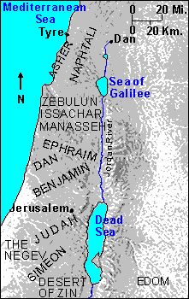
WHERE IS TYRE?
Tyre is located in modern
day Lebanon. We know
the people group as
Phoenicians. The city was
founded by Sidon and for
many years ruled by it.
The city included a main- land port and an island
offshore. Hiram was a
trading partner of David
and Solomon. Jezebel,
wife of King Ahab, was the
daughter of Ethbaal, king
of Tyre and Sidon and priest of ba’al

Slide 5
WHO ARMED TYRE?
Ezekiel 27:10-11 “Persia and Lud and Put were in your army, your men of war. They hung shield and helmet in you; they set forth your splendor. The sons of Arvad and your army were on your walls, all around, and the Gammadim were in your towers. They hung their shields on your walls all around; they perfected your beauty.”
Persia = Iran; Lud = W. Turkey Put = Libya
Arvad = Ruad, island off of Lebanon
Gammadim were Phoenician warriors (Seals)

Slide 6
TIME OF EZEKIEL’S WRITING
At this time, the Northern Kingdom had fallen
Tyre continued trading with Judah
You would have hoped that a trading partner would be an ally, but clearly this wasn’t the case
Tyre’s attitude was “what can I get out of Judah’s demise?” “What’s in it for me?”
Tyre had a human king
Tyre also had another ruler who had nothing good in mind and wasn’t human

Slide 7
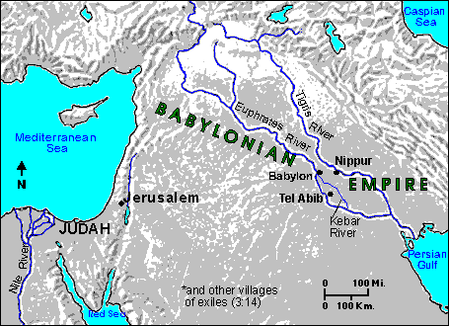
PLACES WHERE WE SEE SATAN
Garden of Eden
In heaven, appearing before God (Job)
Tyre
Judean wilderness (Jesus’ temptation)
Manipulating Peter
In Judas
Pergamum?
Acts 12:20-23
records Herod’s
death

Slide 8
THE LEADER OF TYRE (28:1-10)
Leader: nagid: commander, prince, leader
He is a man (28:2,9)
Claims to be a god
Claims to be wise
Rich, full treasuries; enriched by trade
Proud
Heart is lifted up (arrogant)
Headed for destruction
Will be destroyed by strangers

Slide 9
THE KING OF TYRE
Ezekiel 28:12 "Son of man, take up a lamentation over the king of Tyre
Lamentation: qinah: a dirge
King: melek: king
Ezekiel 28:12-13 "You had the seal of perfection, full of wisdom and perfect in beauty. "You were in Eden, the garden of God; Every precious stone was your covering: The ruby, the topaz and the diamond; The beryl, the onyx and the jasper; The lapis lazuli, the turquoise and the emerald;
Exodus 28:17-20 "You shall mount on it four rows of stones; the first row shall be a row of ruby, topaz and emerald; and the second row a turquoise, a sapphire and a diamond; and the third row a jacinth, an agate and an amethyst; and the fourth row a beryl and an onyx and a jasper; they shall be set in gold filigree.

Slide 10
A CREATED BEING
Ezekiel 28:13 …. And the gold, the workmanship of your settings and sockets, was in you. On the day that you were created they were prepared.
Ezekiel 28:14 "You were the anointed cherub who covers, and I placed you there.”
2 Chronicles 5:8 For the cherubim spread their wings over the place of the ark, so that the cherubim made a covering over the ark and its poles.

Slide 11
MORE INFO
On the holy mountain of God in the midst of the stones of fire (28:14)
In Eden, the garden of God
Ezekiel 28:15-16 "You were blameless in your ways from the day you were created until unrighteousness was found in you. By the abundance of your trade you were internally filled with violence, and you sinned; therefore I have cast you as profane from the mountain of God. And I have destroyed you, O covering cherub, from the midst of the stones of fire.

Slide 12
DESTRUCTION ASSURED
Ezekiel 28:18-19 "By the multitude of your iniquities, in the unrighteousness of your trade you profaned your sanctuaries. Therefore I have brought fire from the midst of you; It has consumed you, and I have turned you to ashes on the earth in the eyes of all who see you. All who know you among the peoples are appalled at you; You have become terrified and you will cease to be forever.”
Revelation 20:10 And the devil who deceived them was thrown into the lake of fire and brimstone, where the beast and the false prophet are also; and they will be tormented day and night forever and ever.

