Slide 1
PREPARED FOR ACTION
A Study from 1 Peter
JoLynn Gower
352-2458 493-6151
jgower@guardingthetruth.org

Slide 2
RECIPIENTS OF THE LETTER
1 Peter 1:1 Peter, an apostle of Jesus Christ, to those who reside as aliens, scattered throughout Pontus, Galatia, Cappadocia, Asia, and Bithynia
Apostle: apostolos: one sent with a message; an ambassador, a missionary; one who had seen the risen Lord
Aliens: parepidimos: sojourners in a strange place; ex-pats
Scattered: diaspora: dispersed

Slide 3
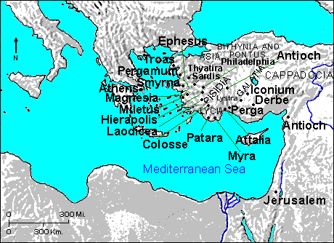
WHERE WERE THE SCATTERED?
Pontus, Galatia, Cappadocia, Asia, Bythinia (N. Turkey)

Slide 4
CHOSEN PEOPLE
1 Peter 1:2 …chosen according to the foreknowledge of God the Father, by the sanctifying work of the Spirit, to obey Jesus Christ and be sprinkled with His blood: May grace and peace be yours in the fullest measure.
Romans 8:29 For those whom He foreknew, He also predestined to become conformed to the image of His Son, so that He would be the firstborn among many brethren;
Foreknew: proginosko: to know ahead of time
Predestined: proorizo: to limit ahead of time
Chosen: elektos: selected from a larger group
Ephesians 1:4 …just as He chose us in Him before the foundation of the world, that we would be holy and blameless before Him.

Slide 5
SANCTIFIED PEOPLE
1 Peter 1:2 …according to the foreknowledge of God the Father, by the sanctifying work of the Spirit, to obey Jesus Christ and be sprinkled with His blood: May grace and peace be yours in the fullest measure.
Sanctifying: hagiosmos: to make pure or holy
I am sanctified; I am being sanctified; I will be sanctified
Spirit does this work creating our obedience

Slide 6
SPRINKLING
1 Peter 1:2 … to obey Jesus Christ and be sprinkled with His blood: May grace and peace be yours in the fullest measure.
Exodus 24:8 So Moses took the blood and sprinkled it on the people, and said, "Behold the blood of the covenant, which the Lord has made with you in accordance with all these words."
Hebrews 9:21 And in the same way he sprinkled both the tabernacle and all the vessels of the ministry with the blood.
Hebrews 9:13-14 For if the blood of goats and bulls and the ashes of a heifer sprinkling those who have been defiled sanctify for the cleansing of the flesh, how much more will the blood of Christ, who through the eternal Spirit offered Himself without blemish to God, cleanse your conscience from dead works to serve the living God?

Slide 7
GREAT MERCY
1 Peter 1:3 Blessed be the God and Father of our Lord Jesus Christ, who according to His great mercy has caused us to be born again to a living hope through the resurrection of Jesus Christ from the dead…
Mercy: eleos: when we don’t get the punishment that we deserve
In place of the punishment we deserved, He has given us a living hope

Slide 8
LIVING HOPE
John 10:24-30 The Jews then gathered around Him, and were saying to Him, "How long will You keep us in suspense? If You are the Christ, tell us plainly.” Jesus answered them, "I told you, and you do not believe; the works that I do in My Father's name, these testify of Me. But you do not believe because you are not of My sheep. My sheep hear My voice, and I know them, and they follow Me; and I give eternal life to them, and they will never perish; and no one will snatch them out of My hand. My Father, who has given them to Me, is greater than all; and no one is able to snatch them out of the Father's hand. I and the Father are one."
A LIVING HOPE IS SURE, CERTAIN, AND REAL

Slide 9
OUR INHERITANCE
1 Peter 1:4…to obtain an inheritance which is imperishable and undefiled and will not fade away, reserved in heaven for you…
Ephesians 1:13-14 In Him, you also, after listening to the message of truth, the gospel of your salvation—having also believed, you were sealed in Him with the Holy Spirit of promise, who is given as a pledge of our inheritance, with a view to the redemption of God's own possession, to the praise of His glory.
Ephesians 1:18 I pray that the eyes of your heart may be enlightened, so that you will know what is the hope of His calling, what are the riches of the glory of His inheritance in the saints…
For the Lord’s portion is his people; Deuteronomy 32:9

Slide 10
THE NATURE OF THE INHERITANCE
Imperishable, undefiled, eternal, and reserved
Reserved: tereo: to guard; to watch over to prevent loss or injury
1 Peter 1:5 …who are protected by the power of God through faith for a salvation ready to be revealed in the last time.
Protected: phroureo: advance watcher
We are saved, we are working out our salvation, we will be saved

