Slide 1
PREPARED FOR ACTION
A Study from 1 Peter
JoLynn Gower
352-2458 493-6151
jgower@guardingthetruth.org

Slide 2
WHO IS PETER?
A disciple of John (the Baptist)
From Bethsaida (north side of sea of Galilee)
Later, probably most of his adult life, lived in Capernaum
First saw Jesus at Bethany beyond Jordan where John was baptizing
Brought to Jesus by his brother Andrew
Peter was the first to express the understanding that Jesus was the Messiah AND was God

Slide 3
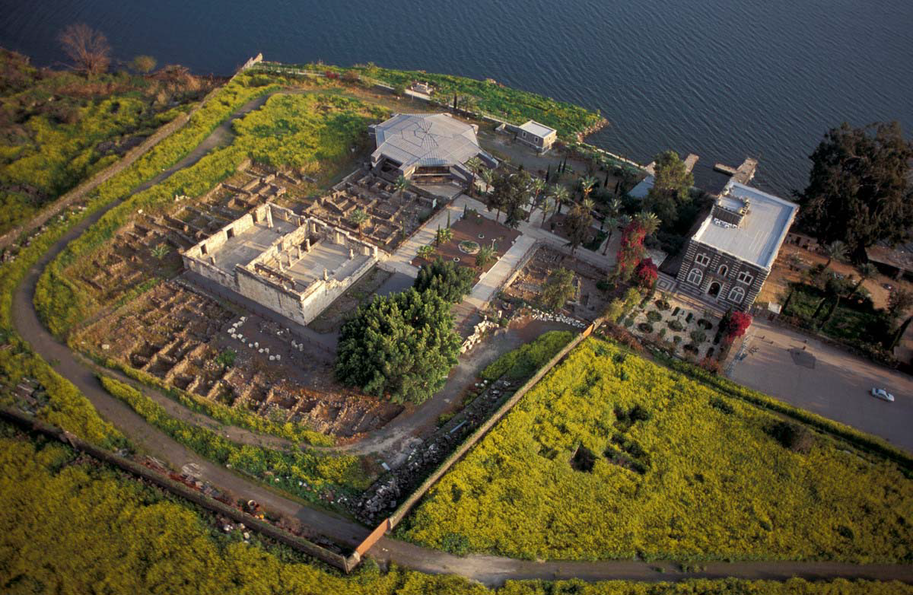
CAPERNAUM

Slide 4
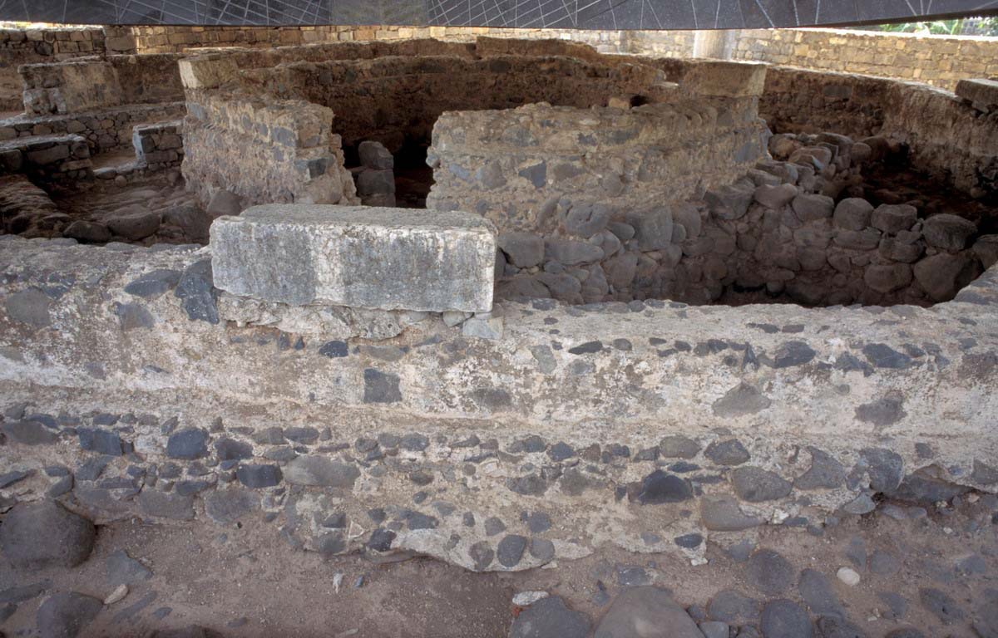
RUINS OF PETER’S HOUSE

Slide 5
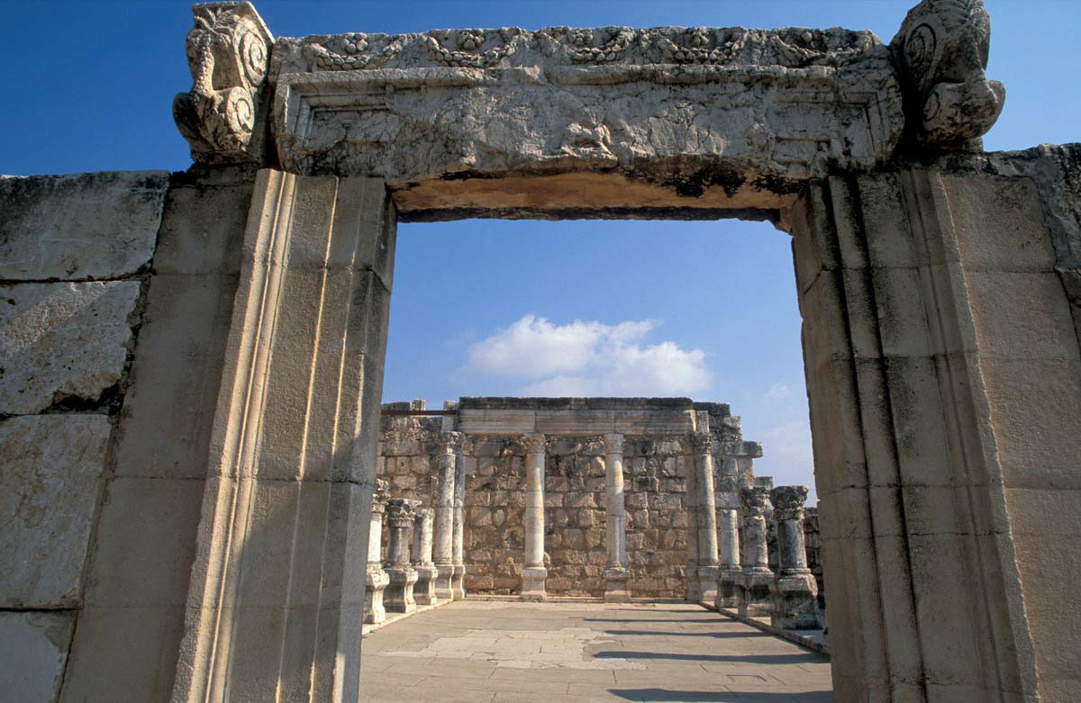
SYNAGOGUE IN CAPERNAUM
John 6:59 These things He said in the synagogue as He taught in Capernaum.

Slide 6
WHO IS PETER?
His name was Simon but Jesus called him Peter
Son of a man named John (bar Jonah)
By trade, a fisherman
Matthew 4:18-19 Now as Jesus was walking by the Sea of Galilee, He saw two brothers, Simon who was called Peter, and Andrew his brother, casting a net into the sea; for they were fishermen. And He said to them, "Follow Me, and I will make you fishers of men."
One of the 12; then one of the 3

Slide 7
WHAT TRIGGERED PERSECUTION
The Romans: Christianity was considered legal in most areas because it was thought to be a sect of Judaism, a legal religion
When Christians refused to worship the Emperor, refused to join the army, or participated in civil unrest, problems could arise
People (like Peter—or Paul – or the other apostles) who were on the forefront of evangelism were more likely targets
Acts 19:28-29 When they heard this and were filled with rage, they began crying out, saying, "Great is Artemis of the Ephesians!” The city was filled with the confusion, and they rushed with one accord into the theater, dragging along Gaius and Aristarchus, Paul's traveling companions from Macedonia.

Slide 8
WHAT TRIGGERED PERSECUTION
The Jews: many Jews didn’t appreciate being associated with Christians as a sect of the same religion
For Paul, it took a personal appearance from Christ on the road to Damascus
For Peter, it took a vision on the roof of Simon the tanner
Acts 10:9-15 On the next day, as they were on their way and approaching the city, Peter went up on the housetop about the sixth hour to pray. But he became hungry and was desiring to eat; but while they were making preparations, he fell into a trance; and he saw the sky opened up, and an object like a great sheet coming down, lowered by four corners to the ground, and there were in it all kinds of four-footed animals and crawling creatures of the earth and birds of the air. A voice came to him, "Get up, Peter, kill and eat!” But Peter said, "By no means, Lord, for I have never eaten anything unholy and unclean.” Again a voice came to him a second time, “What God has cleansed, no longer consider unholy.”

Slide 9
WHAT TRIGGERED PERSECUTION
Their own families: under Roman law, the ruling male controlled the entire family
A wife or children could be removed from the house by the ruling male if there was a difference of opinion
If dependents were turned-out of the home, the courts would not uphold their case; they basically had no recourse except the church
This system of forced submission isn’t the biblical model!

Slide 10
PETER’S PENTECOST SERMON
Acts 2:14-21 But Peter, taking his stand with the eleven, raised his voice and declared to them: "Men of Judea and all you who live in Jerusalem, let this be known to you and give heed to my words. For these men are not drunk, as you suppose, for it is only the third hour of the day; but this is what was spoken of through the prophet Joel: 'And it shall be in the last days,' God says, 'That I will pour forth of My Spirit on all mankind; and your sons and your daughters shall prophesy, and your young men shall see visions, and your old men shall dream dreams; Even on My bondslaves, both men and women, I will in those days pour forth of My Spirit and they shall prophesy. And I will grant wonders in the sky above and signs on the earth below, blood, and fire, and vapor of smoke. The sun will be turned into darkness and the moon into blood, before the great and glorious day of the Lord shall come. And it shall be that everyone who calls on the name of the Lord will be saved.'

Slide 11
PETER’S GENTILE SERMON
Acts 10:34-43 Opening his mouth, Peter said: "I most certainly understand now that God is not one to show partiality, but in every nation the man who fears Him and does what is right is welcome to Him. The word which He sent to the sons of Israel, preaching peace through Jesus Christ (He is Lord of all)— you yourselves know the thing which took place throughout all Judea, starting from Galilee, after the baptism which John proclaimed. You know of Jesus of Nazareth, how God anointed Him with the Holy Spirit and with power, and how He went about doing good and healing all who were oppressed by the devil, for God was with Him. We are witnesses of all the things He did both in the land of the Jews and in Jerusalem. They also put Him to death by hanging Him on a cross. God raised Him up on the third day and granted that He become visible, not to all the people, but to witnesses who were chosen beforehand by God, that is, to us who ate and drank with Him after He arose from the dead. And He ordered us to preach to the people, and solemnly to testify that this is the One who has been appointed by God as Judge of the living and the dead. Of Him all the prophets bear witness that through His name everyone who believes in Him receives forgiveness of sins."

Slide 12
APPROPRIATE RESPONSE
Peter stresses submission as the appropriate response to persecution in some circumstances
1 Peter 2:20 For what credit is there if, when you sin and are harshly treated, you endure it with patience? But if when you do what is right and suffer for it you patiently endure it, this finds favor with God.
Acts 4:17-20 "But so that it will not spread any further among the people, let us warn them to speak no longer to any man in this name.” And when they had summoned them, they commanded them not to speak or teach at all in the name of Jesus. But Peter and John answered and said to them, "Whether it is right in the sight of God to give heed to you rather than to God, you be the judge; for we cannot stop speaking about what we have seen and heard."

