Slide 1
REVERENCE FOR GOD’S PROMISES
JoLynn Gower
352-2458 cell 493-6151
jgower@guardingthetruth.org

Slide 2
BACKGROUND INFORMATION
Abram (Abraham) …Isaac …Jacob
Jacob’s 12 sons (Jacob was renamed Israel)
Leah, Rachel, Bilhah, Zilpah Genesis 35: 23-26
Oldest Reuben
Oldest by Rachel: Joseph
Genesis 35:22 It came about while Israel was dwelling in that land, that Reuben went and lay with Bilhah his father's concubine, and Israel heard of it.
Jacob gave the birthright double portion to Joseph

Slide 5
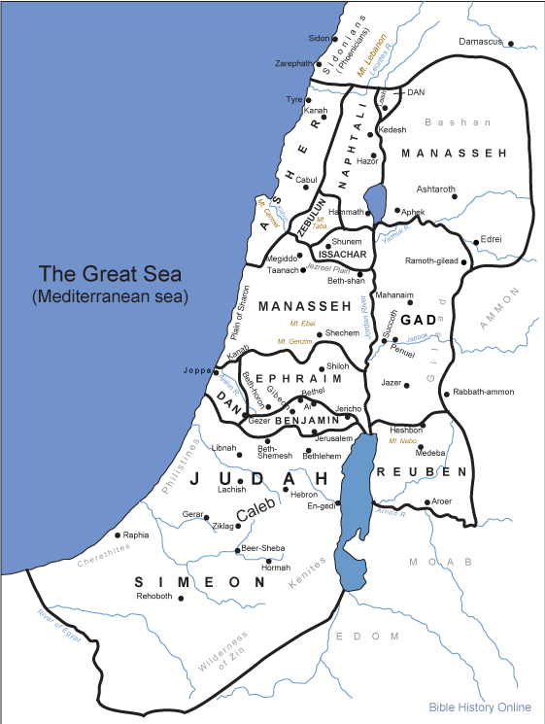

Slide 6
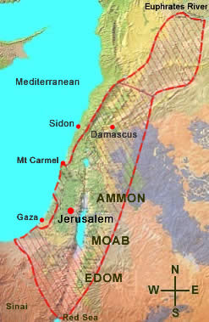

Slide 8
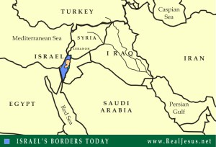

Slide 9
ABRAHAMIC COVENANT
Genesis 15:1 After these things the word of the Lord came to Abram in a vision, saying,
"Do not fear, Abram,
I am a shield to you;
Your reward shall be very great."
Genesis 15:5-6 And He took him outside and said, "Now look toward the heavens, and count the stars, if you are able to count them." And He said to him, "So shall your descendants be.“ Then he believed in the Lord; and He reckoned it to him as righteousness.
Reckoned: chashab: valued, regarded

Slide 10
CHILDREN + LAND
Genesis 15:7 And He said to him, "I am the Lord who brought you out of Ur of the Chaldeans, to give you this land to possess it."
Abram prepared the animals for the covenant-making process
Genesis 15:13 God said to Abram, "Know for certain that your descendant(s) will be strangers in a land that is not theirs, where they will be enslaved and oppressed four hundred years.

Slide 11
NOT BASED ON LAW
Galatians 3:16-18 Now the promises were spoken to Abraham and to his seed. He does not say, "And to seeds," as referring to many, but rather to one, "And to your seed," that is, Christ. What I am saying is this: the Law, which came four hundred and thirty years later, does not invalidate a covenant previously ratified by God, so as to nullify the promise. For if the inheritance is based on law, it is no longer based on a promise; but God has granted it to Abraham by means of a promise.

Slide 12
WALK OF DEATH
Genesis 15:17-21 It came about when the sun had set, that it was very dark, and behold, there appeared a smoking oven and a flaming torch which passed between these pieces. On that day the Lord made a covenant with Abram, saying, "To your descendants I have given this land, from the river of Egypt as far as the great river, the river Euphrates: the Kenite and the Kenizzite and the Kadmonite and the Hittite and the Perizzite and the Rephaim and the Amorite and the Canaanite and the Girgashite and the Jebusite."
THE PROMISE LASTED AS LONG AS THE ONE TAKING THE WALK LIVED

Slide 13
TRIBES SEALED (Tribulation)
Revelation 7:4-8 And I heard the number of those who were sealed, one hundred and forty-four thousand sealed from every tribe of the sons of Israel:
from the tribe of Judah, twelve thousand were sealed, from the tribe of Reuben twelve thousand, from the tribe of Gad twelve thousand,
from the tribe of Asher twelve thousand, from the tribe of Naphtali twelve thousand, from the tribe of Manasseh twelve thousand,
from the tribe of Simeon twelve thousand, from the tribe of Levi twelve thousand, from the tribe of Issachar twelve thousand,
from the tribe of Zebulun twelve thousand, from the tribe of Joseph twelve thousand, from the tribe of Benjamin, twelve thousand were sealed.

Slide 14
TRIBES IN NEW JERUSALEM
Revelation 21:10-14 And he carried me away in the Spirit to a great and high mountain, and showed me the holy city, Jerusalem, coming down out of heaven from God, having the glory of God. Her brilliance was like a very costly stone, as a stone of crystal-clear jasper. It had a great and high wall, with twelve gates, and at the gates twelve angels; and names were written on them, which are the names of the twelve tribes of the sons of Israel. There were three gates on the east and three gates on the north and three gates on the south and three gates on the west. And the wall of the city had twelve foundation stones, and on them were the twelve names of the twelve apostles of the Lamb.

