Slide 1
REVERENCE FOR GOD’S PROMISES
JoLynn Gower
352-2458 cell 493-6151
jgower@guardingthetruth.org

Slide 2
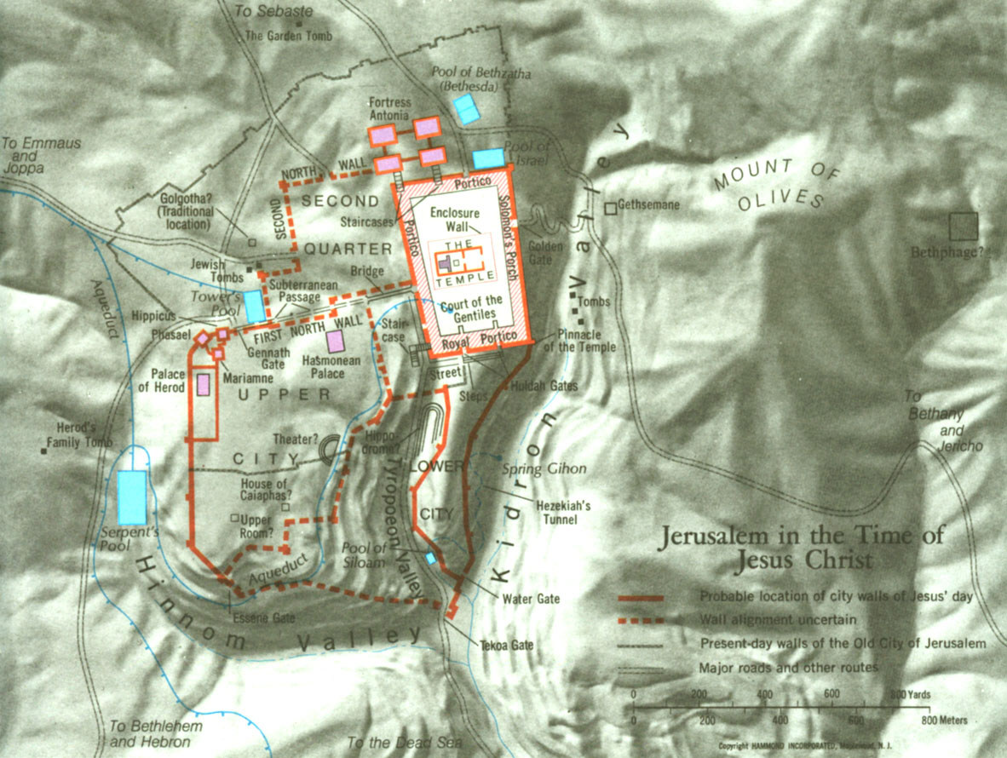

Slide 3
EZEKIEL’S TEMPLE
Ezekiel 47:1 Then he brought me back to the door of the house; and behold, water was flowing from under the threshold of the house toward the east, for the house faced east. And the water was flowing down from under, from the right side of the house, from south of the altar.
Ezekiel saw a river flowing from the temple, around the altar to the south, through the eastern gate, and gradually gaining in depth with each measurement
1000 cu then ankle deep (1750 feet)
1000 cu more then knee deep (3500 feet)
1000 cu more then loin deep (5250 feet)
1000 cu more and unfordable (7000 feet)

Slide 4
REQUIRED ATTENDANCE
Required High holy days:
S 1st Day of Unleavened Bread
S Pentecost
F Tabernacles
Other spring feasts:
Passover
First Fruits (Christ rose from the dead)
Other fall feasts:
Trumpets
Day of Atonement

Slide 5
FALL FEASTS
THE FALL FEASTS ARE YET TO BE FULFILLED
These feasts all fall in the 7th month of Tishri
Tishri 1 is the Feast of Trumpets (New Moon)
Tishri 1 also began the sabbatical year every
7th year
Tishri 1 also began the year of Jubilee every
50th year
The final trumpet of the feast day is called the “great trumpet”
Matthew 24:31 "And He will send forth His angels with a GREAT TRUMPET and they will gather together His elect from the four winds, from one end of the sky to the other.

Slide 6
TRUMPETS = ROSH HASHANA
Matthew 24:36 “But of that day and hour no one knows, not even the angels of heaven, nor the Son, but the Father alone.”
The Feast of Trumpets is the only feast where the day and hour was not known
Other fall feasts:
Tishri 10: Day of Atonement (Yom Kippur)
Tishri 15: Begins Tabernacles
Israelites were to live in booths to commemorate their time in the wilderness wandering during the Exodus

Slide 7
FEAST OF TABERNACLES
Worshiper carried two things: aetrog (citron) in the left hand; lulab (tied bouquet of palm, myrtle and willow)
Live in a temporary shelter no more than 30’ high and no lower than 4’
At least 3 walls; thatched roof to see sky/stars
Not under a tree; no cloth covering
No more covered roof than open
Not attached to something growing in ground
Live in it for entire time of the festival

Slide 8
THE CEREMONY
While the morning sacrifice was being prepared, a priest, accompanied by a joyous procession and with music, went down to the Pool of Siloam, where he drew water into a golden pitcher capable of holding three logs (1 liter)
At the same time that the procession started for Siloam, another went to a place in the Kidron Valley, from which they brought willow branches. These they stuck on either side of the great altar, bending them over so as to form a canopy.

Slide 9
THE CEREMONY (2)
The priest who had gone to Siloam timed his return so as to join his brother priests as they carried the sacrifice to the altar. On reaching the water gate he was welcomed by three blasts of the trumpet. He ascended the steps of the altar with another priest, who carried a pitcher of wine for a drink offering. They turned to the left, where there were two silver basins with holes in the bottom; the basin for the water at the W with a narrower hole, that for the wine at the E with wider hole, so that both might empty at the same time.
The first 6 days, the priests marched around the altar once; on the 7th day they marched around 7 times

Slide 10
THE CEREMONY (3)
Water was an important part of the Feast of Tabernacles. Before the festival, the Rabbis taught on every passage in Scripture dealing with water.
Isaiah 12:1-4 Then you will say on that day, "I will give thanks to You, O Lord; For although You were angry with me, your anger is turned away, and You comfort me. Behold, God is my salvation, I will trust and not be afraid; For the Lord God is my strength and song, and He has become my salvation. Therefore you will joyously draw water from the springs of salvation. And in that day you will say, give thanks to the Lord, call on His name. Make known His deeds among the peoples; Make them remember that His name is exalted.”
Salvation: yeshuah

Slide 11
THE LAST DAY
John 7:37-39 Now on the last day, the great day of the feast, Jesus stood and cried out, saying, "If anyone is thirsty, let him come to Me and drink. He who believes in Me, as the Scripture said, 'From his innermost being will flow rivers of living water.’ But this He spoke of the Spirit, whom those who believed in Him were to receive; for the Spirit was not yet given, because Jesus was not yet glorified.

Slide 12
RIVER OF EZEKIEL’S TEMPLE

Slide 13
THE MILLENNIAL RIVER
Ezekiel 47:12 "By the river on its bank, on one side and on the other, will grow all kinds of trees for food. Their leaves will not wither and their fruit will not fail. They will bear every month because their water flows from the sanctuary, and their fruit will be for food and their leaves for healing."
This river seems to merge with the Jordan at the northern side of the Dead Sea.
The dead sea will become fresh water
The marshes will be left for salt

Slide 14
THE NEW JERUSALEM
Revelation 22:1-2 Then he showed me a river of the water of life, clear as crystal, coming from the throne of God and of the Lamb, in the middle of its street. On either side of the river was the tree of life, bearing twelve kinds of fruit, yielding its fruit every month; and the leaves of the tree were for the healing of the nations.
There is no temple in the New Jerusalem because the Lord God the Almighty and the Lamb are its temple

