Slide 1
REVERENCE FOR GOD’S PROMISES
JoLynn Gower
352-2458 cell 493-6151
jgower@guardingthetruth.org

Slide 2
EZEKIEL’S TEMPLE
No wall of partition to exclude Gentiles (compare
Ephesians 2:14)
No Court of Women (compare Galatians 3:28
(Outer Court and Inner Court only)
No Laver (see Ezekiel 36:24-27, John 15:3)
No Table of Shewbread (see Micah 5:4, John 6:35)
No Lampstand or Menorah (see Isaiah 49:6, John
8:12)
No Golden Altar of Incense (Zechariah 8:20-23,
John 14:6)
No Veil (Isaiah 25:6-8, Matthew 27:51)
No Ark of the Covenant (Jeremiah 3:16, John
10:30-33)

Slide 3
ALTAR CHANGES?
Major Changes to the Altar: The sacrificial Altar will be approached by a ramp from the East. Previous altars were all approached from the South. Now there will be stairs to the altar, not a ramp as previously. The top of the altar is now described by the Hebrew word "ariel" [Isaiah 29:1] meaning "hearth of God" or "lion of God."

Slide 4
WHO BUILDS THE TEMPLE
Zechariah 6:12-13 "Then say to him, 'Thus says the Lord of hosts, "Behold, a man whose name is Branch, for He will branch out from where He is; and He will build the temple of the Lord. Yes, it is He who will build the temple of the Lord, and He who will bear the honor and sit and rule on His throne. Thus, He will be a priest on His throne, and the counsel of peace will be between the two offices.”
Daniel 9:27 "And he will make a firm covenant with the many for one week, but in the middle of the week he will put a stop to sacrifice and grain offering; and on the wing of abominations will come one who makes desolate, even until a complete destruction, one that is decreed, is poured out on the one who makes desolate.”

Slide 5
EVIDENCE OF TRIB TEMPLE
2 Thessalonians 2:4…who opposes and exalts himself above every so-called god or object of worship, so that he takes his seat in the temple of God, displaying himself as being God.
Revelation 11:1-2 Then there was given me a measuring rod like a staff; and someone said, "Get up and measure the temple of God and the altar, and those who worship in it. "Leave out the court which is outside the temple and do not measure it, for it has been given to the nations; and they will tread under foot the holy city for forty-two months.

Slide 6
1. Outer Court - 40:17-19 2. Inner Court - 40:44,47 3. The Temple or Sanctuary - 41:1-26 4. Wall around the outside of the Temple - 40:5 (42:15-20, 45:2) 5. Fifty cubits of open space - 45:2

Slide 7
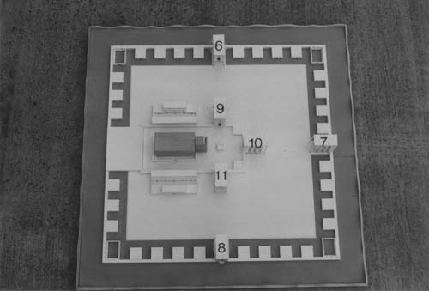
6. Outer Court Northern Gateway - 40:20-23 7. Outer Court Eastern Gateway - 40:6-16 8. Outer Court Southern Gateway - 40:24-27 9. Inner Court Northern Gateway - 40:35-37 10. Inner Court Eastern Gateway - 40:32-34 11. Inner Court Southern Gateway - 40:28-31

Slide 8
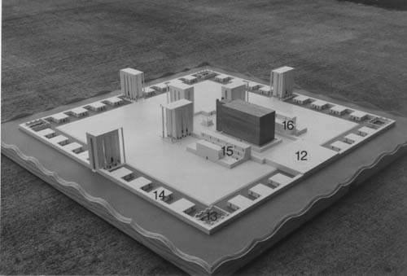
12. Building at the Western End - 41:12 13. Four Kitchens (one in each corner of the Outer Court) - 46:21-24 14. Outer Court Chambers (30 total) - 40:17 15. Northern Priests Chambers in three story Galleries- 42:1-9 16. Southern Priests Chambers in three story Galleries - 42:10-14

Slide 10
WHEN??
Tribulation temple?
Millennial temple?
Temple in the New Jerusalem? NO!
Revelation 21:22-23 I saw no temple in it, for the Lord God the Almighty and the Lamb are its temple. And the city has no need of the sun or of the moon to shine on it, for the glory of God has illumined it, and its lamp is the Lamb.

Slide 11
THE EASTERN GATE
Ezekiel 43:1-2 Then he led me to the gate, the gate facing toward the east; and behold, the glory of the God of Israel was coming from the way of the east. And His voice was like the sound of many waters; and the earth shone with His glory.
Ezekiel 43:4-5 And the glory of the Lord came into the house by the way of the gate facing toward the east. And the Spirit lifted me up and brought me into the inner court; and behold, the glory of the Lord filled the house.

Slide 12
CORPSES OF KINGS
Ezekiel 43:7-8 He said to me, "Son of man, this is the place of My throne and the place of the soles of My feet, where I will dwell among the sons of Israel forever. And the house of Israel will not again defile My holy name, neither they nor their kings, by their harlotry and by the corpses of their kings when they die, by setting their threshold by My threshold and their door post beside My door post, with only the wall between Me and them. And they have defiled My holy name by their abominations which they have committed. So I have consumed them in My anger.

Slide 13
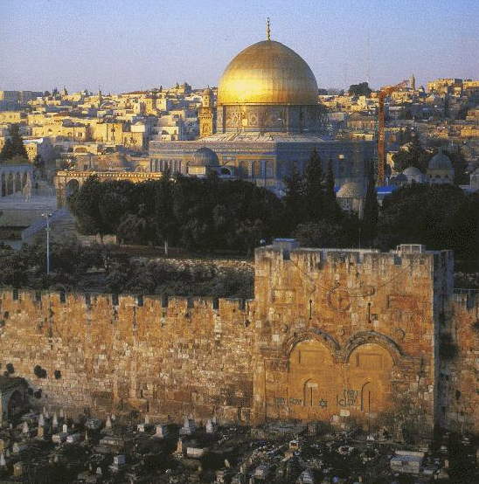

Slide 14
WHO IS EZEKIEL’S TEMPLE FOR?
Ezekiel 43:10-11 “As for you, son of man, describe the temple to the house of Israel, that they may be ashamed of their iniquities; and let them measure the plan. If they are ashamed of all that they have done, make known to them the design of the house, its structure, its exits, its entrances, all its designs, all its statutes, and all its laws. And write it in their sight, so that they may observe its whole design and all its statutes and do them.”
Ezekiel 43:12 "This is the law of the house: its entire area on the top of the mountain all around shall be most holy. Behold, this is the law of the house.”

