Slide 1
REVERENCE FOR GOD’S PROMISES
JoLynn Gower
352-2458 cell 493-6151
jgower@guardingthetruth.org

Slide 2
PROPHECY ON DAMASCUS
Isaiah 17:1-2 The oracle concerning Damascus. “Behold, Damascus is about to be removed from being a city and will become a fallen ruin. The cities of Aroer are forsaken; They will be for flocks to lie down in, and there will be no one to frighten them.”
The “about to be” must tie to what went before, which was prophecy concerning the end of the age
Damascus has never been destroyed and left a ruin
Josephus says it was founded by Uz the son of Aram the son of Shem

Slide 3
THE ARAB CONFLICT
Psalm 83:3-4 They make shrewd plans against Your people, and conspire together against Your treasured ones. They have said, "Come, and let us wipe them out as a nation, that the name of Israel be remembered no more."
Psalm 83:16-18 Fill their faces with dishonor, that they may seek Your name, O Lord. Let them be ashamed and dismayed forever, and let them be humiliated and perish, that they may know that You alone, whose name is the Lord, are the Most High over all the earth.

Slide 4
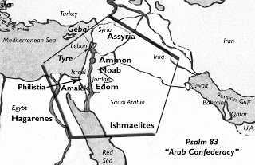
COUNTRIES IN ARAB CONFLICT

Slide 5
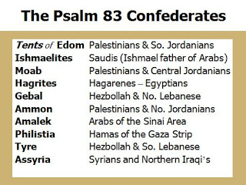

Slide 6
EZEKIEL’S PROPHECY
Ezekiel 38:1-3 And the word of the Lord came to me saying, “Son of man, set your face toward Gog of the land of Magog, the prince of Rosh, Meshech and Tubal, and prophesy against him and say, thus says the Lord God, "Behold, I am against you, O Gog, prince of Rosh, Meshech and Tubal.”
Genesis 10:2 The sons of Japheth were Gomer and Magog and Madai and Javan and Tubal and Meshech and Tiras.
Turkey and Eastern Europe as far west as Germany

Slide 7
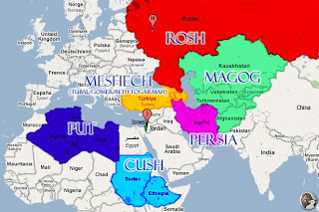
EZEKIEL’S NATIONS

Slide 8
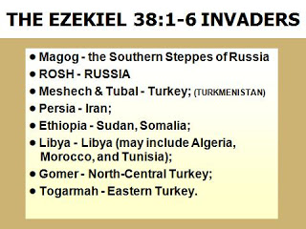

Slide 9
THE PLAN OF THE NATIONS
Ezekiel 38:8-9 After many days you will be summoned; in the latter years you will come into the land that is restored from the sword, whose inhabitants have been gathered from many nations to the mountains of Israel which had been a continual waste; but its people were brought out from the nations, and they are living securely, all of them. You will go up, you will come like a storm; you will be like a cloud covering the land, you and all your troops, and many peoples with you."

Slide 10
THE DESTRUCTION OF GOG
Ezekiel 38:21-23 "I will call for a sword against him on all My mountains," declares the Lord God. "Every man's sword will be against his brother. With pestilence and with blood I will enter into judgment with him; and I will rain on him and on his troops, and on the many peoples who are with him, a torrential rain, with hailstones, fire and brimstone. I will magnify Myself, sanctify Myself, and make Myself known in the sight of many nations; and they will know that I am the Lord.”

Slide 11
TIMING
Ezekiel 39:9 Then those who inhabit the cities of Israel will go out and make fires with the weapons and burn them, both shields and bucklers, bows and arrows, war clubs and spears, and for seven years they will make fires of them.
Ezekiel 39:11-12 “On that day I will give Gog a burial ground there in Israel, the valley of those who pass by east of the sea, and it will block off those who would pass by. So they will bury Gog there with all his horde, and they will call it the valley of Hamon-gog. For seven months the house of Israel will be burying them in order to cleanse the land.”

Slide 12
WAR’S RESULT
Ezekiel 39:14-15 "They will set apart men who will constantly pass through the land, burying those who were passing through, even those left on the surface of the ground, in order to cleanse it. At the end of seven months they will make a search. As those who pass through the land pass through and anyone sees a man's bone, then he will set up a marker by it until the buriers have buried it in the valley of Hamon-gog.”
Ezekiel 39:21-22 "And I will set My glory among the nations; and all the nations will see My judgment which I have executed and My hand which I have laid on them. And the house of Israel will know that I am the Lord their God from that day onward.

