Slide 1
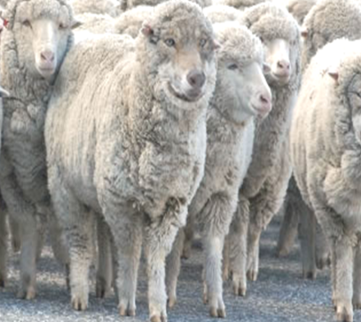
THE GREAT EXCHANGE
REVISITED
JoLynn Gower
Spring 2019
217-493-6151
jgower@guardingthetruth.org
Lesson 11

Slide 2
VERSE FOR THE JOURNEY
Romans 1:21-25 For even though they knew God, they did not honor Him as God or give thanks, but they became futile in their speculations, and their foolish heart was darkened. Professing to be wise, they became fools, and exchanged the glory of the incorruptible God for an image in the form of corruptible man and of birds and four-footed animals and crawling creatures. Therefore God gave them over in the lusts of their hearts to impurity, so that their bodies would be dishonored among them. For they exchanged the truth of God for a lie, and worshiped and served the creature rather than the Creator, who is blessed forever. Amen.
Exchanged: allasso: to alter, to substitute one thing for another

Slide 3
BABYLON RISING
Scripture speaks of a “spirit of antichrist” as well as a person called Antichrist at the end of the age
Scripture also speaks of a false church, a global movement comprised of many religious backgrounds
Revelation 17:3-5 And he carried me away in the Spirit into a wilderness; and I saw a woman sitting on a scarlet beast, full of blasphemous names, having seven heads and ten horns. The woman was clothed in purple and scarlet, and adorned with gold and precious stones and pearls, having in her hand a gold cup full of abominations and of the unclean things of her immorality, and on her forehead a name was written, a mystery, "BABYLON THE GREAT, THE MOTHER OF HARLOTS AND OF THE ABOMINATIONS OF THE EARTH."

Slide 4
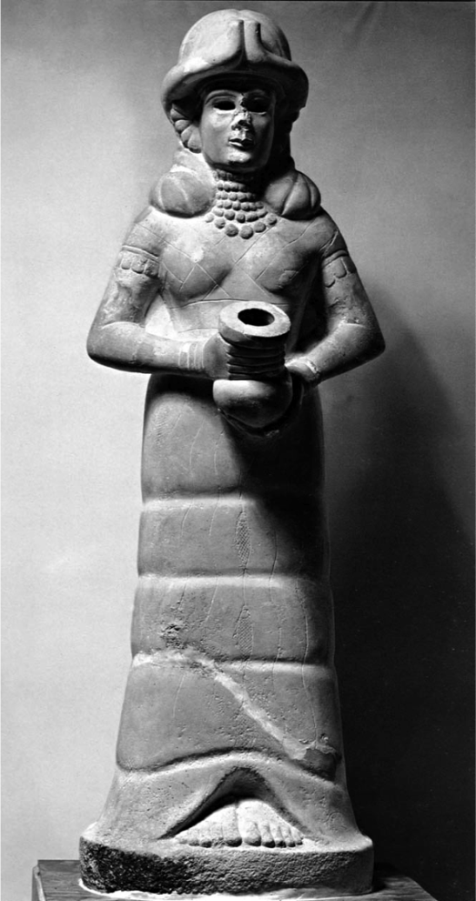
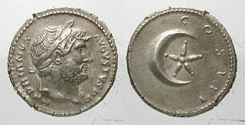
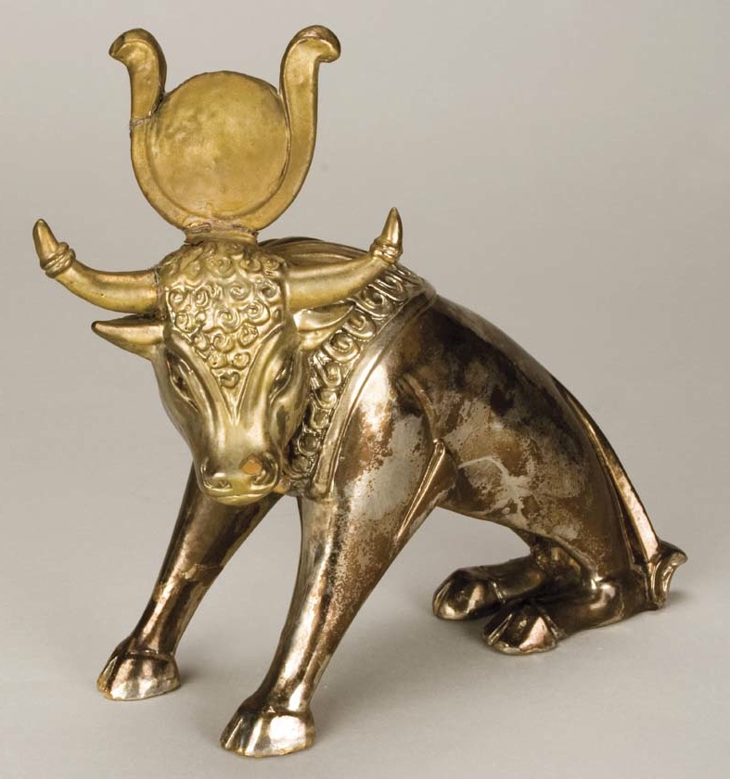
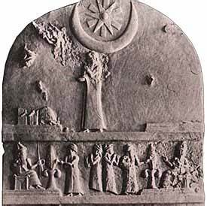
HER CLOTHING
Revelation 17:4 The woman was clothed in purple and scarlet, and adorned with gold and precious stones and pearls, having in her hand a gold cup full of abom- inations and of the unclean things of her immorality…

Slide 5
MYSTERY BABYLON
Revelation 17:7-11 And the angel said to me, "Why do you wonder? I will tell you the mystery of the woman and of the beast that carries her, which has the seven heads and the ten horns. The beast that you saw was and is not, and is about to come up out of the abyss and go to destruction. And those who dwell on the earth, whose name has not been written in the book of life from the foundation of the world, will wonder when they see the beast, that he was and is not and will come. Here is the mind which has wisdom. The seven heads are seven mountains on which the woman sits, and they are seven kings; five have fallen, one is, the other has not yet come; when he comes, he must remain a little while. The beast which was and is not, is himself also an eighth and is one of the seven, and he goes to destruction.

Slide 6
THE BEAST
Revelation 13:1-4 And the dragon stood on the sand of the seashore. Then I saw a beast coming up out of the sea, having ten horns and seven heads, and on his horns were ten diadems, and on his heads were blasphemous names. And the beast which I saw was like a leopard, and his feet were like those of a bear, and his mouth like the mouth of a lion. And the dragon gave him his power and his throne and great authority. I saw one of his heads as if it had been slain, and his fatal wound was healed. And the whole earth was amazed and followed after the beast; they worshiped the dragon because he gave his authority to the beast; and they worshiped the beast, saying, "Who is like the beast, and who is able to wage war with him?“
THE ANTICHRIST

Slide 7
FOUR BEASTS DANIEL SAW
Lion with wings of eagle
Bear, stronger on one side than the other
Leopard with four wings and four heads
Horrible 4th beast with 10 horns; another horn plucks 3
Daniel 7:11 "Then I kept looking because of the sound of the boastful words which the horn was speaking; I kept looking until the beast was slain, and its body was destroyed and given to the burning fire.”
Daniel 7:23-25 'As for the ten horns, out of this king-dom ten kings will arise; another will arise after them, and he will be different from the previous ones and will subdue three kings. 'He will speak out against the Most High and wear down the saints of the Highest One; he will intend to make alterations in times and in law; they will be given into his hand for a time, times, and half a time

Slide 8
SUMMARIZE
A harlot (people group worshiping wrongly)
The harlot is attired like the Babylonian cult goddess Ishtar and is the mother of harlots
The harlot is being punished for her immorality
The harlot is riding a beast—a world system bringing her into power
The beast has 10 horns and 7 heads
The heads are seven kingdoms: when John was writing, 5 had fallen, one was in power, and one was yet to come
The heads are also seven mountains (or hills) on which the harlot sits
The ten horns are ten kings that arise out of the former Roman Empire

Slide 9
THE FATE OF THE HARLOT
Revelation 17:13-18 "These have one purpose, and they give their power and authority to the beast. These will wage war against the Lamb, and the Lamb will overcome them, because He is Lord of lords and King of kings, and those who are with Him are the called and chosen and faithful.” And he said to me, "The waters which you saw where the harlot sits, are peoples and multitudes and nations and tongues. And the ten horns which you saw, and the beast, these will hate the harlot and will make her desolate and naked, and will eat her flesh and will burn her up with fire. For God has put it in their hearts to execute His purpose by having a common purpose, giving their kingdom to the beast, until the words of God will be fulfilled.The woman whom you saw is the great city, which reigns over the kings of the earth."

Slide 10
THE ANTICHRIST HAS HELP
Revelation 13:5-6 There was given to him a mouth speaking arrogant words and blasphemies, and authority to act for forty-two months was given to him. He opened his mouth in blasphemies against God, to blaspheme His name and His tabernacle, that is, those who dwell in heaven
Revelation 13:11-14 I saw another beast coming up out of the earth; and he had two horns like a lamb and he spoke as a dragon. He exercises all the authority of the first east in his presence. He makes the earth and those who dwell in it to worship the first beast, whose fatal wound was heal-ed. He performs great signs, so that he even makes fire come down out of heaven to the earth in the presence of men. He deceives those who dwell on the earth because of the signs it was given him to perform in the presence of the beast, telling those who dwell on the earth to make an image to the beast who had the wound of the sword and has come to life.

Slide 11
A SEVEN YEAR COVENANT
Daniel 9:26-27 "Then after the sixty-two weeks the Messiah will be cut off and have nothing, and the people of the prince who is to come will destroy the city and the sanctuary. And its end will come with a flood; even to the end there will be war; desolations are determined. And he will make a firm covenant with the many for one week, but in the middle of the week he will put a stop to sacrifice and grain offering; and on the wing of abominations will come one who makes desolate, even until a complete destruction, one that is decreed, is poured out on the one who makes desolate."
3 ½ years into the covenant, the Antichrist breaks it
Sometime in that 7 year period (Just before? Middle? Very end?) the church will be raptured (caught up)

Slide 12
The rapture
Fitting in with their kingdom now theology, there is really no need for a rapture
1 Thessalonians 4:15-17 For this we say to you by the word of the Lord, that we who are alive and remain until the coming of the Lord, will not precede those who have fallen asleep. For the Lord Himself will descend from heaven with a shout, with the voice of the archangel and with the trumpet of God, and the dead in Christ will rise first. Then we who are alive and remain will be caught up together with them in the clouds to meet the Lord in the air, and so we shall always be with the Lord.
Caught up: harpazo (from Latin rapturo) to snatch

Slide 13
