Slide 1
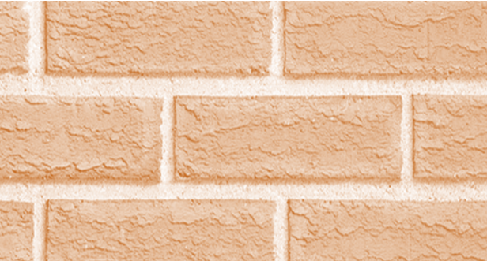
A FIRM FOUNDATION
FOR
TROUBLED TIMES
Lesson Twelve
JoLynn Gower
Fall 2019
jgower@guardingthetruth.org
493-6151

Slide 2
VERSE FOR THE JOURNEY
2 Chronicles 7:12-15 Then the LORD appeared to Solomon at night and said to him, "I have heard your prayer and have chosen this place for Myself as a house of sacrifice. If I shut up the heavens so that there is no rain, or if I command the locust to devour the land, or if I send pestilence among My people, and My people who are called by My name humble themselves and pray and seek My face and turn from their wicked ways, then I will hear from heaven, will forgive their sin and will heal their land. Now My eyes will be open and My ears attentive to the prayer offered in this place.”
Who takes action? What action should be taken?

Slide 3
Watching the times
1 Chronicles 12:32 Of the sons of Issachar, men who understood the times, with knowledge of what Israel should do, their chiefs were two hundred; and all their kinsmen were at their command.
This happened during the time of David’s struggle against Saul when changes were happening and people were deciding who they supported politically
In our times, we must develop:
1. understanding of the supernatural
2. awareness of good and evil
3. understanding biblical authority
4. appropriate approach to people issues
5. an accurate perception of truth

Slide 4
CHANGES COMING
University of Illinois estimates that computing ability will increase over 100 times in the next ten years
Artificial intelligence will come to more prominence
Cyber warfare will increase
With increasing population, food production must also increase
The educational patterns of the 1990’s will no longer be effective
The government may not have your best interests at heart
WHAT OPPORTUNITIES ARE PRESENTED TO SHARE THE GOSPEL?

Slide 5
The good fight
1 Timothy 6:12 Fight the good fight of faith; take hold of the eternal life to which you were called, and you made the good confession in the presence of many witnesses.
Once you’ve chosen a side, there will be a battle
Both the battle and the enemy are very real
You must have the resources to enable victory
You must think through your world view very carefully so that you are not easily deceived
You must decide if you live for eternity or for the moment
You must decide if you believe that there are moral absolutes – and if so, what are they?

Slide 6
MY WORLDVIEW
My purpose
My giftings
Understanding the enemy
Balancing faith and works
Exodus 20:1-16: God’s value system
James 1:17 Every good thing given and every perfect gift is from above, coming down from the Father of lights, with whom there is no variation or shifting shadow.
Variation: parallage: fickleness; change
Shifting shadow: aposkiasma: moving or turning shade
Malachi 3:6 “For I, the LORD, do not change; therefore you, O sons of Jacob, are not consumed.”

Slide 7
VALUING THE WORD
We spend time on things that we value
The minimalization of the Old Testament is egregious
We understand New Testament discussions based on
the Old Testament usage and custom
We want to know what has been fulfilled and what remains to be fulfilled:
Two major areas to understand fully are:
1. Kinsman Redeemer model
2. Tabernacle Model
Matthew 5:17-18 "Do not think that I came to abolish the Law or the Prophets; I did not come to abolish but to fulfill. For truly I say to you, until heaven and earth pass away, not the smallest letter or stroke shall pass from the Law until all is accomplished.

Slide 8
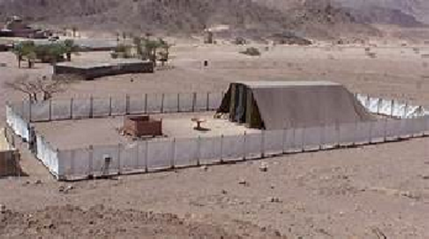

Slide 10
NARROW GATE: THE WAY
Matthew 7:13 "Enter through the narrow gate; for the gate is wide and the way is broad that leads to destruction, and there are many who enter through it.”
Outer court: salvation: sacrifice, cleansing
Leviticus 9:24 Then fire came out from before the LORD and consumed the burnt offering and the portions of fat on the altar;
The altar fire was to be kept burning continuously; it was also the only fire to be used in the incense altar
The laver was at the entrance to the inner courts
Ephesians 5:26-27 …so that He might sanctify her, having cleansed her by the washing of water with the word, that He might present to Himself the church in all her glory, having no spot or wrinkle or any such thing; but that she would be holy and blameless.

Slide 11
The OUTER COURT IS FREE
Choosing to go further will cost you something
THE HOLY PLACE: DISCIPLESHIP
Table of showbread: one loaf for each tribe; bread of the presence;
Romans 8:28 And we know that God causes all things to work together for good to those who love God, to those who are called according to His purpose.
Purpose: prothesis: setting forth; specifically the showbread
John 4:34 Jesus said to them, "My food is to do the will of Him who sent Me and to accomplish His work.
2 Timothy 1:9 …who has saved us and called us with a holy calling, not according to our works, but according to His own purpose and grace which was granted us in Christ Jesus from all eternity…

Slide 12
THE HOLY PLACE: DOOR OF TRUTH
Altar of incense representing prayer: always fired from the sacrificial altar
John 14:13-15 “Whatever you ask in My name, that will I do, so that the Father may be glorified in the Son. If you ask Me anything in My name, I will do it. If you love Me, you will keep My commandments.”
In my name: en mou to onomati: by my name, authority, or stated cause
Lampstand representing light to a dark world
1 John 1:5 This is the message we have heard from Him and announce to you, that God is Light, and in Him there is no darkness at all.
Psalm 119:105 Your word is a lamp to my feet and a light to my path.

Slide 13
Holy of holies
Entered through the veil (Veil of Life)
Hebrews 10:19-20 Therefore, brethren, since we have confidence to enter the holy place by the blood of Jesus, by a new and living way which He inaugurated for us through the veil, that is, His flesh…
The Ark of the Covenant with mercy seat lid
God’s presence (shekinah glory) manfested here
The Law that judged us was contained inside
The mercy seat was the covering
Grace: when we get something good undeserved
Mercy: when we don’t get something bad that was deserved
Mercy triumphs over judgment

Slide 14
TABERNACLE: copy/shadow
Narrow Gate/Way; the Door of Truth; the Veil of Life
John 14:6 Jesus said to him, "I am the way, and the truth, and the life; no one comes to the Father but through Me.
Hebrews 8:5 …who serve a copy and shadow of the heavenly things, just as Moses was warned by God when he was about to erect the tabernacle; for, "SEE," He says, "THAT YOU MAKE all things ACCORDING TO THE PATTERN WHICH WAS SHOWN YOU ON THE MOUNTAIN.”
Hebrews 9:11-12 But when Christ appeared as a high priest of the good things to come, He entered through the greater and more perfect tabernacle, not made with hands, that is to say, not of this creation; and not through the blood of goats and calves, but through His own blood, He entered the holy place once for all, having obtained eternal redemption.

