Slide 1
JoLynn Gower April 2019 jgower@guardingthetruth.org
EVERYTHING SUMMED UP IN CHRIST
KINSMAN REDEEMER
SPRING
FEASTS
JESUS
FALL
FEASTS
TABERNACLE

Slide 2
VERSE FOR THE JOURNEY
Ephesians 1:9-12 He made known to us the mystery of His will, according to His kind intention which He purposed in Him with a view to an administration suitable to the fullness of the times, that is, the summing up of all things in Christ, things in the heavens and things on the earth. In Him also we have obtained an inheritance, having been predestined according to His purpose who works all things after the counsel of His will,to the end that we who were the first to hope in Christ would be to the praise of His glory.
Summed up: anakephalaiomai: gathered in one place
Predestined: proorizo: to limit in advance
Purpose: prothesis: sacred showbread; setting forth of a design for living

Slide 3
PURPOSE OF THE LAW
REVEALS GOD’S RIGHTEOUS STANDARD Romans 7:12 So then, the Law is holy, and the commandment is holy and righteous and good.
GIVES KNOWLEDGE OF SIN Matthew 18:11 "For the Son of Man has come to save that which was lost.
TUTOR THAT POINTS US TO CHRIST Galatians 3:24-25 Therefore the Law has become our tutor to lead us to Christ, so that we may be justified by faith. But now that faith has come, we are no longer under a tutor.
Matthew 22:37-40 And He said to him, "'YOU SHALL LOVE THE LORD YOUR GOD WITH ALL YOUR HEART, AND WITH ALL YOUR SOUL, AND WITH ALL YOUR MIND.‘ This is the great and foremost commandment. "The second is like it, 'YOU SHALL LOVE YOUR NEIGHBOR AS YOURSELF.’ On these two commandments depend the whole Law and the Prophets.“

Slide 4
BASICS FIRST
All people are sinners Romans 3:23 ..for all have sinned and fall short of the glory of God..
The penalty for sin is eternal separation from God 1 Corinthians 6:9 Or do you not know that the unrighteous will not inherit the kingdom of God
Jesus came to save sinners 1 Peter 3:18 For Christ also died for sins once for all, the just for the unjust, so that He might bring us to God, having been put to death in the flesh, but made alive in the spirit;
Jesus took our sin on Himself 2 Corinthians 5:21 He made Him who knew no sin to be sin on our behalf, so that we might become the righteousness of God in Him
Repentance is required Acts 26:18 …to open their eyes so that they may turn from darkness to light and from the dominion of Satan to God, that they may receive forgiveness of sins…

Slide 5
PEOPLE CANNOT SAVE THEMSELVES
Until people realize they are sinners, they don’t see their need for a savior
Ephesians 2:8-9 For by grace you have been saved through faith; and that not of yourselves, it is the gift of God; not as a result of works, so that no one may boast.
Romans 7:7 What shall we say then? Is the Law sin? May it never be! On the contrary, I would not have come to know sin except through the Law;
God doesn’t want anyone to go to hell
2 Peter 3:9 The Lord is not slow about His promise, as some count slowness, but is patient toward you, not wishing for any to perish but for all to come to repentance.
GOD BEGAN REVEALING HIS PLAN FOR REDEMPTION IN THE LAW

Slide 6
CHOOSING ABRAHAM
Genesis 12:1 Now the LORD said to Abram, "Go forth from your country, and from your relatives and from your father's house, to the land which I will show you;
Genesis 13:2 Now Abram was very rich in livestock, in silver and in gold.
Genesis 14:14 When Abram heard that his relative had been taken captive, he led out his trained men, born in his house, three hundred and eighteen, and went in pursuit as far as Dan.
Genesis 15:5-8 He took him outside and said, "Now look toward the heavens, and count the stars, if you are able to count them." And He said to him, "So shall your descendants be.” Then he believed in the LORD; and He reckoned it to him as righteousness. And He said to him, "I am the LORD who brought you out of Ur of the Chaldeans, to give you this land to possess it.” He said, "O Lord GOD, how may I know that I will possess it?"

Slide 7
CAPTIVITY IN EGYPT
During a time of famine, Abram’s descendants willingly went to Egypt, but were later enslaved
Genesis 15:13 God said to Abram, "Know for certain that your descendants will be strangers in a land that is not theirs, where they will be enslaved and oppressed four hundred years.
God chose Moses to bring the people out of that slavery and back to the land he had promised Abram by covenant
On Mt. Sinai, God gave the Law to Moses
At Mt. Sinai, the people committed egregious sin by making a golden calf
Where did the concept of a golden calf come from? To understand that, we go back to pre-flood accounts

Slide 8
THE NEPHILIM
Genesis 6:1-4 Now it came about, when men began to multiply on the face of the land, and daughters were born to them, that the sons of God saw that the daughters of men were beautiful; and they took wives for themselves, whomever they chose. Then the LORD said, "My Spirit shall not strive with man forever, because he also is flesh; nevertheless his days shall be one hundred and twenty years.” The Nephilim were on the earth in those days, and also afterward, when the sons of God came in to the daughters of men, and they bore children to them. Those were the mighty men who were of old, men of renown.
Renown: ha shem anse: making a name for themselves
The pseudepigraphal book of Enoch relates more

Slide 9
POST FLOOD
After the flood, Noah’s great grandson, Nimrod, seems to restore the sin that caused God’s destruction by flood
Genesis 10:8-10 Now Cush became the father of Nimrod; he became a mighty one on the earth. He was a mighty hunter before the LORD; therefore it is said, "Like Nimrod a mighty hunter before the LORD." The beginning of his kingdom was Babel and Erech and Accad and Calneh, in the land of Shinar.
Genesis 11:4 … "Come, let us build for ourselves a city, and a tower whose top will reach into heaven, and let us make for ourselves a name, otherwise we will be scattered abroad over the face of the whole earth."
The tower was the Tower of Babel in Nimrod’s kingdom; Nimrod was the source of the Babylonian cult religions as we know them today

Slide 10
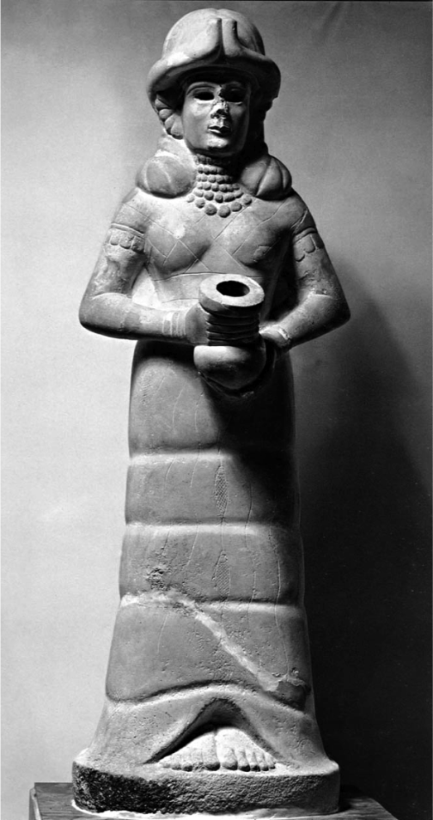
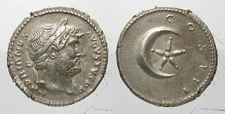
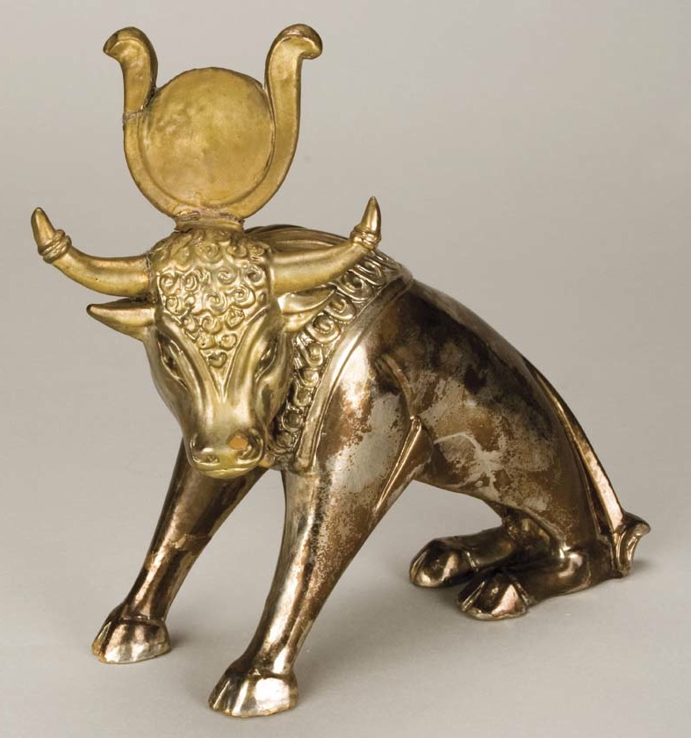
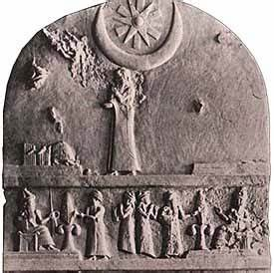
BABYLON, MOTHER OF HARLOTS
Revelation 17:4 The woman was clothed in purple and scarlet, and adorned with gold and precious stones and pearls, having in her hand a gold cup full of abom- inations and of the unclean things of her immorality…

Slide 11
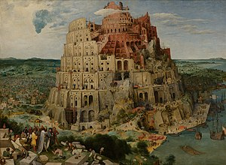
Peter Bruegel 1563
EU Parliament, Strawbourg

Slide 12
Creation – Nephilim/sin/making a name – Noah/flood – Nimrod/Babel/Marduk, Sin/Ishtar/ making a name Abram called; covenant for land – Isaac, Jacob (Israel) – Egypt - Moses (law) Noah – Shem – Arpachshad – Shelah – Eber (Hebrews) Peleg, Reu, Serug, Nahor, Terah, Abram, Isaac, Jacob (Israelites)

Slide 13
LAWS TO GOVERN
When they left Egypt, God gave the Law to Moses to govern the people
Exodus 19:12-13 "You shall set bounds for the people all around, saying, 'Beware that you do not go up on the mountain or touch the border of it; whoever touches the mountain shall surely be put to death. No hand shall touch him, but he shall surely be stoned or shot through; whether beast or man, he shall not live.' When the ram's horn sounds a long blast, they shall come up to the mountain."
The Law included the 10 commandments and more
Today we will concern ourselves with the Tabernacle, its purpose, and its meaning; we specifically want to know how it was “summed up in Christ.”

Slide 14
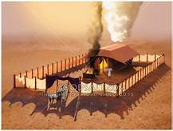

Slide 15
IN THE TABERNACLE

Slide 16
THE OLD AND THE NEW
Galatians 2:15-16 "We are Jews by nature and not sinners from among the Gentiles; nevertheless knowing that a man is not justified by the works of the Law but through faith in Christ Jesus, even we have believed in Christ Jesus, so that we may be justified by faith in Christ and not by the works of the Law; since by the works of the Law no flesh will be justified.
Galatians 3:19-21 Why the Law then? It was added because of transgressions, having been ordained through angels by the agency of a mediator, until the seed would come to whom the promise had been made. Now a mediator is not for one party only; whereas God is only one. Is the Law then contrary to the promises of God? May it never be! For if a law had been given which was able to impart life, then righteousness would indeed have been based on law.

Slide 17
THE COMPARISON
Ministry of death and condemnation
Bondwoman/slave/Hagar
Old Covenant
Present Jerusalem
Sinai: mountain that could be touched resulting in death
Ministry of Spirit/glory
Free woman/Sarah
New Covenant/Zion
New Jerusalem
Hebrews 12:18 For you have not come to a mountain that can be touched and to a blazing fire, and to darkness and gloom and whirlwind…
Galatians 5:16-18 But I say, walk by the Spirit, and you will not carry out the desire of the flesh. For the flesh sets its desire against the Spirit, and the Spirit against the flesh; for these are in opposition to one another, so that you may not do the things that you please. But if you are led by the Spirit, you are not under the Law.

