Slide 1
EN GARDE!
A STUDY OF UNSEEN FORCES AT WORK
IN OUR WORLD
JoLynn Gower
Spring 2020
217-493-6151
jgower@guardingthetruth.org
Lesson 9

Slide 2
VERSE FOR THE JOURNEY
Ephesians 6:10-13 Finally, be strong in the Lord and in the strength of His might. Put on the full armor of God, so that you will be able to stand firm against the schemes of the devil. For our struggle is not against flesh and blood, but against the rulers, against the powers, against the world forces of this darkness, against the spiritual forces of wickedness in the heavenly places. Therefore, take up the full armor of God, so that you will be able to resist in the evil day, and having done everything, to stand firm.
Struggle: pale: to wrestle; a close quarters combat
Resist: anthistemi: withstand while opposing
Stand: histemi: make a stand; be established

Slide 3
SATAN AND GOD’S THRONE
Genesis 3:1 Now the serpent was more crafty than any beast of the field which the LORD God had made. And he said to the woman, "Indeed, has God said, 'You shall not eat from any tree of the garden’?”
Revelation 12:9 And the great dragon was thrown down, the serpent of old who is called the devil and Satan, who deceives the whole world; he was thrown down to the earth, and his angels were thrown down with him.
Revelation 20:1-3 Then I saw an angel coming down from heaven, holding the key of the abyss and a great chain in his hand. And he laid hold of the dragon, the serpent of old, who is the devil and Satan, and bound him for a thousand years; and he threw him into the abyss…

Slide 4
A LEADER AND A KING
Ezekiel 28:1-2, 9 The word of the LORD came again to me saying, "Son of man, say to the leader of Tyre, 'Thus says the Lord GOD, "Because your heart is lifted up and you have said, 'I am a god, I sit in the seat of gods in the heart of the seas'; Yet you are a man and not God, although you make your heart like the heart of God….will you still say, "I am a god," in the presence of your slayer, though you are a man and not God, in the hands of those who wound you?
Ezekiel 28:11-12 Again the word of the LORD came to me saying, "Son of man, take up a lamentation over the king of Tyre and say to him, 'Thus says the Lord GOD, "You had the seal of perfection, full of wisdom and perfect in beauty.

Slide 5
MORE ON THE KING OF TYRE
Ezekiel 28:13-16 "You were in Eden, the garden of God; Every precious stone was your covering: The ruby, the topaz and the diamond; The beryl, the onyx and the jasper; The lapis lazuli, the turquoise and the emerald; And the gold, the workmanship of your settings and sockets, was in you. On the day that you were created they were prepared. You were the anointed cherub who covers, and I placed you there. You were on the holy mountain of God; You walked in the midst of the stones of fire. "You were blameless in your ways From the day you were created until unrighteousness was found in you. By the abundance of your trade You were internally filled with violence, and you sinned; Therefore I have cast you as profane From the mountain of God.
Notes:
n

Slide 6
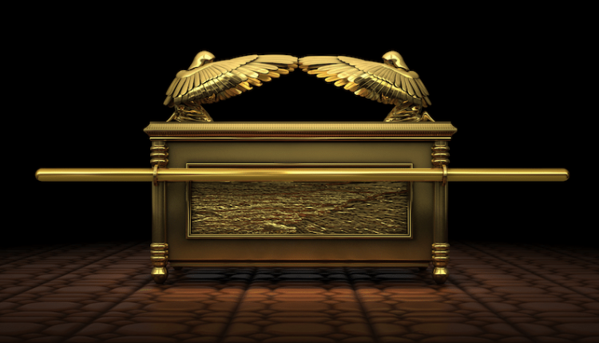
COVERING CHERUBIM
Exodus 25:19-20 "Make one cherub at one end and one cherub at the other end; you shall make the cherubim of one piece with the mercy seat at its two ends. The cherubim shall have their wings spread upward, covering the mercy seat with their wings and facing one another; the faces of the cherubim are to be turned toward the mercy seat.
Do these angels look like the ones that Ezekiel saw?
Four wings; Four faces; covered with eyes; wheels?

Slide 7
SIN OF PRIDE
Isaiah 14:12-15 "How you have fallen from heaven, O star of the morning, son of the dawn! You have been cut down to the earth, you who have weakened the nations! But you said in your heart, 'I will ascend to heaven; I will raise my throne above the stars of God, and I will sit on the mount of assembly In the recesses of the north. 'I will ascend above the heights of the clouds; I will make myself like the Most High.' Nevertheless you will be thrust down to Sheol, to the recesses of the pit.
Isaiah 14:12 (KJV)(AV) How art thou fallen from heaven, O Lucifer, son of the morning! how art thou cut down to the ground, which didst weaken the nations!
quomodo cecidisti de caelo lucifer qui mane oriebaris corruisti in terram qui vulnerabas gentes

Slide 8
OBVIOUSLY SATAN FELL
Satan (H): adversary, accuser: Satanas (G): accuser
Revelation 12:3,4 Then another sign appeared in heaven: and behold, a great red dragon having seven heads and ten horns, and on his heads were seven diadems. And his tail swept away a third of the stars of heaven and threw them to the earth.
Job 1:6 Now there was a day when the sons of God came to present themselves before the LORD, and Satan also came among them.
Job 2:1-2 Again there was a day when the sons of God came to present themselves before the LORD, and Satan also came among them to present himself before the LORD. The LORD said to Satan, "Where have you come from?" Then Satan answered the LORD and said, "From roaming about on the earth and walking around on it."

Slide 9
ACCESS TO HEAVEN
Lost his position but still has access to heaven/God
Revelation 12:10 I heard a loud voice in heaven, saying, "Now the salvation, and the power, and the king-dom of our God and the authority of His Christ have come for the accuser of our brethren has been thrown down, he who accuses them before our God day and night.
Zechariah 3:1 Then he showed me Joshua the high priest standing before the angel of the LORD, and Satan standing at his right hand to accuse him.
Matthew 4:1 Then Jesus was led up by the Spirit into the wilderness to be tempted by the devil.
John 8:43-44 "Why do you not understand what I am saying? It is because you cannot hear My word. You are of your father the devil, and you want to do the desires of your father.

Slide 10
SEED SNATCHER / TARE SOWER
Cherub Proud Fallen Liar Murderer Accuser
Adversary Tempter Enemy
Matthew 13:19 "When anyone hears the word of the kingdom and does not understand it, the evil one comes and snatches away what has been sown in his heart. This is the one on whom seed was sown beside the road.
Matthew 13:36-41 Then He left the crowds and went into the house. And His disciples came to Him and said, "Explain to us the parable of the tares of the field." And He said, "The one who sows the good seed is the Son of Man, and the field is the world; and as for the good seed, these are the sons of the kingdom; and the tares are the sons of the evil one; and the enemy who sowed them is the devil, and the harvest is the end of the age; and the reapers are angels.

Slide 11
BETRAYAL OF JESUS
John 13:26-27 Jesus then *answered, "That is the one for whom I shall dip the morsel and give it to him." So when He had dipped the morsel, He took and gave it to Judas, the son of Simon Iscariot. After the morsel, Satan then entered into him. Therefore Jesus said to him, "What you do, do quickly."
John 6:70 Jesus answered them, "Did I Myself not choose you, the twelve, and yet one of you is a devil?“
Luke 22:52-53 Then Jesus said to the chief priests and officers of the temple and elders who had come against Him, "Have you come out with swords and clubs as you would against a robber? While I was with you daily in the temple, you did not lay hands on Me; but this hour and the power of darkness are yours."

Slide 12
SATAN’S EARTHLY THRONES
Revelation 2:8-9 "And to the angel of the church in Smyrna write: The first and the last, who was dead, and has come to life, says this: 'I know your tribulation and your poverty (but you are rich), and the blasphemy by those who say they are Jews and are not, but are a synagogue of Satan.’
Revelation 2:12-13 "And to the angel of the church in Pergamum write: The One who has the sharp two-edged sword says this: 'I know where you dwell, where Satan's throne is; and you hold fast My name, and did not deny My faith even in the days of Antipas, My witness, My faithful one, who was killed among you, where Satan dwells.
The Babylonian cult religions were headquartered in Pergamum at this time

Slide 13
PERGAMUM ALTAR (BERLIN)

