Slide 1


EN GARDE!
A STUDY OF UNSEEN FORCES AT WORK
IN OUR WORLD
JoLynn Gower
Spring 2020
217-493-6151
jgower@guardingthetruth.org
Lesson 8

Slide 2
VERSE FOR THE JOURNEY
Ephesians 6:10-13 Finally, be strong in the Lord and in the strength of His might. Put on the full armor of God, so that you will be able to stand firm against the schemes of the devil. For our struggle is not against flesh and blood, but against the rulers, against the powers, against the world forces of this darkness, against the spiritual forces of wickedness in the heavenly places. Therefore, take up the full armor of God, so that you will be able to resist in the evil day, and having done everything, to stand firm.
Struggle: pale: to wrestle; a close quarters combat
Resist: anthistemi: withstand while opposing
Stand: histemi: make a stand; be established

Slide 3
WHERE IS GOD’S THRONE
Throne is used in three different ways:
1. an exalted position of kings or rulers
2. the power with which a ruler can act
3. the actual reign of a ruler
1 Samuel 4:4 So the people sent to Shiloh, and from there they carried the ark of the covenant of the LORD of hosts who sits above the cherubim; and the two sons of Eli, Hophni and Phinehas, were there with the ark of the covenant of God.
2 Samuel 6:2 And David arose and went with all the people who were with him to Baale-judah, to bring up from there the ark of God which is called by the Name, the very name of the LORD of hosts who is enthroned above the cherubim.
Notes:
n

Slide 4
A FUTURE REIGN
Jeremiah 3:17 "At that time they will call Jerusalem 'The Throne of the LORD,' and all the nations will be gathered to it, to Jerusalem, for the name of the LORD; nor will they walk anymore after the stubbornness of their evil heart.
Ezekiel 43:7-8 He said to me, "Son of man, this is the place of My throne and the place of the soles of My feet, where I will dwell among the sons of Israel forever. And the house of Israel will not again defile My holy name, neither they nor their kings, by their harlotry and by the corpses of their kings when they die, by setting their threshold by My threshold and their door post beside My door post, with only the wall between Me and them. And they have defiled My holy name by their abominations which they have committed.

Slide 5
DAVIDIC COVENANT
Isaiah 9:6-7 For a child will be born to us, a son will be given to us; And the government will rest on His shoulders; And His name will be called Wonderful Counselor, Mighty God, Eternal Father, Prince of Peace.
There will be no end to the increase of His government or of peace, on the throne of David and over his kingdom, to establish it and to uphold it with justice and righteousness from then on and forevermore. The zeal of the LORD of hosts will accomplish this.
Unconditional covenant:
2 Samuel 7:16-17 "Your house and your kingdom shall endure before Me forever; your throne shall be established forever." In accordance with all these words and all this vision, so Nathan spoke to David.

Slide 6
FULFILLED IN JESUS
Luke 1:30-33 The angel said to her, "Do not be afraid, Mary; for you have found favor with God. And behold, you will conceive in your womb and bear a son, and you shall name Him Jesus. He will be great and will be called the Son of the Most High; the Lord God will give Him the throne of His father David; He will reign over the house of Jacob forever, and His kingdom will have no end”
Acts 2:29-32 "Brethren, I may confidently say to you regarding the patriarch David that he both died and was buried, and his tomb is with us to this day. So, because he was a prophet and knew that GOD HAD SWORN TO HIM WITH AN OATH TO SEAT one OF HIS DESCENDANTS ON HIS THRONE, he looked ahead and spoke of the resurrection of the Christ, that HE WAS NEITHER ABANDONED TO HADES, NOR DID His flesh SUFFER DECAY.

Slide 7
ABSOLUTE SOVEREIGNTY
1 Kings 22:19 Micaiah said, "Therefore, hear the word of the LORD. I saw the LORD sitting on His throne, and all the host of heaven standing by Him on His right and on His left.
2 Chronicles 18:18 Micaiah said, "Therefore, hear the word of the LORD. I saw the LORD sitting on His throne, and all the host of heaven standing on His right and on His left.
Isaiah 6:1-3 In the year of King Uzziah's death I saw the Lord sitting on a throne, lofty and exalted, with the train of His robe filling the temple. Seraphim stood above Him, each having six wings: with two he covered his face, and with two he covered his feet, and with two he flew. And one called out to another and said, "Holy, Holy, Holy, is the LORD of hosts, the whole earth is full of His glory."

Slide 8
A GLIMPSE OF HEAVEN
Ezekiel 1:26-28 Now above the expanse that was over their heads there was something resembling a throne, like lapis lazuli in appearance; and on that which resembled a throne, high up, was a figure with the appearance of a man. Then I noticed from the appearance of His loins and upward something like glowing metal that looked like fire all around within it, and from the appearance of His loins and downward I saw something like fire; and there was a radiance around Him. As the appearance of the rainbow in the clouds on a rainy day, so was the appearance of the surrounding radiance. Such was the appearance of the likeness of the glory of the LORD. And when I saw it, I fell on my face…

Slide 9
JOHN’S VIEW INTO HEAVEN
Revelation 4:2-5 Immediately I was in the Spirit; and behold, a throne was standing in heaven, and One sitting on the throne-who was sitting was like a jasper stone and a sardius in appearance; and there was a rainbow around the throne, like an emerald in appearance. Around the throne were twenty -four thrones; and upon the thrones I saw twenty-four elders sitting, clothed in white garments and golden crowns on their heads. Out from the throne come flashes of lightning and sounds and peals of thunder. And there were seven lamps of fire burning before the throne, which are the seven Spirits of God;
Isaiah 11:2-3 The Spirit of the LORD will rest on Him, the spirit of wisdom and understanding, the spirit of counsel and strength, the spirit of knowledge and the fear of the LORD. And He will delight in the fear of the LORD, and He will not judge by what His eyes see, nor make a decision by what His ears hear;

Slide 10
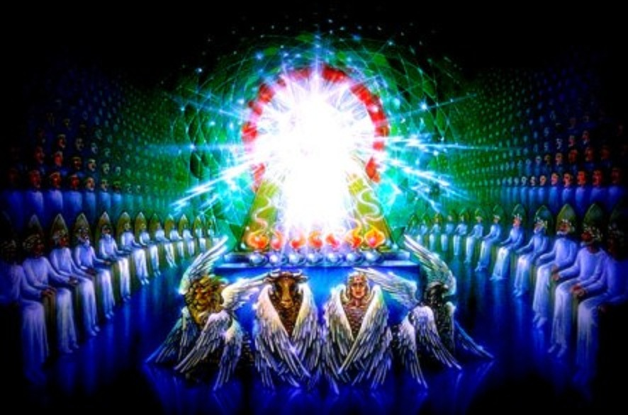
GOD’S THRONE

Slide 11
AROUND THE THRONE
Revelation 4:6-9 …before the throne there was something like a sea of glass, like crystal; and in the center and around the throne, four living creatures full of eyes in front and behind. The first creature was like a lion, and the second creature like a calf, and the third creature had a face like that of a man, and the fourth creature was like a flying eagle. And the four living creatures, each one of them having six wings, are full of eyes around and within; and day and night they do not cease to say, "HOLY, HOLY, HOLY is THE LORD GOD, THE ALMIGHTY, WHO WAS AND WHO IS AND WHO IS TO COME." And when the living creatures give glory and honor and thanks to Him who sits on the throne, to Him who lives forever and ever,

Slide 12
THRONE IN HEAVEN
Psalm 11:4 The LORD is in His holy temple; the LORD'S throne is in heaven; His eyes behold, His eyelids test the sons of men.
Isaiah 66:1 Thus says the LORD, "Heaven is My throne and the earth is My footstool. Where then is a house you could build for Me? And where is a place that I may rest?
Matthew 5:34-35 "But I say to you, make no oath at all, either by heaven, for it is the throne of God,
or by the earth, for it is the footstool of His feet, or by Jerusalem, for it is THE CITY OF THE GREAT KING.
Psalm 45:6 Your throne, O God, is forever and ever; A scepter of uprightness is the scepter of Your kingdom.

Slide 13
IN NEW JERUSALEM
Revelation 22:1-5 Then he showed me a river of the water of life, clear as crystal, coming from the throne of God and of the Lamb, in the middle of its street. On either side of the river was the tree of life, bearing twelve kinds of fruit, yielding its fruit every month; and the leaves of the tree were for the healing of the nations. There will no longer be any curse; and the throne of God and of the Lamb will be in it, and His bond-servants will serve Him; they will see His face, and His name will be on their foreheads. And there will no longer be any night; and they will not have need of the light of a lamp nor the light of the sun, because the Lord God will illumine them; and they will reign forever and ever.

