Slide 1
EN GARDE!
A STUDY OF UNSEEN FORCES AT WORK
IN OUR WORLD
JoLynn Gower
Spring 2020
217-493-6151
jgower@guardingthetruth.org
Lesson 12

Slide 2
VERSE FOR THE JOURNEY
Ephesians 6:10-13 Finally, be strong in the Lord and in the strength of His might. Put on the full armor of God, so that you will be able to stand firm against the schemes of the devil. For our struggle is not against flesh and blood, but against the rulers, against the powers, against the world forces of this darkness, against the spiritual forces of wickedness in the heavenly places. Therefore, take up the full armor of God, so that you will be able to resist in the evil day, and having done everything, to stand firm.
Struggle: pale: to wrestle; a close quarters combat
Resist: anthistemi: withstand while opposing
Stand: histemi: make a stand; be established

Slide 3
WHAT IS THE ABYSS?
Genesis 6:1-4 Now it came about, when men began to multiply on the face of the land, and daughters were born to them, that the sons of God saw that the daughters of men were beautiful; and they took wives for themselves, whomever they chose. Then the LORD said, "My Spirit shall not strive with man forever, because he also is flesh; nevertheless his days shall be one hundred and twenty years." The Nephilim were on the earth in those days, and also afterward, when the sons of God came in to the daughters of men, and they bore children to them. Those were the mighty men who were of old, men of renown.
Nephilim: fallen ones
Men of renown: shem: ones who made a name for themselves

Slide 4
FATE OF THESE ANGELS
Jude 1:6-7 And angels who did not keep their own domain, but abandoned their proper abode, He has kept in eternal bonds under darkness for the judgment of the great day, just as Sodom and Gomorrah and the cities around them, since they in the same way as these indulged in gross immorality and went after strange flesh, are exhibited as an example in undergoing the punishment of eternal fire.
2 Peter 2:4-6 For if God did not spare angels when they sinned, but cast them into hell and committed them to pits of darkness, reserved for judgment and did not spare the ancient world, but preserved Noah, a preacher of righteousness, with seven others, when He brought a flood upon the world of the ungodly; and if He condemned the cities of Sodom and Gomorrah to destruction by reducing them to ashes,
Notes:
n

Slide 5
WHERE ARE THESE ANGELS?
Eternal bonds under darkness--Jude
Pits of darkness in hell – Peter
It seems that these angels were condemned to a special part of hell called “the abyss” or “the pit”
It seems to be a separate part from the areas we looked at last week which are reserved to humans
Angels know about the existence of the abyss!
Luke 8:29-31 For He had commanded the unclean spirit to come out of the man. For it had seized him many times; and he was bound with chains and shackles and kept under guard, and yet he would break his bonds and be driven by the demon into the desert. And Jesus asked him, "What is your name?" And he said, "Legion"; for many demons had entered him. They were imploring Him not to command them to go away into the abyss.

Slide 6
AFTER THE FLOOD: NIMROD!
Genesis 11:1-4 Now the whole earth used the same language and the same words. It came about as they journeyed east, that they found a plain in the land of Shinar and settled there. They said to one another, "Come, let us make bricks and burn them thoroughly." They used brick for stone, and they used tar for mortar. They said, "Come, let us build for ourselves a city, and a tower whose top will reach into heaven, and let us make for ourselves a name, otherwise we will be scattered abroad over the face of the whole earth."
Akkadian literature indicates that pre-flood, towers had been built with upper rooms where the “gods” were invited to have a sexual relationship with women creating a giant race

Slide 7
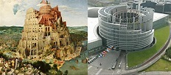
NIMROD’S WORLD RELIGION
THE EU PARLIAMENT BUILDING IN STRASBOURG,
FRANCE WAS MODELED AFTER PETER BRUEGEL
THE ELDER’S PAINTING OF THE TOWER OF BABEL

Slide 8
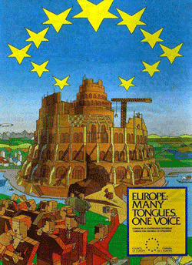
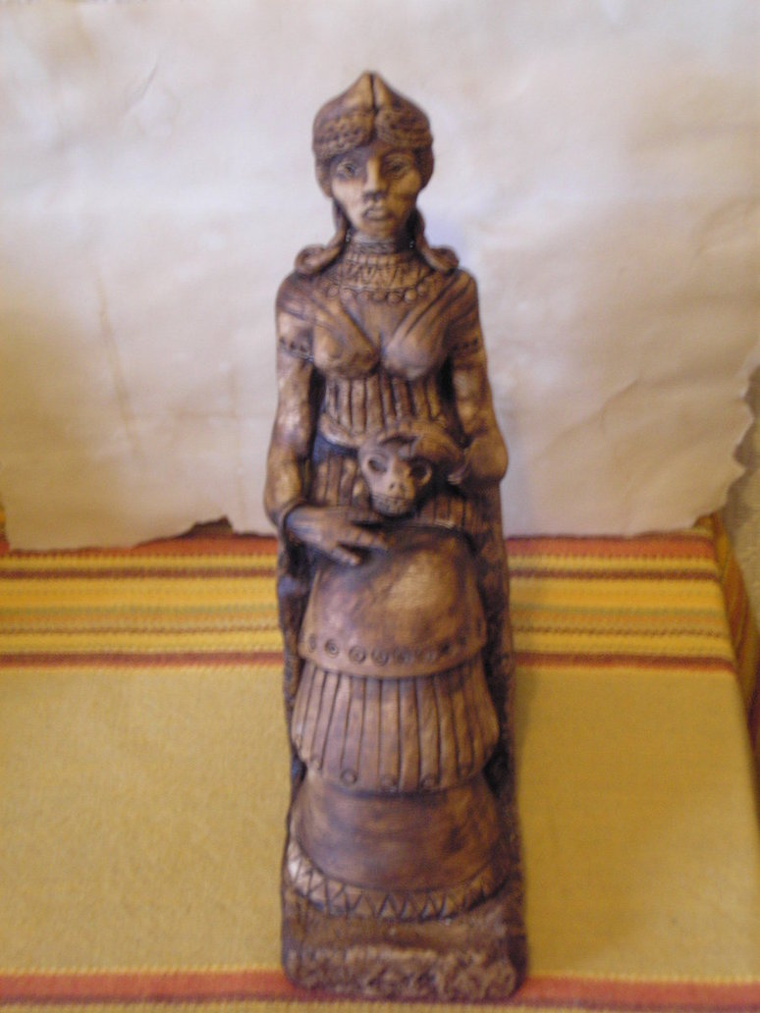
FOR WHAT ITS WORTH….

Slide 9
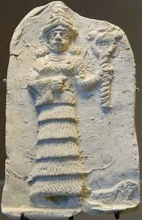
BABYLON THE GREAT
Revelation 17:3-5 And he carried me away in the Spirit into a wilderness; and I saw a woman sitting on a scarlet beast, full of blasphemous names, having seven heads and ten horns. The woman was clothed in purple and scarlet, and adorned with gold and precious stones and pearls,
having in her hand a gold cup
full of abominations and of
the unclean things of her
immorality, and on her
forehead a name was written,
a mystery, "BABYLON THE GREAT,
THE MOTHER OF HARLOTS AND OF
THE ABOMINATIONS OF THE EARTH."

Slide 10
AND ALSO AFTERWARDS…
Genesis 6:4 The Nephilim were on the earth in those days, and also afterward...
Nimrod eventually became worshiped as the ba’al in Israel – various other names: Bel, Marduk
Nimrod’s wife became worshiped as Ishtar
Ishtar’s birthday, near the spring equinox, was celebrated by dying and hiding eggs (she was hatched from an egg in their lore) and with a rabbit (she was the goddess of fertility)
There are many takes on the story: Tammuz was Ishtar’s son/husband and he spent half the year in hell
Ezekiel 8:14 Then He brought me to the entrance of the gate of the LORD'S house which was toward the north; and behold, women were sitting there weeping for Tammuz.

Slide 11
THE ABYSS OPENED
5TH TRUMPET:
Revelation 9:1-4 Then the fifth angel sounded, and I saw a star from heaven which had fallen to the earth; and the key of the bottomless pit was given to him. He opened the bottomless pit, and smoke went up out of the pit, like the smoke of a great furnace; and the sun and the air were darkened by the smoke of the pit. Then out of the smoke came locusts upon the earth, and power was given them, as the scorpions of the earth have power. They were told not to hurt the grass of the earth, nor any green thing, nor any tree, but only the men who do not have the seal of God on their foreheads.
Peter said that the fallen angels in the abyss are being reserved for judgment

Slide 12
THE ANGEL OF THE ABYSS
This is NOT Satan! He has not yet been bound
Revelation 9:11 They have as king over them, the angel of the abyss; his name in Hebrew is Abaddon, and in the Greek he has the name Apollyon.
Abbadon: Hebrew: destroyer
Apollyon: Greek: destroyer
In the Midrash, the ancient homiletic commentary on Scriptures, Azazel is a demon who is called a destroyer
In the book of Enoch, Azazel was the angel that led the rebellion with human women (Genesis 6)
Revelation 20:1-2 Then I saw an angel coming down from heaven, holding the key of the abyss and a great chain in his hand. And he laid hold of the dragon, the serpent of old, who is the devil and Satan, and bound him for a thousand years;

