Slide 1
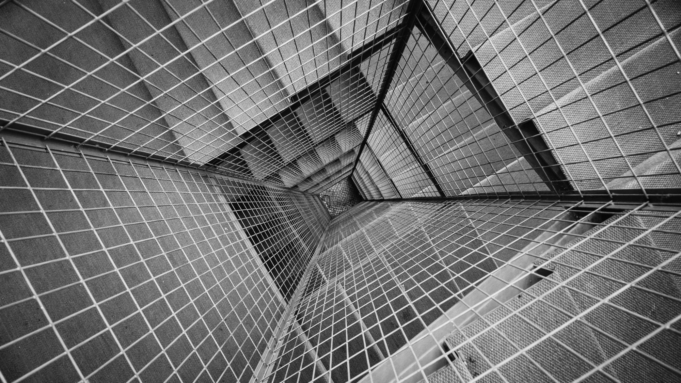
AN APOCALYPTIC
WORLD VIEW
JoLynn Gower
Fall 2020 LESSON 9
217-493-6151
jgower@guardingthetruth.org

Slide 2
VERSE FOR THE JOURNEY
2 Peter 3:11-13 Since all these things are to be destroyed in this way, what sort of people ought you to be in holy conduct and godliness, looking for and hastening the coming of the day of God, because of which the heavens will be destroyed by burning, and the elements will melt with intense heat! But according to His promise we are looking for new heavens and a new earth, in which righteousness dwells.
Promise: epangelma: a self-committal
Before the new heavens and new earth are a reality, there is an apocalypse: destruction and damage on a catastrophic scale

Slide 3
WHO IS SHE?
Revelation 18:1-3 After these things I saw another angel coming down from heaven, having great authority, and the earth was illumined with his glory.
And he cried out with a mighty voice, saying, "Fallen, fallen is Babylon the great! She has become a dwelling place of demons and a prison of every unclean spirit, and a prison of every unclean and hateful bird. For all the nations have drunk of the wine of the passion of her immorality, and the kings of the earth have committed acts of immorality with her, and the merchants of the earth have become rich by the wealth of her sensuality."
1 Peter 5:13 She who is in Babylon, chosen together with you, sends you greetings, and so does my son, Mark

Slide 4
SPIRITUAL AND COMMERCIAL
Revelation 18:4-7 I heard another voice from heaven, saying, "Come out of her, my people, so that you will not participate in her sins and receive of her plagues; for her sins have piled up as high as heaven, and God has remembered her iniquities. Pay her back even as she has paid, and give back to her double according to her deeds; in the cup which she has mixed, mix twice as much for her. To the degree that she glorified herself and lived sensuously, to the same degree give her torment and mourning; for she says in her heart, 'I SIT as A QUEEN AND I AM NOT A WIDOW, and will never see mourning.’
Revelation 18:9-10 "And the kings of the earth, who committed acts of immorality and lived sensuously with her, will weep and lament over her when they see the smoke of her burning, standing at a distance because of the fear of her torment, saying, 'Woe, woe, the great city, Babylon, the strong city! For in one hour your judgment has come.’

Slide 5
TOWER OF SIN
Revelation 18:4-5 I heard another voice from heaven, saying, "Come out of her, my people, so that you will not participate in her sins and receive of her plagues; for her sins have piled up as high as heaven, and God has remembered her iniquities.
Piled up: kollao: united; joined; clinging together
The corruption within the city entwined; corrupt people dealing with corrupt people; a web of corruption
God is the ultimate swamp drainer!
Revelation 18:3 "For all the nations have drunk of the wine of the passion of her immorality, and the kings of the earth have committed acts of immorality with her, and the merchants of the earth have become rich by the wealth of her sensuality."

Slide 6
SPIRITUAL RUIN
Revelation 18:15-16 "The merchants of these things, who became rich from her, will stand at a distance because of the fear of her torment, weeping and mourning, saying, 'Woe, woe, the great city, she who was clothed in fine linen and purple and scarlet, and adorned with gold and precious stones and pearls;
Revelation 18:2 And he cried out with a mighty voice, saying, "Fallen, fallen is Babylon the great! She has become a dwelling place of demons and a prison of every unclean spirit, and a prison of every unclean and hateful bird.
The city has fallen; the spiritual elements have not left
Matthew 12:43 “Now when the unclean spirit goes out of a man, it passes through waterless places seeking rest, and does not find it.”

Slide 7
REJOICE
Revelation 18:18-20 …and were crying out as they saw the smoke of her burning, saying, 'What city is like the great city?' And they threw dust on their heads and were crying out, weeping and mourning, saying, 'Woe, woe, the great city, in which all who had ships at sea became rich by her wealth, for in one hour she has been laid waste!' Rejoice over her, O heaven, and you saints and apostles and prophets, because God has pronounced judgment for you against her."
Revelation 18:21 Then a strong angel took up a stone like a great millstone and threw it into the sea, saying, "So will Babylon, the great city, be thrown down with violence, and will not be found any longer.
Great millstone: megan mulinos: large millstone that required a donkey to turn it

Slide 8
DECEPTION THROUGH SORCERY
Revelation 18:22-23 "And the sound of harpists and musicians and flute-players and trumpeters will not be heard in you any longer; and no craftsman of any craft will be found in you any longer; and the sound of a mill will not be heard in you any longer;
and the light of a lamp will not shine in you any longer; and the voice of the bridegroom and bride will not be heard in you any longer; for your merchants were the great men of the earth, because all the nations were deceived by your sorcery.
From the garden of Eden, one of the devil’s most noticeable tools is deception
Deception: planao: to lead astray
Sorcery: pharmakeia: drug used to alter state of mind

Slide 9
KILLING GOD’S PEOPLE
Revelation 18:24 "And in her was found the blood of prophets and of saints and of all who have been slain on the earth."
Death of God’s people, but also the death of others
John 8:43-44 "Why do you not understand what I am saying? It is because you cannot hear My word. You are of your father the devil, and you want to do the desires of your father. He was a murderer from the beginning, and does not stand in the truth because there is no truth in him. Whenever he speaks a lie, he speaks from his own nature, for he is a liar and the father of lies.
Genesis 3:3-4… but from the fruit of the tree which is in the middle of the garden, God has said, 'You shall not eat from it or touch it, or you will die.'" ⁴ The serpent said to the woman, "You surely will not die!

Slide 10
AVENGING OF BLOOD
Revelation 19:1-5 After these things I heard something like a loud voice of a great multitude in heaven, saying, "Hallelujah! Salvation and glory and power belong to our God; BECAUSE HIS JUDGMENTS ARE TRUE AND RIGHTEOUS; for He has judged the great harlot who was corrupting the earth with her immorality, and HE HAS AVENGED THE BLOOD OF HIS BOND-SERVANTS ON HER." And a second time they said, "Hallelujah! HER SMOKE RISES UP FOREVER AND EVER." And the twenty-four elders and the four living creatures fell down and worshiped God who sits on the throne saying, "Amen. Hallelujah!" And a voice came from the throne, saying, "Give praise to our God, all you His bond-servants, you who fear Him, the small and the great."

Slide 11
AVENGING OF BLOOD
Deuteronomy 32:43 "Rejoice, O nations, with His people; For He will avenge the blood of His servants, And will render vengeance on His adversaries, And will atone for His land and His people."
Duties of the ga’al:
1. redeem a relative in slavery
2. redeem land the relative lost
3. serve as avenger of blood (after guilt confirmed)
4. marry the woman without heirs
Qualifications of a ga’al
1. kinsman (related by blood)
2. willing to make the redemption
3. able to make the redemption
The kinsman redeemer was a guiltless executioner; the penalty for killing someone was death of the murderer

Slide 12
THE WEDDING
Revelation 19:7-10 "Let us rejoice and be glad and give the glory to Him, for the marriage of the Lamb has come and His bride has made herself ready." It was given to her to clothe herself in fine linen, bright and clean; for the fine linen is the righteous acts of the saints. Then he said to me, "Write, 'Blessed are those who are invited to the marriage supper of the Lamb.'" And he said to me, "These are true words of God."
Then I fell at his feet to worship him. But he said to me, "Do not do that; I am a fellow servant of yours and your brethren who hold the testimony of Jesus; worship God. For the testimony of Jesus is the spirit of prophecy."

Slide 13
REDEMPTION MODEL
Jesus is uniquely qualified to be the redeemer; He paid the price for all four areas of redemption
RELATIVE IN SLAVERY:
He redeems us soul and spirit when we receive the completed work of Christ by faith; our bodies are redeemed at the rapture
REDEMPTION OF LAND WE LOST:
John’s revelation shows Jesus judging the earth so that it can be made new: redemption of land we lost
AVENGER OF BLOOD:
Jesus executes those who murdered his kinsmen including Satan, the great murderer of all mankind
BRIDEGROOM MARRIES THE WOMAN
The marriage of the Lamb

Slide 14
SECOND COMING OF CHRIST
Revelation 19:11-16 And I saw heaven opened, and behold, a white horse, and He who sat on it is called Faithful and True, and in righteousness He judges and wages war. His eyes are a flame of fire, and on His head are many diadems; and He has a name written on Him which no one knows except Himself. He is clothed with a robe dipped in blood, and His name is called The Word of God. And the armies which are in heaven, clothed in fine linen, white and clean, were following Him on white horses. From His mouth comes a sharp sword, so that with it He may strike down the nations, and He will rule them with a rod of iron; and He treads the wine press of the fierce wrath of God, the Almighty. And on His robe and on His thigh He has a name written, "KING OF KINGS, AND LORD OF LORDS."

Slide 15
ARMAGEDDON BATTLE
Revelation 19:17-20 Then I saw an angel standing in the sun, and he cried out with a loud voice, saying to all the birds which fly in midheaven, "Come, assemble for the great supper of God, so that you may eat the flesh of kings and the flesh of commanders and the flesh of mighty men and the flesh of horses and of those who sit on them and the flesh of all men, both free men and slaves, and small and great." And I saw the beast and the kings of the earth and their armies assembled to make war against Him who sat on the horse and against His army. And the beast was seized, and with him the false prophet who performed the signs in his presence, by which he de-ceived those who had received the mark of the beast and those who worshiped his image; these two were thrown alive into the lake of fire which burns with brimstone.

Slide 16
THE SWORD
Revelation 19:20-21 And the beast was seized, and with him the false prophet who performed the signs in his presence, by which he deceived those who had received the mark of the beast and those who worshiped his image; these two were thrown alive into the lake of fire which burns with brimstone. And the rest were killed with the sword which came from the mouth of Him who sat on the horse, and all the birds were filled with their flesh.
Hebrews 4:12 For the word of God is living and active and sharper than any two-edged sword, and piercing as far as the division of soul and spirit, of both joints and marrow, and able to judge the thoughts and intentions of the heart.
Ephesians 6:17 …And take THE HELMET OF SALVATION, and the sword of the Spirit, which is the word of God.

