Slide 1
AN APOCALYPTIC WORLD VIEW
JoLynn Gower
Fall 2020 LESSON 8
217-493-6151
jgower@guardingthetruth.org

Slide 2
VERSE FOR THE JOURNEY
2 Peter 3:11-13 Since all these things are to be destroyed in this way, what sort of people ought you to be in holy conduct and godliness, looking for and hastening the coming of the day of God, because of which the heavens will be destroyed by burning, and the elements will melt with intense heat! But according to His promise we are looking for new heavens and a new earth, in which righteousness dwells.
Promise: epangelma: a self-committal
Before the new heavens and new earth are a reality, there is an apocalypse: destruction and damage on a catastrophic scale

Slide 3
VICTORY OVER THE BEAST
Revelation 15:1-3 Then I saw another sign in heaven, great and marvelous, seven angels who had seven plagues, which are the last, because in them the wrath of God is finished. I saw something like a sea of glass mixed with fire, and those who had been victorious over the beast and his image and the number of his name, standing on the sea of glass, holding harps of God. And they sang the song of Moses, the bond-servant of God, and the song of the Lamb, saying, "Great and marvelous are Your works, oh Lord God, the Almighty; Righteous and true are Your ways, King of the nations!
Exodus 15:1-2 Then Moses and the sons of Israel sang this song to the LORD, and said, "I will sing to the LORD, for He is highly exalted; The horse and its rider He has hurled into the sea. The LORD is my strength and song, And He has become my salvation; This is my God, and I will praise Him; My father's God, and I will extol Him.

Slide 4
HEAVENLY TABERNACLE
Revelation 15:5-8 After these things I looked, and the temple of the tabernacle of testimony in heaven was opened, and the seven angels who had the seven plagues came out of the temple, clothed in linen, clean and bright, and girded around their chests with golden sashes. Then one of the four living creatures gave to the seven angels seven golden bowls full of the wrath of God, who lives forever and ever. And the temple was filled with smoke from the glory of God and from His power; and no one was able to enter the temple until the seven plagues of the seven angels were finished.
1 Kings 8:10-11 It happened that when the priests came from the holy place, the cloud filled the house of the LORD, so that the priests could not stand to minister because of the cloud, for the glory of the LORD filled the house of the LORD.

Slide 5
LAST PLAGUES
The last plagues seem to move very quickly
Revelation 16:2-3 So the first angel went and poured out his bowl on the earth; and it became a loathsome and malignant sore on the people who had the mark of the beast and who worshiped his image.
The second angel poured out his bowl into the sea,
and it became blood like that of a dead man; and
every living thing in the sea died.
Revelation 16:4-7 Then the third angel poured out his bowl into the rivers and the springs of waters; and they became blood. I heard the angel of the waters saying, "Righteous are You, who are and who were, O Holy One, because You judged these things; for they poured out the blood of saints and prophets, and You have given them blood to drink. They deserve it."

Slide 6
FINAL PLAGUES
Revelation 16:8-11 The fourth angel poured out his bowl upon the sun, and it was given to it to scorch men with fire. Men were scorched with fierce heat; and they blasphemed the name of God who has the power over these plagues, and they did not repent so as to give Him glory. Then the fifth angel poured out his bowl on the throne of the beast, and his kingdom became darkened; and they gnawed their tongues because of pain, and they blasphemed the God of heaven because of their pains and their sores; and they did not repent of their deeds.
Revelation 16:12 The sixth angel poured out his bowl on the great river, the Euphrates; and its water was dried up, so that the way would be prepared for the kings from the east.
The final three plagues have a more spiritual aspect

Slide 7
ARMAGEDDON
Revelation 16:13-16 And I saw coming out of the mouth of the dragon and out of the mouth of the beast and out of the mouth of the false prophet, three unclean spirits like frogs; for they are spirits of demons, performing signs, which go out to the kings of the whole world, to gather them together for the war of the great day of God, the Almighty. ("Behold, I am coming like a thief. Blessed is the one who stays awake and keeps his clothes, so that he will not walk about naked and men will not see his shame.") And they gathered them together to the place which in Hebrew is called Har-Magedon.
Megiddo was one of Solomon’s fortress cities, located on a rise overlooking the valley of Jezreel
The Kishon River flowed through to the Mediterranean

Slide 8
MEGIDDO

Slide 9
IT IS DONE!
Revelation 16:17-18 Then the seventh angel poured out his bowl upon the air, and a loud voice came out of the temple from the throne, saying, "It is done." And there were flashes of lightning and sounds and peals of thunder; there was a great earthquake, such as there had not been since man came to be upon the earth, so great an earthquake was it, and so mighty.
John 19:30 Therefore when Jesus had received the sour wine, He said, "It is finished!" And He bowed His head and gave up His spirit.
Revelation 10:7 The mystery of God is finished
Islands were gone; mountains were gone
Hundred pound hail stones rained down
People’s response: blaspheme God

Slide 10
PROSTITUTE AND THE BEAST
Revelation 17:3-5 And he carried me away in the Spirit into a wilderness; and I saw a woman sitting on a scarlet beast, full of blasphemous names, having seven heads and ten horns. The woman was clothed in purple and scarlet, and adorned with gold and precious stones and pearls, having in her hand a gold cup full of abominations and of the unclean things of her immorality, and on her forehead a name was written, a mystery, "BABYLON THE GREAT, THE MOTHER OF HARLOTS AND THE ABOMINATIONS OF THE EARTH"
Revelation 17:8 "The beast that you saw was, and is not, and is about to come up out of the abyss and go to destruction. And those who dwell on the earth, whose name has not been written in the book of life from the foundation of the world, will wonder…

Slide 11
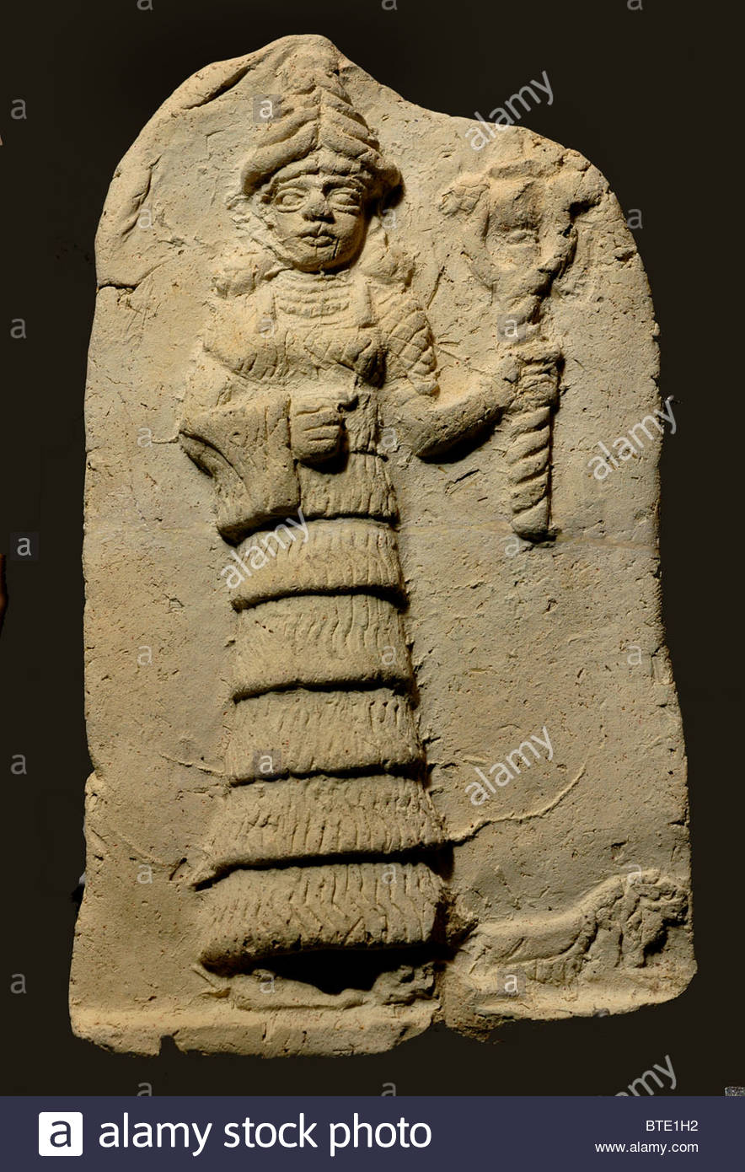
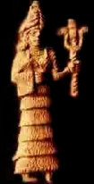
TERRA COTTA IMAGES OF ISHTAR
Ishtar, goddess of Babylon; clothed in red and purple; wearing pearls and golden arm rings; holding a gold cup or sometimes a gold cup, a purple fabric, and the scepter of the moon god, Sin. (crescent moon and star)

Slide 12
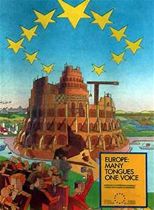
EU POSTER

Slide 13
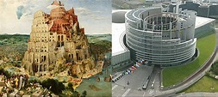
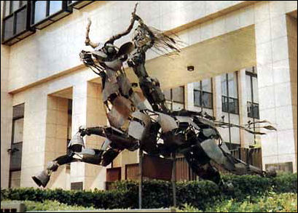
EU PARLIAMENT

Slide 14
THE HEADS
Revelation 17:9-11 "Here is the mind which has wisdom. The seven heads are seven mountains on which the woman sits, and they are seven kings; five have fallen, one is, the other has not yet come; and when he comes, he must remain a little while. The beast which was and is not, is himself also an eighth and is one of the seven, and he goes to destruction.
At the time John was writing:
FALLEN: Egypt, Assyria, Babylon, Medo-Persia,
Greece
IS: Rome
TO COME: Ten king federation rising out of Rome
The empowerment behind the Antichrist was previously empowering one of the seven
Babylon???

Slide 15
THE HORNS
Revelation 17:12-14 "The ten horns which you saw are ten kings who have not yet received a kingdom, but they receive authority as kings with the beast for one hour. These have one purpose, and they give their power and authority to the beast. These will wage war against the Lamb, and the Lamb will overcome them, because He is Lord of lords and King of kings, and those who are with Him are the called and chosen and faithful."
Daniel spoke of these kings in Daniel 7:24; the kings were rising out of the former Roman Empire
The antichrist was rising up to subdue 3 of them leaving 7 with himself an 8th
He will make alterations in times and law for 3 ½ years

