Slide 1
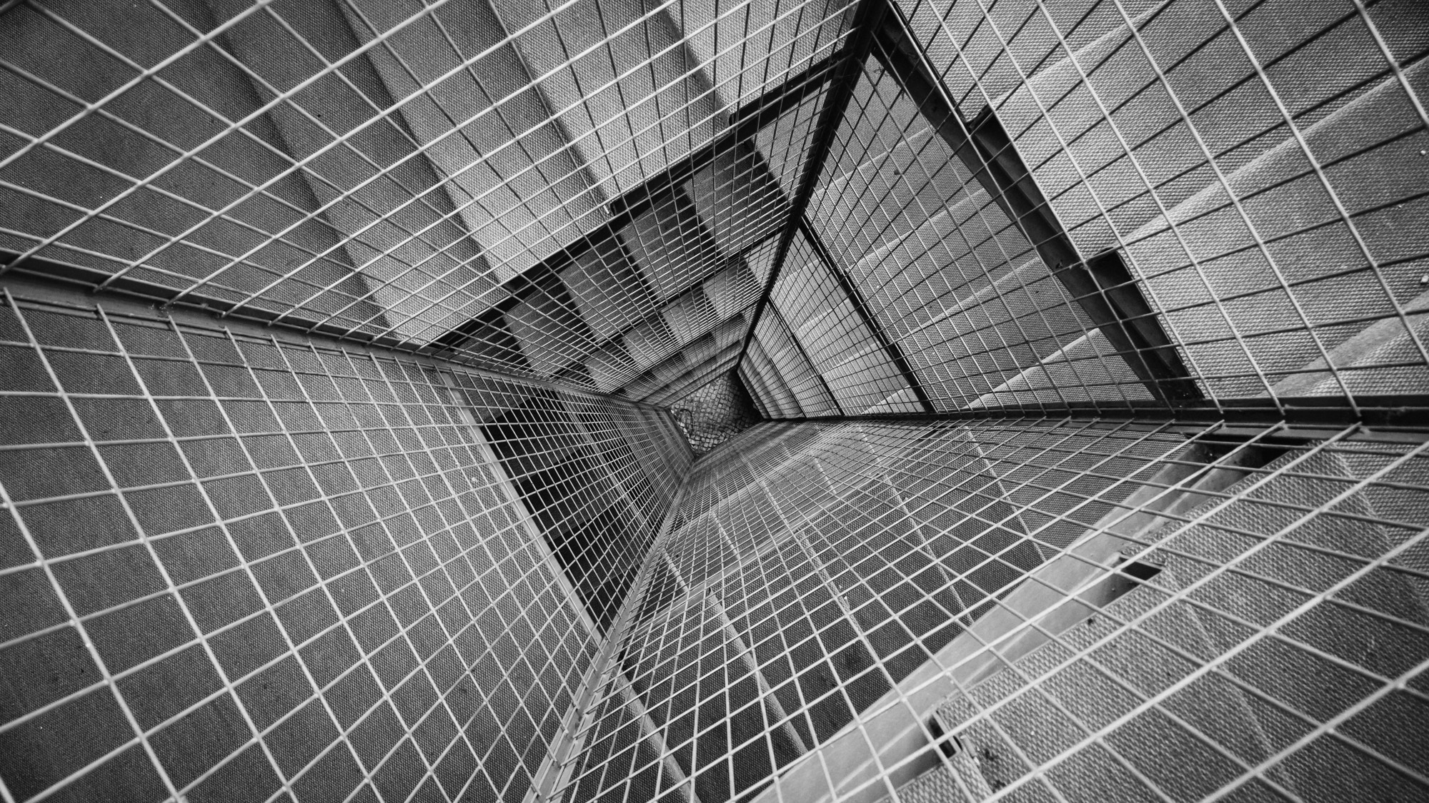
AN APOCALYPTIC
WORLD VIEW
JoLynn Gower
Fall 2020 LESSON 7
217-493-6151
jgower@guardingthetruth.org

Slide 2
VERSE FOR THE JOURNEY
2 Peter 3:11-13 Since all these things are to be destroyed in this way, what sort of people ought you to be in holy conduct and godliness, looking for and hastening the coming of the day of God, because of which the heavens will be destroyed by burning, and the elements will melt with intense heat! But according to His promise we are looking for new heavens and a new earth, in which righteousness dwells.
Promise: epangelma: a self-committal
Before the new heavens and new earth are a reality, there is an apocalypse: destruction and damage on a catastrophic scale

Slide 3
MEASURING THE CITY
Revelation 11:1-4 Then there was given me a measuring rod like a staff; and someone said, "Get up and measure the temple of God and the altar, and those who worship in it. Leave out the court which is outside the temple and do not measure it, for it has been given to the nations; and they will tread under foot the holy city for forty-two months. And I will grant authority to my two witnesses, and they will prophesy for twelve hundred and sixty days, clothed in sackcloth. These are the two olive trees and the two lampstands that stand before the Lord of the earth.
Fire from mouth kills enemies
Shut up sky – no rain (Elijah?)
Turn water to blood (Moses?)

Slide 4
THEIR DEATH
Revelation 11:7-10 When they have finished their testimony, the beast that comes up out of the abyss will make war with them, and overcome them and kill them. And their dead bodies will lie in the street of the great city which mystically is called Sodom and Egypt, where also their Lord was crucified. Those from the peoples and tribes and tongues and nations will look at their dead bodies for three and a half days, and will not permit their dead bodies to be laid in a tomb. And those who dwell on the earth will rejoice over them and celebrate; and they will send gifts to one another, because these two prophets tormented those who dwell on the earth.
After 3½ days they are called up to heaven in a cloud
Simultaneous with mid-trib rapture?

Slide 5
SEVENTH (LAST) TRUMPET
Revelation 11:15-18 Then the seventh angel sounded; and there were loud voices in heaven, saying, "The kingdom of the world has become the kingdom of our Lord and of His Christ; and He will reign forever and ever." And the twenty-four elders, who sit on their thrones before God, fell on their faces and worshiped God, saying, "We give You thanks, O Lord God, the Almighty, who are and who were, because You have taken Your great power and have begun to reign. And the nations were enraged, and Your wrath came, and the time came for the dead to be judged, and the time to reward Your bond-servants the prophets and the saints and those who fear Your name, the small and the great, and to destroy those who destroy the earth.“
Rapture?

Slide 6
ABOUT INTERLUDES
Interludes make interpretation difficult Woman clothed with the sun
Red dragon with 7 heads, 10 horns; sweeps away 1/3 angels
War between dragon and woman but the child is caught up to heaven
Woman flees to the wilderness
War between Michael and his angels and the dragon and his angels; the dragon loses and is confined to earth
Revelation 12:10-11 Then I heard a loud voice in heaven, saying, "Now the salvation, and the power, and the kingdom of our God and the authority of His Christ have come, for the accuser of our brethren has been thrown down, he who accuses them before our God day and night. And they overcame him because of the blood of the Lamb and because of the word of their testimony, and they did not love their life even when faced with death.

Slide 7
THE DRAGON REACTS
Revelation 12:13 And when the dragon saw that he was thrown down to the earth, he persecuted the woman who gave birth to the male child.
Revelation 12:17 So the dragon was enraged with the woman, and went off to make war with the rest of her children, who keep the commandments of God and hold to the testimony of Jesus.
Revelation 13:1 And the dragon stood on the sand of the seashore. Then I saw a beast coming up out of the sea having ten horns and seven heads; on his horns were ten diadems, and on his heads were blasphemous names.
Revelation 13:3 And the dragon gave him his power and his throne and great authority. I saw one of his heads as if it had been slain, and his fatal wound was healed. And the whole earth was amazed and followed after the beast;

Slide 8
THE FALSE TRINITY
Satan: false father
Beast: the antichrist
Revelation 13:4-7 …they worshiped the dragon because he gave his authority to the beast; and they worshiped the beast, saying, "Who is like the beast, and who is able to wage war with him?" There was given to him a mouth speaking arrogant words and blasphemies, and authority to act for forty-two months was given to him. And he opened his mouth in blasphemies against God, to blaspheme His name and His tabernacle, that is, those who dwell in heaven.
It was also given to him to make war with the saints and to overcome them, and authority over every tribe and people and tongue and nation was given to him.

Slide 9
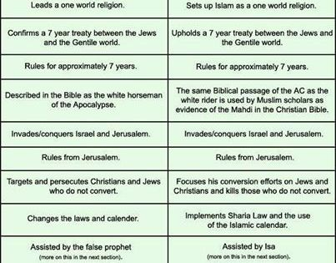
THE MAHDI

Slide 10
SECOND BEAST: FALSE HOLY SPIRIT
Revelation 13:8 All who dwell on the earth will worship him, everyone whose name has not been written from the foundation of the world in the book of life of the Lamb who has been slain.
Revelation 13:11-14 Then I saw another beast coming up out of the earth; and he had two horns like a lamb and he spoke as a dragon. He exercises all the authority of the first beast in his presence. And he makes the earth and those who dwell in it to worship the first beast, whose fatal wound was healed. He performs great signs, so that he even makes fire come down out of heaven to the earth in the presence of men. And he deceives those who dwell on the earth because of the signs which it was given him to perform in the presence of the beast, telling those who dwell on the earth to make an image to the beast who had the wound of the sword and has come to life.

Slide 11
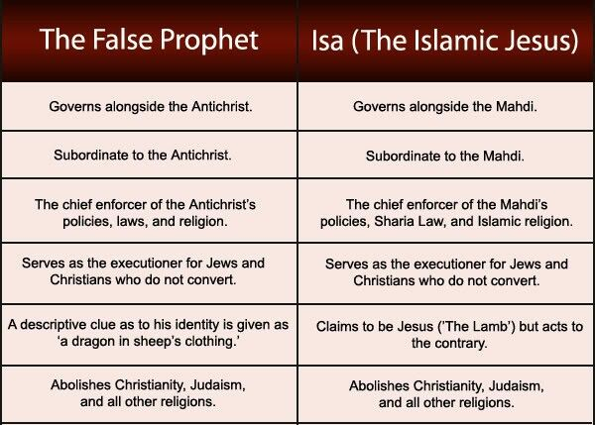

Slide 12
THE MARK OF THE BEAST
Revelation 13:15-17 And it was given to him to give breath to the image of the beast, so that the image of the beast would even speak and cause as many as do not worship the image of the beast to be killed. And he causes all, the small and the great, and the rich and the poor, and the free men and the slaves, to be given a mark on their right hand or on their forehead, and he provides that no one will be able to buy or to sell, except the one who has the mark, either the name of the beast or the number of his name.
Revelation 13:18 Here is wisdom. Let him who has understanding calculate the number of the beast, for the number is that of a man; and his number is six hundred and sixty-six.

Slide 13
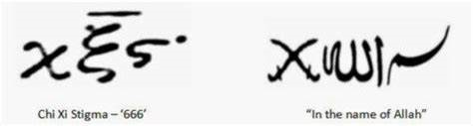
WAS JOHN CONFUSED?

Slide 14
THE NUMBER
Hebrew numerology is based on Hebrew numbers written by using letters of the Hebrew alphabet.
Each Hebrew letter corresponds to a number, with no notation for zero. (Mystics like this fact, deriving much homiletic material from it, not least, that since there is a G-d, there is never nothing …)
Because of this, numbers can spell words, and words add up to numerical values.
The first nine letters of the alphabet correspond to the Hebrew numbers 1-9. The next nine letters to the tens units (10-90), and the last 4 letters of the Hebrew alphabet to the first four hundreds (100-400). Numbers over 10 are formed by combining letters, whose numerical equivalents are added together
EXCEPTION: 15 and 16 (9+6, 9+7)

Slide 15
144,000 PICTURED IN HEAVEN
First fruits
Revelation 14:6-7 I saw another angel flying in midheaven, having an eternal gospel to preach to those who live on the earth, and to every nation and tribe and tongue and people; and he said with a loud voice, "Fear God, and give Him glory, because the hour of His judgment has come; worship Him who made the heaven and the earth and sea and springs of waters."
Matthew 24:12-14 "Because lawlessness is increased, most people's love will grow cold. But the one who endures to the end, he will be saved. This gospel of the kingdom shall be preached in the whole world as a testimony to all the nations, and then the end will come.

Slide 16
ABOMINATION OF DESOLATION
Revelation 14:8-10 And another angel, a second one, followed, saying, "Fallen, fallen is Babylon the great, she who has made all the nations drink of the wine of the passion of her immorality." Then another angel, a third one, followed them, saying with a loud voice, "If anyone worships the beast and his image, and receives a mark on his forehead or on his hand, he also will drink of the wine of the wrath of God, which is mixed in full strength in the cup of His anger; and he will be tormented with fire and brimstone in the presence of the holy angels and in the presence of the Lamb.
Matthew 24:15 "Therefore when you see the ABOMINATION OF DESOLATION which was spoken of through Daniel the prophet, standing in the holy place…

Slide 17
REAPING THE EARTH
Revelation 14:15-16 And another angel came out of the temple, crying out with a loud voice to Him who sat on the cloud, "Put in your sickle and reap, for the hour to reap has come, because the harvest of the earth is ripe." Then He who sat on the cloud swung His sickle over the earth, and the earth was reaped.
Revelation 14:18-19 Then another angel, the one who has power over fire, came out from the altar; and he called with a loud voice to him who had the sharp sickle, saying, "Put in your sharp sickle and gather the clusters from the vine of the earth, because her grapes are ripe." So the angel swung his sickle to the earth and gathered the clusters from the vine of the earth, and threw them into the great wine press of the wrath of God.

Slide 18
REAPING THE EARTH
Revelation 15:5-8 After these things I looked, and the temple of the tabernacle of testimony in heaven was opened, and the seven angels who had the seven plagues came out of the temple, clothed in linen, clean and bright, and girded around their chests with golden sashes. Then one of the four living creatures gave to the seven angels seven golden bowls full of the wrath of God, who lives forever and ever. And the temple was filled with smoke from the glory of God and from His power; and no one was able to enter the temple until the seven plagues of the seven angels were finished.
The final plague are poured out quickly
There is an interlude between the 6th and 7th bowls

