Slide 1
AN APOCALYPTIC WORLD VIEW
JoLynn Gower
Fall 2020 LESSON 6
217-493-6151
jgower@guardingthetruth.org

Slide 2
VERSE FOR THE JOURNEY
2 Peter 3:11-13 Since all these things are to be destroyed in this way, what sort of people ought you to be in holy conduct and godliness, looking for and hastening the coming of the day of God, because of which the heavens will be destroyed by burning, and the elements will melt with intense heat! But according to His promise we are looking for new heavens and a new earth, in which righteousness dwells.
Promise: epangelma: a self-committal
Before the new heavens and new earth are a reality, there is an apocalypse: destruction and damage on a catastrophic scale

Slide 3
SEALING THE 144,000
Revelation 7:2-3 And I saw another angel ascending from the rising of the sun, having the seal of the living God; and he cried out with a loud voice to the four angels to whom it was granted to harm the earth and the sea, saying, "Do not harm the earth or the sea or the trees until we have sealed the bond-servants of our God on their foreheads."
Revelation 7:9-10 After these things I looked, and behold, a great multitude which no one could count, from every nation and all tribes and peoples and tongues, standing before the throne and before the Lamb, clothed in white robes, and palm branches were in their hands; and they cry out with a loud voice, saying, "Salvation to our God who sits on the throne, and to the Lamb."

Slide 4
TENDED BY GOD
Revelation 7:14-17 I said to him, "My lord, you know." And he said to me, "These are the ones who come out of the great tribulation, and they have washed their robes and made them white in the blood of the Lamb. For this reason, they are before the throne of God; and they serve Him day and night in His temple; and He who sits on the throne will spread His tabernacle over them. They will hunger no longer, nor thirst anymore; nor will the sun beat down on them, nor any heat; for the Lamb in the center of the throne will be their shepherd, and will guide them to springs of the water of life; and God will wipe every tear from their eyes."
Revelation 8:1 When the Lamb broke the seventh seal, there was silence in heaven for about half an hour.

Slide 5
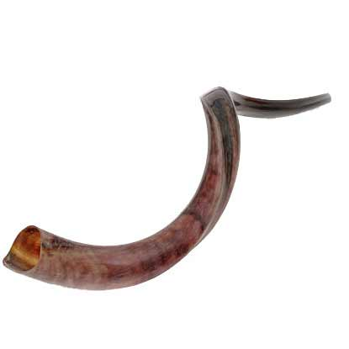
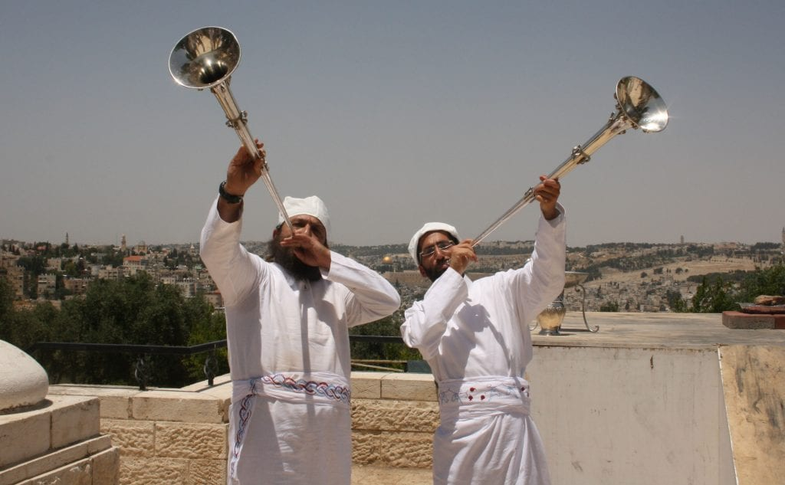

Slide 6
THE TRUMPETS/PRAYER
Revelation 8:2-5 And I saw the seven angels who stand before God, and seven trumpets were given to them. Another angel came and stood at the altar, holding a golden censer; and much incense was given to him, so that he might add it to the prayers of all the saints on the golden altar which was before the throne. And the smoke of the incense, with the prayers of the saints, went up before God out of the angel's hand. Then the angel took the censer and filled it with the fire of the altar, and threw it to the earth; and there followed peals of thunder and sounds and flashes of lightning and an earthquake.
Revelation 8:7 The first sounded, and there came hail and fire, mixed with blood, and they were thrown to the earth; and a third of the earth was burned up, and a third of the trees were burned up, and all the green grass was burned up.

Slide 7
A THIRD (OF ¾)
Revelation 8:8-12 The second angel sounded, and something like a great mountain burning with fire was thrown into the sea; and a third of the sea became blood, and a third of the creatures which were in the sea and had life, died; and a third of the ships were destroyed. The third angel sounded, and a great star fell from heaven, burning like a torch, and it fell on a third of the rivers and on the springs of waters. The name of the star is called Wormwood; and a third of the waters became wormwood, and many men died from the waters, because they were made bitter. The fourth angel sounded, and a third of the sun and a third of the moon and a third of the stars were struck, so that a third of them would be darkened and the day would not shine for a third of it, and the night in the same way.

Slide 8
THREE WOES
Revelation 8:13 Then I looked, and I heard an eagle flying in midheaven, saying with a loud voice, "Woe, woe, woe to those who dwell on the earth, because of the remaining blasts of the trumpet of the three angels who are about to sound!"
1ST woe at 9:12
2nd woe at 11:14
3rd woe 12:12?
Revelation 9:1-2 Then the fifth angel sounded, and I saw a star from heaven which had fallen to the earth; and the key of the bottomless pit was given to him. He opened the bottomless pit, and smoke went up out of the pit, like the smoke of a great furnace; and the sun and the air were darkened by the smoke of the pit.
Who is in the pit (abyss)? Why are they there?

Slide 9
A THIRD OF MANKIND
Revelation 9:13-18 Then the sixth angel sounded, and I heard a voice from the four horns of the golden altar which is before God, one saying to the sixth angel who had the trumpet, "Release the four angels who are bound at the great river Euphrates." And the four angels, who had been prepared for the hour and day and month and year, were released, so that they would kill a third of mankind. The number of the armies of the horsemen was two hundred million; I heard the number of them. And this is how I saw in the vision the horses and those who sat on them: the riders had breastplates the color of fire and of hyacinth and of brimstone; and the heads of the horses are like the heads of lions; and out of their mouths proceed fire and smoke and brimstone. A third of mankind was killed by these three plagues, by the fire and the smoke and the brimstone which proceeded out of their mouths.

Slide 10
STRONG ANGEL
Revelation 10:1-4 I saw another strong angel coming down out of heaven, clothed with a cloud; and the rainbow was upon his head, and his face was like the sun, and his feet like pillars of fire; and he had in his hand a little book which was open. He placed his right foot on the sea and his left on the land; and he cried out with a loud voice, as when a lion roars; and when he had cried out, the seven peals of thunder uttered their voices. When the seven peals of thunder had spoken, I was about to write; and I heard a voice from heaven saying, "Seal up the things which the seven peals of thunder have spoken and do not write them."
Daniel 12:7 I heard the man dressed in linen, who was above the waters of the river, as he raised his right hand and his left toward heaven, and swore by Him who lives forever that it would be for a time, times, and half a time;

Slide 11
SEVENTH TRUMPET
Revelation 10:5-7 Then the angel whom I saw standing on the sea and on the land lifted up his right hand to heaven, and swore by Him who lives forever and ever, WHO CREATED HEAVEN AND THE THINGS IN IT, AND THE EARTH AND THE THINGS IN IT, AND THE SEA AND THE THINGS IN IT, that there will be delay no longer, but in the days of the voice of the seventh angel, when he is about to sound, then the mystery of God is finished, as He preached to His servants the prophets.
1 Corinthians 15:51-52 Behold, I tell you a mystery; we will not all sleep, but we will all be changed, in a moment, in the twinkling of an eye, at the last trumpet; for the trumpet will sound, and the dead will be raised imperishable, and we will be changed.

Slide 12
THE MYSTERY
Mark 4:10-11 As soon as He was alone, His followers, along with the twelve, began asking Him about the parables. And He was saying to them, "To you has been given the mystery of the kingdom of God, but those who are outside get everything in parables…
Romans 16:25-27 Now to Him who is able to establish you according to my gospel and the preaching of Jesus Christ, according to the revelation of the mystery which has been kept secret for long ages past, but now is manifested, and by the Scriptures of the prophets, according to the commandment of the eternal God, has been made known to all the nations, leading to obedience of faith; to the only wise God, through Jesus Christ, be the glory forever. Amen.

Slide 13
SUPREMACY OF THE WORD
Revelation 10:8-11 Then the voice which I heard from heaven, I heard again speaking with me, and saying, "Go, take the book which is open in the hand of the angel who stands on the sea and on the land." So I went to the angel, telling him to give me the little book. And he said to me, "Take it and eat it; it will make your stomach bitter, but in your mouth it will be sweet as honey." I took the little book out of the angel's hand and ate it, and in my mouth it was sweet as honey; and when I had eaten it, my stomach was made bitter. And they said to me, "You must prophesy again concerning many peoples and nations and tongues and kings."

