Slide 1
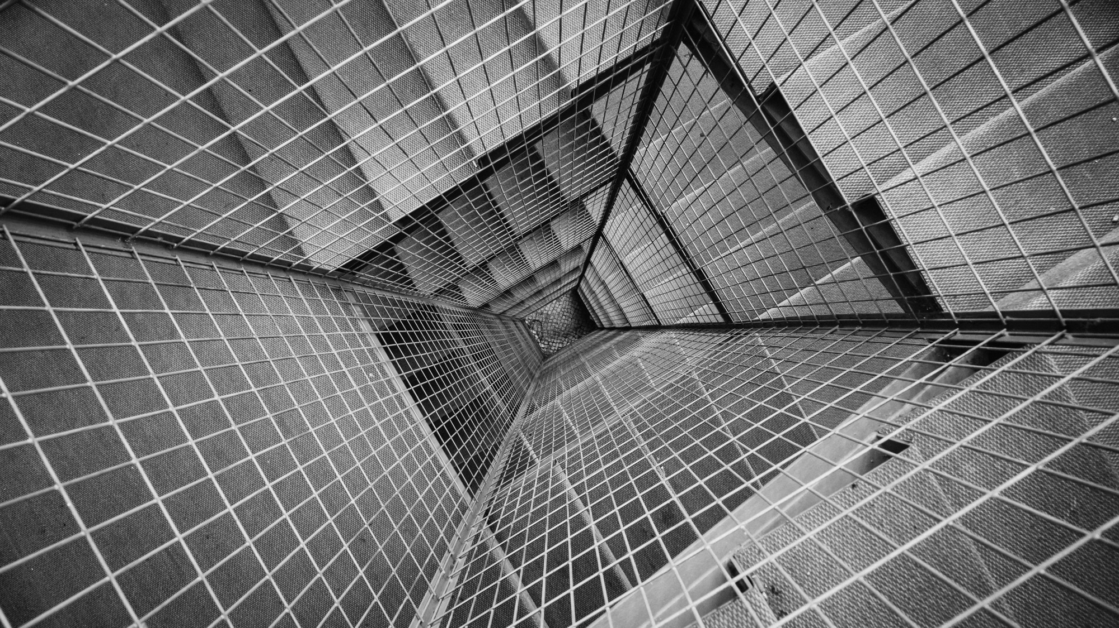
AN APOCALYPTIC
WORLD VIEW
JoLynn Gower
Fall 2020 LESSON 5
217-493-6151
jgower@guardingthetruth.org

Slide 2
VERSE FOR THE JOURNEY
2 Peter 3:11-13 Since all these things are to be destroyed in this way, what sort of people ought you to be in holy conduct and godliness, looking for and hastening the coming of the day of God, because of which the heavens will be destroyed by burning, and the elements will melt with intense heat! But according to His promise we are looking for new heavens and a new earth, in which righteousness dwells.
Promise: epangelma: a self-committal
Before the new heavens and new earth are a reality, there is an apocalypse: destruction and damage on a catastrophic scale

Slide 3
HEAVENLY DESCRIPTION
Revelation 4:2-4 Immediately I was in the Spirit; and behold, a throne was standing in heaven, and One sitting on the throne. And He who was sitting was like a jasper stone and a sardius in appearance; and there was a rainbow around the throne, like an emerald in appearance. Around the throne were twenty-four thrones; and upon the thrones I saw twenty-four elders sitting, clothed in white garments, and golden crowns on their heads.
Revelation 4:6-8 …and before the throne there was something like a sea of glass, like crystal; and in the center and around the throne, four living creatures full of eyes in front and behind. The first creature was like a lion, and the second creature like a calf, and the third creature had a face like that of a man, and the fourth creature was like a flying eagle. And the four living creatures, each one of them having six wings, are full of eyes around and within;

Slide 4
A SEALED BOOK
Revelation 5:1-3 I saw in the right hand of Him who sat on the throne a book written inside and on the back, sealed up with seven seals. And I saw a strong angel proclaiming with a loud voice, "Who is worthy to open the book and to break its seals?" And no one in heaven or on the earth or under the earth was able to open the book or to look into it.
Revelation 5:5… and one of the elders said to me, "Stop weeping; behold, the Lion that is from the tribe of Judah, the Root of David, has overcome so as to open the book and its seven seals."
Revelation 5:9-10 And they *sang a new song, saying, "Worthy are You to take the book and to break its seals; for You were slain, and purchased for God with Your blood men from every tribe and tongue and people and nation.
You have made them to be a kingdom and priests to our God; and they will reign upon the earth.

Slide 5
HEAVENLY WORSHIP
Revelation 5:12-14 saying with a loud voice, "Worthy is the Lamb that was slain to receive power and riches and wisdom and might and honor and glory and blessing."
And every created thing which is in heaven and on the earth and under the earth and on the sea, and all things in them, I heard saying, "To Him who sits on the throne, and to the Lamb, be blessing and honor and glory and dominion forever and ever." And the four living creatures kept saying, "Amen." And the elders fell down and worshiped.
They are ascribing worth to Jesus: only He can break the seal on the book because he is the rightful owner of everything
Chapters 4 and 5 affirm that the world isn’t under the control of some mindless fate; our future is in the hands of a Father who loves us and a Savior who died for us

Slide 6
THE SEVEN SEALS
Introduce the 4 horsemen of the apocalypse
White, Red, Black and Yellowish/green
Revelation 6:1-3 Then I saw when the Lamb broke one of the seven seals, and I heard one of the four living creatures saying as with a voice of thunder, "Come." I looked, and behold, a white horse, and he who sat on it had a bow; and a crown was given to him, and he went out conquering and to conquer.
Was given: didomi: to give or grant something to someone
The living creatures call out the four horsemen; heaven is giving permission to these horsemen
The intent of the first horseman is domination
This is the Antichrist; in the future we will look at the Islamic Mahdi, who also rides in on a white horse

Slide 7
SEAL #2
Revelation 6:3-4 When He broke the second seal, I heard the second living creature saying, "Come." And another, a red horse, went out; and to him who sat on it, it was granted to take peace from the earth, and that men would slay one another; and a great sword was given to him.
Granted: didomi: given by someone
This horseman ushers in war – people killing each other
He was given a large sword: megas machaira: a short sword or dagger used in hand-to-hand combat
In prophetic terms, a sword usually represents judgment
In prophetic terms, red usually represents war

Slide 8
SEAL #3
Revelation 6:5-6 When He broke the third seal, I heard the third living creature saying, "Come." I looked, and behold, a black horse; and he who sat on it had a pair of scales in his hand. And I heard something like a voice in the center of the four living creatures saying, "A quart of wheat for a denarius, and three quarts of barley for a denarius; and do not damage the oil and the wine.”
Black is the color associated with death
The result of war is often famine or hyper-inflation
A denarius was a day’s wage; nothing would be left over to buy oil or wine, which were also important commodities

Slide 9
SEAL #4
Revelation 6:7-8 When the Lamb broke the fourth seal, I heard the voice of the fourth living creature saying, "Come." I looked, and behold, an ashen horse; and he who sat on it had the name Death; and Hades was following with him. Authority was given to them over a fourth of the earth, to kill with sword and with famine and with pestilence and by the wild beasts of the earth.
Ashen: cloros: pale yellowish green
Pestilence: thanatos: death
Wild beasts: therion: an untamed animal that naturally exists in the wild
Wild beasts could include large and small animals as well as disease bearing insects: ticks, spiders, bees

Slide 10
SEAL #5
Revelation 6:9-11 When the Lamb broke the fifth seal, I saw underneath the altar the souls of those who had been slain because of the word of God, and because of the testimony which they had maintained;
and they cried out with a loud voice, saying, "How long, O Lord, holy and true, will You refrain from judging and avenging our blood on those who dwell on the earth? And there was given to each of them a white robe; and they were told that they should rest for a little while longer, until the number of their fellow servants and their brethren who were to be killed even as they had been, would be completed also.
Leviticus 4:34 'The priest is to take some of the blood of the sin offering with his finger and put it on the horns of the altar of burnt offering, and all the rest of its blood he shall pour out at the base of the altar.

Slide 11
SEAL #6
Revelation 6:12-17 I looked when He broke the sixth seal, and there was a great earthquake; and the sun became black as sackcloth made of hair, and the whole moon became like blood; and the stars of the sky fell to the earth, as a fig tree casts its unripe figs when shaken by a great wind. The sky was split apart like a scroll when it is rolled up, and every mountain and island were moved out of their places. Then the kings of the earth and the great men and the commanders and the rich and the strong and every slave and free man hid themselves in the caves and among the rocks of the mountains; and they said to the mountains and to the rocks, "Fall on us and hide us from the presence of Him who sits on the throne, and from the wrath of the Lamb; for the great day of their wrath has come, and who is able to stand?"

Slide 12
SEALING THE 144,000
Revelation 7:1-3 After this I saw four angels standing at the four corners of the earth, holding back the four winds of the earth, so that no wind would blow on the earth or on the sea or on any tree. And I saw another angel ascending from the rising of the sun, having the seal of the living God; and he cried out with a loud voice to the four angels to whom it was granted to harm the earth and the sea, saying, "Do not harm the earth or the sea or the trees until we have sealed the bond-servants of our God on their foreheads.“
Who are these people? Would Christians need a seal?
Ephesians 1:13 In Him, you also, after listening to the message of truth, the gospel of your salvation—having also believed, you were sealed in Him with the Holy Spirit of promise,

