Slide 1


Slide 2
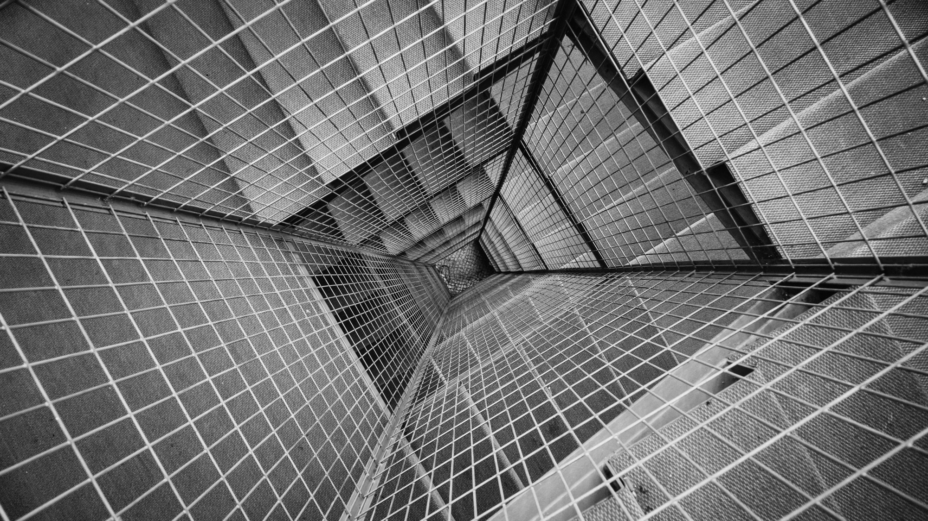
AN APOCALYPTIC
WORLD VIEW
JoLynn Gower
Fall 2020 LESSON 10
217-493-6151
jgower@guardingthetruth.org

Slide 3
VERSE FOR THE JOURNEY
2 Peter 3:11-13 Since all these things are to be destroyed in this way, what sort of people ought you to be in holy conduct and godliness, looking for and hastening the coming of the day of God, because of which the heavens will be destroyed by burning, and the elements will melt with intense heat! But according to His promise we are looking for new heavens and a new earth, in which righteousness dwells.
Promise: epangelma: a self-committal
Before the new heavens and new earth are a reality, there is an apocalypse: destruction and damage on a catastrophic scale

Slide 4
SATAN BOUND
The Antichrist and the False Holy Spirit have been condemned directly to the lake of fire
Revelation 20:1-3 Then I saw an angel coming down from heaven, holding the key of the abyss and a great chain in his hand. And he laid hold of the dragon, the serpent of old, who is the devil and Satan, and bound him for a thousand years; and he threw him into the abyss, and shut it and sealed it over him, so that he would not deceive the nations any longer, until the thousand years were completed; after these things he must be released for a short time.
Revelation 1:17-18…He placed His right hand on me, saying, "Do not be afraid; I am the first and the last, and the living One; and I was dead, and behold, I am alive forevermore, and I have the keys of death and of Hades.

Slide 5
ORDER OF EVENTS
RAPTURE: saved people up to this time
FIRST RESURRECTION: saved between rapture and second coming
Revelation 20:4-6 Then I saw thrones, and they sat on them, and judgment was given to them. I saw the souls of those who had been beheaded because of their testimony of Jesus and because of the word of God, and those who had not worshiped the beast or his image, and had not received the mark on their forehead and on their hand; they came to life and reigned with Christ for a thousand years. The rest of the dead did not come to life until the thousand years were completed. This is the first resurrection. Blessed and holy is the one who has a part in the first resurrection; over these the second death has no power…
GREAT WHITE THRONE RESURRECTION: unsaved dead; happens at the end of the millennium

Slide 6
WHERE ARE THE 1000 YEARS?
Revelation 20:7-10 When the thousand years are completed, Satan will be released from his prison, and will come out to deceive the nations which are in the four corners of the earth, Gog and Magog, to gather them together for the war; the number of them is like the sand of the seashore. And they came up on the broad plain of the earth and surrounded the camp of the saints and the beloved city, and fire came down from heaven and devoured them. The devil who deceived them was thrown into the lake of fire and brimstone, where the beast and the false prophet are also; and they will be tormented day and night forever and ever.
What happens during the 1000 year reign of Christ? Apparently we don’t need to know!

Slide 7
GREAT WHITE THRONE
Revelation 20:11-15 Then I saw a great white throne and Him who sat upon it, from whose presence earth and heaven fled away, and no place was found for them. And I saw the dead, the great and the small, standing before the throne, and books were opened; and another book was opened, which is the book of life; and the dead were judged from the things which were written in the books, according to their deeds. And the sea gave up the dead which were in it, and death and Hades gave up the dead which were in them; they were judged, every one of them according to their deeds. Then death and Hades were thrown into the lake of fire. This is the second death, the lake of fire. And if anyone's name was not found written in the book of life, he was thrown into the lake of fire.

Slide 8
MAKING THINGS NEW
NEW HEAVENS: …according to His promise we are looking for new heavens and a new earth, in which righteousness dwells.
2 Peter 3:7 But by His word the present heavens and earth are being reserved for fire, kept for the day of judgment and destruction of ungodly men.
2 Peter 3:10 But the day of the Lord will come like a thief, in which the heavens will pass away with a roar and the elements will be destroyed with intense heat, and the earth and its works will be burned up.
Pass away: parachermai: to come near or beside
Isaiah 34:4 And all the host of heaven will wear away, And the sky will be rolled up like a scroll;
Revelation 6:14 The sky was split apart like a scroll when it is rolled up…

Slide 9
NEW HEAVEN AND EARTH
Revelation 21:1-2 Then I saw a new heaven and a new earth; for the first heaven and the first earth passed away, and there is no longer any sea. And I saw the holy city, new Jerusalem, coming down out of heaven from God, made ready as a bride adorned for her husband.
New: kainos: fresh: to refresh or refurbish
Naos would be used if age were in mind
Revelation 21:4-6 …and He will wipe away every tear from their eyes; and there will no longer be any death; there will no longer be any mourning, or crying, or pain; the first things have passed away." He who sits on the throne said, "Behold, I am making all things new." And He said, "Write, for these words are faithful and true." Then He said to me, "It is done. I am the Alpha and the Omega, the beginning and the end. I will give to the one who thirsts from the spring of the water of life without cost.

Slide 10
SECOND DEATH
Revelation 20:14-15 Then death and Hades were thrown into the lake of fire. This is the second death, the lake of fire. And if anyone's name was not found written in the book of life, he was thrown into the lake of fire.
Revelation 21:7-8 "He who overcomes will inherit these things, and I will be his God and he will be My son. But for the cowardly and unbelieving and abominable and murderers and immoral persons and sorcerers and idolaters and all liars, their part will be in the lake that burns with fire and brimstone, which is the second death.”
BORN ONCE – DIE TWICE
BORN TWICE – DIE ONCE

Slide 11
HERE COMES THE BRIDE
Revelation 21:9-14 Then one of the seven angels who had the seven bowls full of the seven last plagues came and spoke with me, saying, "Come here, I will show you the bride, the wife of the Lamb." And he carried me away in the Spirit to a great and high mountain, and showed me the holy city, Jerusalem, coming down out of heaven from God, having the glory of God. Her brilliance was like a very costly stone, as a stone of crystal-clear jasper. It had a great and high wall, with twelve gates, and at the gates twelve angels; names were written on them, which are the names of the twelve tribes of the sons of Israel. There were three gates on the east and three gates on the north and three gates on the south and three gates on the west. And the wall of the city had twelve foundation stones, and on them were the twelve names of the twelve apostles of the Lamb.

Slide 12
PEARLY GATES!
Revelation 21:16-21 The city is laid out as a square, and its length is as great as the width; he measured the city with the rod, fifteen hundred miles; its length and width and height are equal. He measured its wall, seventy-two yards, according to human measurements, which are also angelic measurements. The material of the wall was jasper; the city was pure gold, like clear glass. The foundation stones of the city wall were adorned with every kind of precious stone. The first foundation stone was jasper; the second, sapphire; the third, chalcedony; the fourth, emerald; the fifth, sardonyx; the sixth, sardius; the seventh, chrysolite; the eighth, beryl; the ninth, topaz; the tenth, chrysoprase; the eleventh, jacinth; the twelfth, amethyst. The twelve gates were twelve pearls; each of the gates was a single pearl.The street of the city was pure gold, like transparent glass.

Slide 13
NO TEMPLE
Revelation 21:22-27 I saw no temple in it, for the Lord God the Almighty and the Lamb are its temple.
And the city has no need of the sun or of the moon to shine on it, for the glory of God has illumined it, and its lamp is the Lamb. The nations will walk by its light, and the kings of the earth will bring their glory into it.
In the daytime (for there will be no night there) its gates will never be closed; and they will bring the glory and the honor of the nations into it; and nothing unclean, and no one who practices abomination and lying, shall ever come into it, but only those whose names are written in the Lamb's book of life.
ONLY SAVED PEOPLE WILL BE THERE

Slide 14
TREE OF LIFE
Revelation 22:1-4 Then he showed me a river of the water of life, clear as crystal, coming from the throne of God and of the Lamb, in the middle of its street. On either side of the river was the tree of life, bearing twelve kinds of fruit, yielding its fruit every month; and the leaves of the tree were for the healing of the nations. There will no longer be any curse; and the throne of God and of the Lamb will be in it, and His bond-servants will serve Him; they will see His face, and His name will be on their foreheads.
Genesis 3:22 Then the LORD God said, "Behold, the man has become like one of Us, knowing good and evil; and now, he might stretch out his hand, and take also from the tree of life, and eat, and live forever"—

Slide 15
LIVE FOREVER
Genesis 3:24 So He drove the man out; and at the east of the garden of Eden He stationed the cherubim and the flaming sword which turned every direction to guard the way to the tree of life.
GOD DID NOT WANT PEOPLE TO LIVE FOREVER IN A STATE OF SIN/SEPARATION FROM HIM
Revelation 22:3-5 There will no longer be any curse; and the throne of God and of the Lamb will be in it; His bond-servants will serve Him; they will see His face, and His name will be on their foreheads. There will no longer be any night; and they will not have need of the light of a lamp nor the light of the sun, because the Lord God will illumine them; and they will reign forever and ever.
Revelation 22:7 "And behold, I am coming quickly. Blessed is he who heeds the words of the prophecy…

Slide 16
IMPORTANCE
Revelation 22:10-15 And he said to me, "Do not seal up the words of the prophecy of this book, for the time is near. Let the one who does wrong, still do wrong; and the one who is filthy, still be filthy; and let the one who is righteous, still practice righteousness; and the one who is holy, still keep himself holy. Behold, I am coming quickly, and My reward is with Me, to render to every man according to what he has done.
I am the Alpha and the Omega, the first and the last, the beginning and the end. Blessed are those who wash their robes, so that they may have the right to the tree of life, and may enter by the gates into the city. Outside are the dogs and the sorcerers and the immoral persons and the murderers and the idolaters, and everyone who loves and practices lying.

Slide 17
CONCLUSION
Revelation 22:16-21 "I, Jesus, have sent My angel to testify to you these things for the churches. I am the root and the descendant of David, the bright morning star. The Spirit and the bride say, "Come." And let the one who hears say, "Come." Let the one who is thirsty come; let the one who wishes take the water of life without cost. I testify to everyone who hears the words of the prophecy of this book: if anyone adds to them, God will add to him the plagues which are written in this book; and if anyone takes away from the words of the book of this prophecy, God will take away his part from the tree of life and from the holy city, which are written in this book. He who testifies to these things says, "Yes, I am coming quickly." Amen. Come, Lord Jesus. The grace of the Lord Jesus be with all. Amen.

