Slide 1
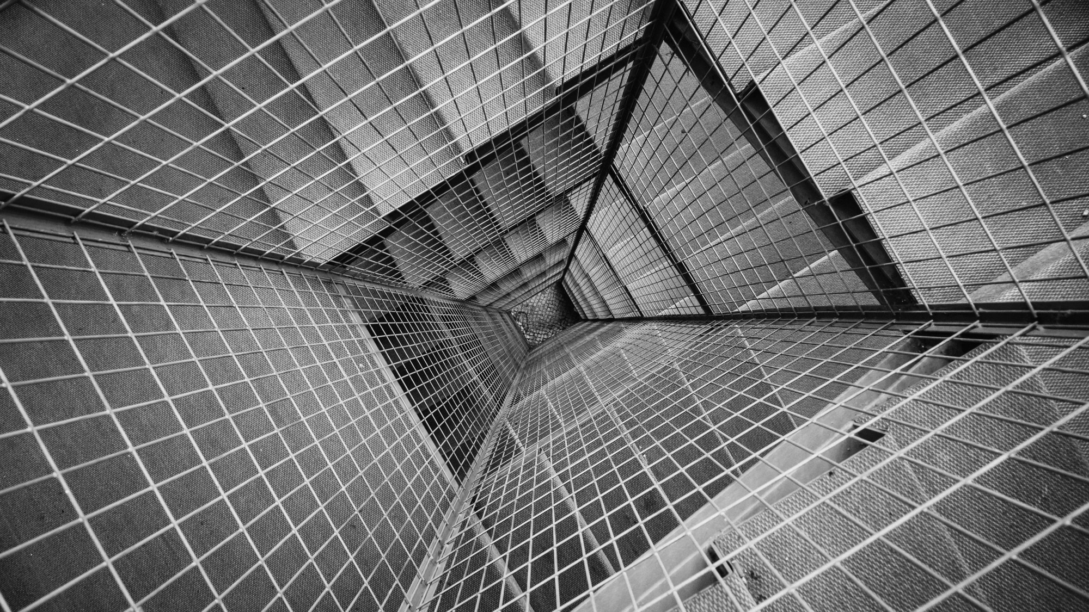
AN APOCALYPTIC
WORLD VIEW
JoLynn Gower
Fall 2020 LESSON 3
217-493-6151
jgower@guardingthetruth.org

Slide 2
VERSE FOR THE JOURNEY
2 Peter 3:11-13 Since all these things are to be destroyed in this way, what sort of people ought you to be in holy conduct and godliness, looking for and hastening the coming of the day of God, because of which the heavens will be destroyed by burning, and the elements will melt with intense heat! But according to His promise we are looking for new heavens and a new earth, in which righteousness dwells.
Promise: epangelma: a self-committal
Before the new heavens and new earth are a reality, there is an apocalypse: destruction and damage on a catastrophic scale

Slide 3
DANIEL 9 PROPHECY
Before or after the Lion’s Den? Most think before
Daniel 9:1-2 In the first year of Darius the son of Ahasuerus, of Median descent, who was made king over the kingdom of the Chaldeans— in the first year of his reign, I, Daniel, observed in the books the number of the years which was revealed as the word of the LORD to Jeremiah the prophet for the completion of the desolations of Jerusalem, namely, seventy years. 538 BC
Jeremiah 29:10-11…thus says the LORD, 'When seventy years have been completed for Babylon, I will visit you and fulfill My good word to you, to bring you back to this place.
2 Chronicles 36:20-21 …to fulfill the word of the LORD by the mouth of Jeremiah, until the land had enjoyed its sabbaths. All the days of its desolation it kept sabbath until seventy years were complete.

Slide 4
THE PRAYER
Daniel 9:7-10,20-21 "Righteousness belongs to You, O Lord, but to us open shame, as it is this day—to the men of Judah, the inhabitants of Jerusalem and all Israel, those who are nearby and those who are far away in all the countries to which You have driven them, because of their unfaithful deeds which they have committed against You. Open shame belongs to us, O Lord, to our kings, our princes and our fathers, because we have sinned against You. To the Lord our God belong com-passion and forgiveness, for we have rebelled against Him; nor have we obeyed the voice of the LORD our God, to walk in His teachings which He set before us through His servants the prophets.While I was speaking and praying, confessing my sin and the sin of my people Israel, and presenting my suppli-cation before the LORD my God in behalf of the holy mountain of my God, while I was still speaking in prayer, then the man Gabriel, whom I had seen in the vision previously, came to me in my extreme weariness about the time of the evening offering.

Slide 5
THE PROPHECY
Daniel 9:24-25 “Seventy weeks have been decreed for your people and your holy city, to finish the transgression, to make an end of sin, to make atonement for iniquity, to bring in everlasting righteousness, to seal up vision and prophecy and to anoint the most holy place. So you are to know and discern that from the issuing of a decree to restore and rebuild Jerusalem until Messiah the Prince there will be seven weeks and sixty-two weeks; it will be built again, with plaza and moat, even in times of distress.”
Daniel 9:26 "after the sixty-two weeks the Messiah will be cut off and have nothing, and the people of the prince who is to come will destroy the city and the sanctuary. And its end will come with a flood; even to the end there will be war; desolations are determined.”

Slide 6
TIMING
Week: shabua: period of seven
7 WEEKS = 49 YEARS
62 WEEKS = 434 YEARS
1 WEEK = 7 YEARS
483 years after the decree, the Messiah will be cut off
2 decrees to consider: Cyrus, 535 BC
Artaxerxes, 444 BC
Counting years is difficult: leap years 3,6,8,11,14,17,19
Rome destroyed the city and sanctuary in 70 AD
The “prince who is to come” must come from or be affiliated in some way with Rome
Rome destroyed Jerusalem and the temple in 70 AD

Slide 7
ACTIONS BY THE PRINCE
Daniel 9:27 "And he will make a firm covenant with the many for one week, but in the middle of the week he will put a stop to sacrifice and grain offering; and on the wing of abominations will come one who makes desolate, even until a complete destruction, one that is decreed, is poured out on the one who makes desolate."
This “week” is the last seven years, also called “the Tribulation.”
7 year agreement; 3 ½ year point it’s broken
Abomination of desolation is set up
2 Thessalonians 2:3-4 Let no one in any way deceive you, for it will not come unless the apostasy comes first, and the man of lawlessness is revealed, the son of destruction, who opposes and exalts himself above every so-called god or object of worship, so that he takes his seat in the temple of God, displaying himself as being God.

Slide 8
A TEMPLE?
Ezekiel 37:26-28 "I will make a covenant of peace with them; it will be an everlasting covenant with them. And I will place them and multiply them, and will set My sanctuary in their midst forever. My dwelling place also will be with them; and I will be their God, and they will be My people. And the nations will know that I am the LORD who sanctifies Israel, when My sanctuary is in their midst forever.”
Revelation 21:22-23 I saw no temple in it, for the Lord God the Almighty and the Lamb are its temple.
Zechariah 6:15 "Those who are far off will come and build the temple of the LORD. Then you will know that the LORD of hosts has sent me to you. And it will take place if you completely obey the LORD your God.”

Slide 9
BRANCH—PRIEST AND KING
Zechariah 6:12-13 "Then say to him, 'Thus says the LORD of hosts, "Behold, a man whose name is Branch, for He will branch out from where He is; and He will build the temple of the LORD. "Yes, it is He who will build the temple of the LORD, and He who will bear the honor and sit and rule on His throne. Thus, He will be a priest on His throne, and the counsel of peace will be between the two offices
Jeremiah 23:5 "Behold, the days are coming," declares the LORD, "When I will raise up for David a righteous Branch; And He will reign as king and act wisely and do justice and righteousness in the land.”
Two prophecies by Ezekiel that we can’t place in time:
1. Ezekiel’s war
2. Temple built

