Slide 1
ANOTHER HELPER
JoLynn Gower
493-6151
jgower@guardingthetruth.org

Slide 2
INTRODUCTION
John 14:16-17 I will ask the Father and He will give you another Helper, that He may be with you forever; that is the Spirit of truth whom the world cannot receive, because it does not see Him or know Him, but you know Him because he abides with you and will be in you.
Today we are going to think about walking as he walked
1 John 2:3-6 By this we know that we have come to know Him, if we keep His commandments. The one who says, "I have come to know Him," and does not keep His commandments, is a liar, and the truth is not in him; but whoever keeps His word, in him the love of God has truly been perfected. By this we know that we are in Him: the one who says he abides in Him ought himself to walk in the same manner as He walked.

Slide 3
ABOUT RELATIONSHIP
Jesus gave us some beautiful examples of relationship with him
Jesus is the vine
God is the vinedresser
We are the branches
John 15:2 “Every branch in Me that does not bear fruit, He takes away; and every branch that bears fruit, He prunes it so that it may bear more fruit.”
This is a branch “in Him”
Takes away: airo: to lift, to raise, to take up
Pruned: kathairo: to clean; to cut away what is not needed
Jesus lifts us up and prunes away what is not needed so that we bear maximum amounts of fruit

Slide 4
MAKE A CHOICE
John 15:3-5 “You are already clean because of the word which I have spoken to you. Abide in Me, and I in you. As the branch cannot bear fruit of itself unless it abides in the vine, so neither can you unless you abide in Me. I am the vine, you are the branches; he who abides in Me and I in him, he bears much fruit, for apart from Me you can do nothing.”
The disciples don’t need to be lifted up – they are already clean
But they do need to stay with Jesus so that they will bear fruit
John 15:6 “If anyone does not abide in Me, he is thrown away as a branch and dries up; and they gather them, and cast them into the fire and they are burned.”
There is a choice: stay with him or be burned

Slide 5
LET GOD BE IN CHARGE
Isaiah 41:9-10 You whom I have taken from the ends of the earth, and called from its remotest parts and said to you, 'You are My servant, I have chosen you and not rejected you. Do not fear, for I am with you; Do not anxiously look about you, for I am your God. I will strengthen you, surely I will help you, surely I will uphold you with My righteous right hand.’
Isaiah 46:9-10 "Remember the former things long past, for I am God, and there is no other; I am God, and there is no one like Me,
declaring the end from the beginning, and from ancient times things which have not been done, saying, 'My purpose will be established, and I will accomplish all My good pleasure.’
God is in charge; He will do what is best for you

Slide 6
MATCHING THE ASSIGNMENT
One of the most amazing things about God is that He matches the assignment to the people
God builds churches and groups to match the assignment that he is going to give
YOU ARE ON A MISSION!
Acts 8:26-28 But an angel of the Lord spoke to Philip saying, "Get up and go south to the road that descends from Jerusalem to Gaza." (This is a desert road.) So he got up and went; and there was an Ethiopian eunuch, a court official of Candace, queen of the Ethiopians, who was in charge of all her treasure; and he had come to Jerusalem to worship, and he was returning and sitting in his chariot, and was reading the prophet Isaiah.

Slide 7
READING ABOUT JESUS
Acts 8:29-33 Then the Spirit said to Philip, "Go up and join this chariot." Philip ran up and heard him reading Isaiah the prophet, and said, "Do you understand what you are reading?" And he said, "Well, how could I, unless someone guides me?" And he invited Philip to come up and sit with him. Now the passage of Scripture which he was reading was this: "HE WAS LED AS A SHEEP TO SLAUGHTER; AND AS A LAMB BEFORE ITS SHEARER IS SILENT, SO HE DOES NOT OPEN HIS MOUTH. IN HUMILIATION HIS JUDGMENT WAS TAKEN AWAY; WHO WILL RELATE HIS GENERATION? FOR HIS LIFE IS REMOVED FROM THE EARTH."
He was reading about Jesus!

Slide 8
A BAPTISM AND A DISAPPEARANCE
Acts 8:34-40 The eunuch answered Philip and said, "Please tell me, of whom does the prophet say this? Of himself or of someone else?"
Then Philip opened his mouth, and beginning from this Scripture he preached Jesus to him. As they went along the road they came to some water; and the eunuch said, "Look! Water! What prevents me from being baptized?" And Philip said, "If you believe with all your heart, you may." And he answered and said, "I believe that Jesus Christ is the Son of God." And he ordered the chariot to stop; and they both went down into the water, Philip as well as the eunuch, and he baptized him. When they came up out of the water, the Spirit of the Lord snatched Philip away; and the eunuch no longer saw him, but went on his way rejoicing. But Philip found himself at Azotus, and as he passed through he kept preaching the gospel to all the cities until he came to Caesarea.

Slide 9
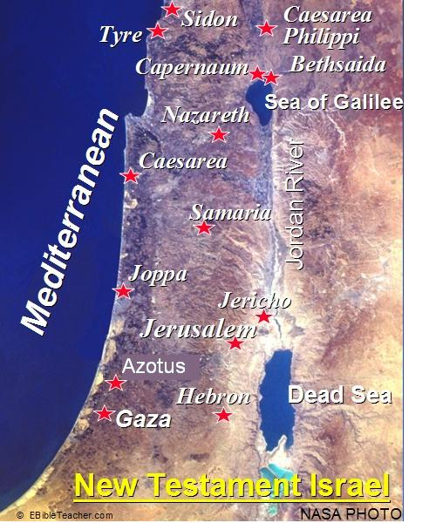

Slide 10
THE PARABLE OF THE SLAVES
Matthew 18:27-35 "And the lord of that slave felt compassion and released him and forgave him the debt. But that slave went out and found one of his fellow slaves who owed him a hundred denarii; and he seized him and began to choke him, saying, 'Pay back what you owe.’ So his fellow slave fell to the ground and began to plead with him, saying, 'Have patience with me and I will repay you.' But he was unwilling and went and threw him in prison until he should pay back what was owed. So when his fellow slaves saw what had happened, they were deeply grieved and came and reported to their lord all that had happened. Then summoning him, his lord *said to him, 'You wicked slave, I forgave you all that debt because you pleaded with me. Should you not also have had mercy on your fellow slave, in the same way that I had mercy on you?' And his lord, moved with anger, handed him over to the torturers until he should repay all that was owed him. My heavenly Father will also do the same to you, if each of you does not forgive his brother from your heart."

Slide 11
THINKING IT THROUGH
Matthew 20:6-13 And about the eleventh hour he went out and found others standing. And he said to them, ‘Why do you stand here idle all day?’ They said to him, ‘Because no one has hired us.’ He said to them, ‘You go into the vineyard too.’ And when evening came, the owner of the vineyard said to his foreman, ‘Call the laborers and pay them their wages, beginning with the last, up to the first.’ And when those hired about the eleventh hour came, each of them received a denarius. Now when those hired first came, they thought they would receive more, but each of them also received a denarius. And on receiving it they grumbled at the master of the house, saying, ‘These last worked only one hour, and you have made them equal to us who have borne the burden of the day and the scorching heat.’ But he replied to one of them, ‘Friend, I am doing you no wrong. Did you not agree with me for a denarius?

Slide 12
HOW TO BECOME GREAT
Koinonia in the body of Christ is dependent upon relationship with Him
Matthew 18:1-4 At that time the disciples came to Jesus, saying, “Who is the greatest in the kingdom of heaven? And calling to him a child, he put him in the midst of them and said, “Truly, I say to you, unless you turn and become like children, you will never enter the kingdom of heaven. Whoever humbles himself like this child is the greatest in the kingdom of heaven.
Matthew 20:25-28 Jesus called them to Himself and said, "You know that the rulers of the Gentiles lord it over them, and their great men exercise authority over them. "It is not this way among you, but whoever wishes to become great among you shall be your servant and whoever wishes to be first among you shall be your slave; just as the Son of Man did not come to be served, but to serve, and to give His life a ransom for many.

Slide 13
CONCLUSION
Matthew 6:25-30 "For this reason I say to you, do not be worried about your life, as to what you will eat or what you will drink; nor for your body, as to what you will put on. Is not life more than food, and the body more than clothing? Look at the birds of the air, that they do not sow, nor reap nor gather into barns, and yet your heavenly Father feeds them. Are you not worth much more than they? And who of you by being worried can add a single hour to his life? And why are you worried about clothing? Observe how the lilies of the field grow; they do not toil nor do they spin, yet I say to you that not even Solomon in all his glory clothed himself like one of these. But if God so clothes the grass of the field, which is alive today and tomorrow is thrown into the furnace, will He not much more clothe you? You of little faith!

