Slide 1
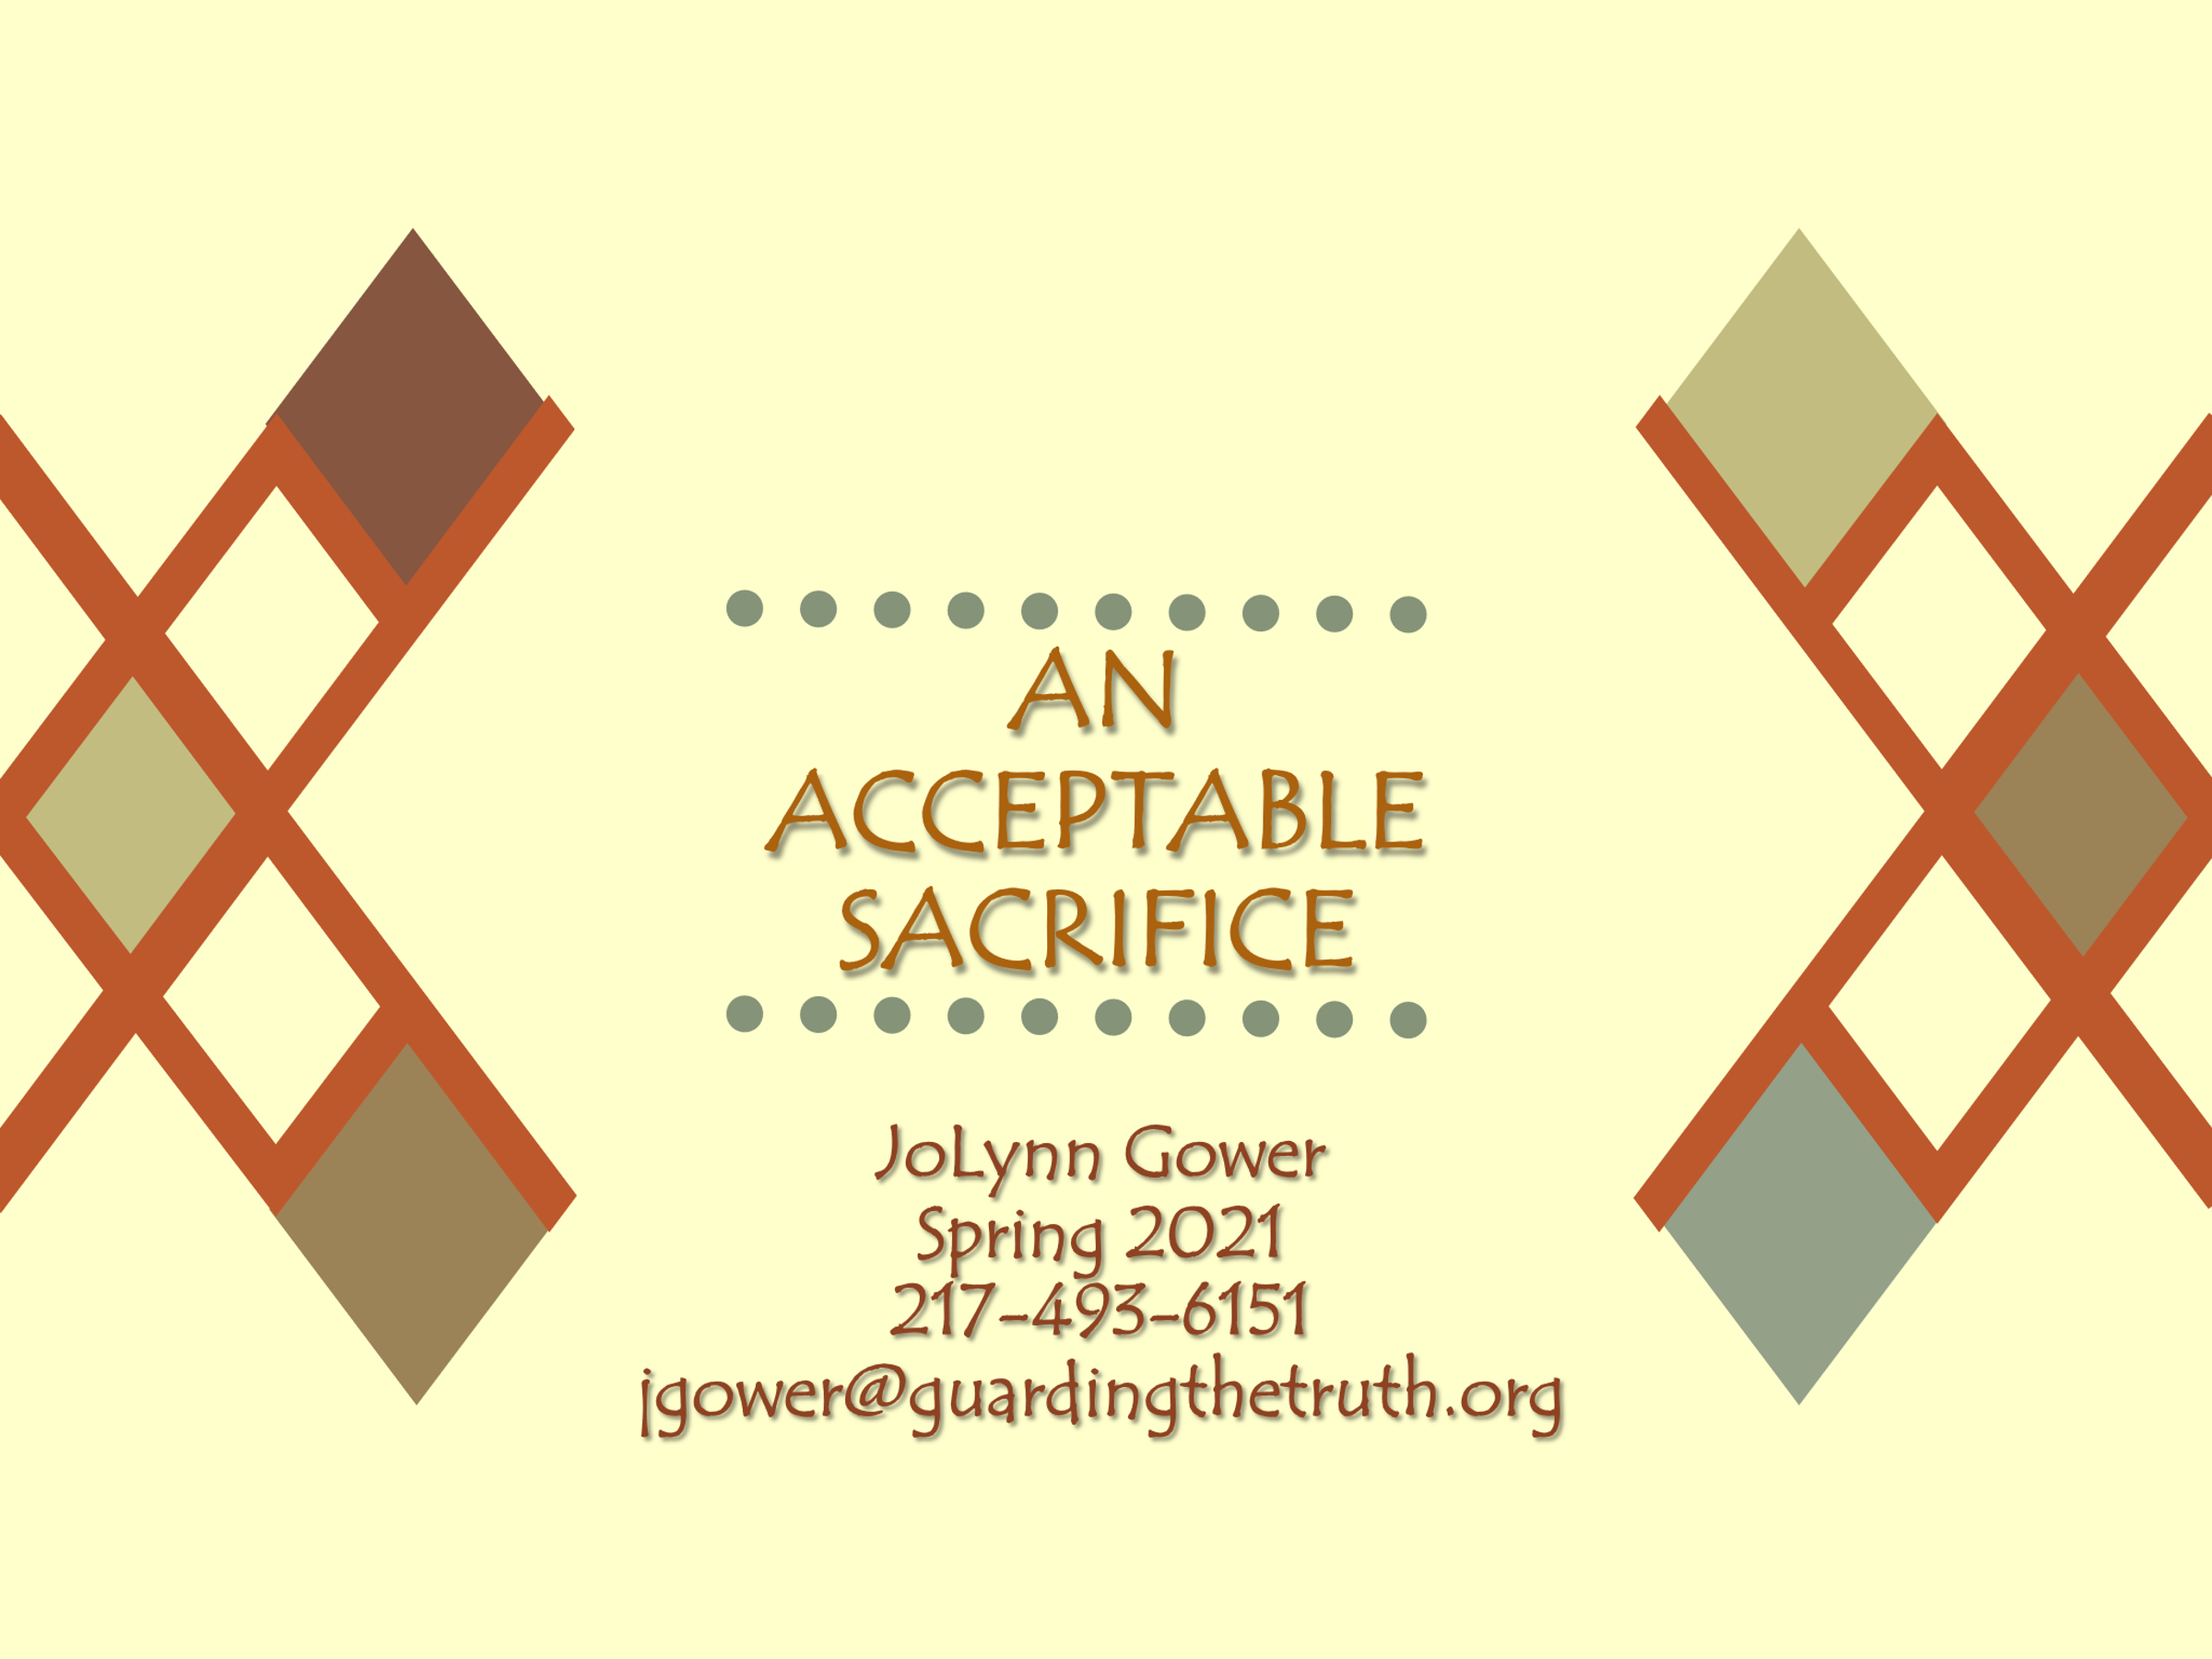
Lesson 14

Slide 2
VERSE FOR THE JOURNEY
1 John 2:3-6 By this we know that we have come to know Him, if we keep His commandments. The one who says, "I have come to know Him," and does not keep His commandments, is a liar, and the truth is not in him; whoever keeps His word, in him the love of God has truly been perfected. By this we know that we are in Him: the one who says he abides in Him ought himself to walk in the same manner as He walked.
Hebrews 10:1 For the Law, since it has only a shadow of the good things to come and not the very form of things, can never, by the same sacrifices which they offer continually year by year, make perfect those who draw near.

Slide 3
SHADOW vs REAL
Hebrews is an amazing doctrinal exposition
Chapter 7 argues for the superiority of Christ as high priest
Chapter 8 argues for a superior covenant
Chapter 9 argues for a superior sacrifice
Chapter 10 is the summary telling us why the Law could never perfect anyone
Our relationship with Jesus provides the forgiveness that the Law could never provide
Galatians 3:21-22 Is the Law then contrary to the promises of God? May it never be! If a law had been given which was able to impart life, then righteousness would indeed have been based on law. But the Scripture has shut up everyone under sin, so that the promise by faith in Jesus Christ might be given to those who believe.

Slide 4
THE WAY TO FORGIVENESS
When we establish a relationship with Jesus by faith, there is atonement for the enmity of sin inherited through the intentional sin of Adam
2 Corinthians 5:17-19 Therefore if anyone is in Christ, he is a new creature; the old things passed away; behold, new things have come. Now all these things are from God, who reconciled us to Himself through Christ and gave us the ministry of reconciliation, namely, that God was in Christ reconciling the world to Himself, not counting their trespasses against them, and He has committed to us the word of reconciliation.
We need to tell others that this forgiveness is available to them as well

Slide 5
SAVED ISN’T PERFECT
1 John 1:8 If we say that we have no sin, we are deceiving ourselves and the truth is not in us.
Colossians 3:10 … and have put on the new self who is being renewed to a true knowledge according to the image of the One who created him—
When you realize that you have sinned, that is the time for confession
James 4:17 Therefore, to one who knows the right thing to do and does not do it, to him it is sin.
1 John 1:9 If we confess our sins, He is faithful and righteous to forgive us our sins and to cleanse us from all unrighteousness.
Romans 5:13 …for until the Law sin was in the world, but sin is not imputed when there is no law.

Slide 6
AFTER CONFESSION
Matthew 5:23-26 "Therefore if you are presenting your offering at the altar, and there remember that your brother has something against you, leave your offering there before the altar and go; first be reconciled to your brother, and then come and present your offering. Make friends quickly with your opponent at law while you are with him on the way, so that your opponent may not hand you over to the judge, and the judge to the officer, and you be thrown into prison. Truly I say to you, you will not come out of there until you have paid up the last cent.
Matthew 5:20 “For I say to you that unless your righteousness surpasses that of the scribes and Pharisees, you will not enter the kingdom of heaven.”

Slide 7
FORGIVING OTHERS
Forgiveness is a matter of the will, not of the emotions
Forgiveness is, therefore, a matter of choice
Forgiving someone doesn’t let them “off the hook” with God
Forgiving doesn’t mean saying “that’s OK”
Matthew 6:12-15 'And forgive us our debts, as we also have forgiven our debtors. 'And do not lead us into temptation, but deliver us from evil. [For Yours is the kingdom and the power and the glory forever. Amen.'] For if you forgive others for their transgressions, your heavenly Father will also forgive you. But if you do not forgive others, then your Father will not forgive your transgressions.

Slide 8
DO WE WANT THE BENEFIT?
We benefit when we forgive
John 5:5-8 A man was there who had been ill for thirty-eight years. When Jesus saw him lying there, and knew that he had already been a long time in that condition, He said to him, "Do you wish to get well?" The sick man answered Him, "Sir, I have no man to put me into the pool when the water is stirred up, but while I am coming, another steps down before me." Jesus said to him, "Get up, pick up your pallet and walk."

Slide 9
COMPELLED
1 Corinthians 9:16-18 For if I preach the gospel, I have nothing to boast of, for I am under compulsion; for woe is me if I do not preach the gospel. For if I do this voluntarily, I have a reward; but if against my will, I have a stewardship entrusted to me. What then is my reward? That, when I preach the gospel, I may offer the gospel without charge, so as not to make full use of my right in the gospel.
Compulsion: anagke: under obligation; pressed to the point of distress
John 14:15 If you love Me, you will keep My commandments.
If you truly love Jesus, you will be doing what He tells you to do

Slide 10
BUT HE/SHE PRAYED THE PRAYER
Romans 3:23 …for all have sinned and fall short of the glory of God…
Romans 6:23 For the wages of sin is death, but the free gift of God is eternal life in Christ Jesus our Lord.
Romans 5:8 But God demonstrates His own love toward us, in that while we were yet sinners, Christ died for us.
Romans 10:9-10 …that if you confess with your mouth Jesus as Lord, and believe in your heart that God raised Him from the dead, you will be saved; for with the heart a person believes, resulting in righteousness, and with the mouth he confesses, resulting in salvation.
Saying words doesn’t save you—there must also be a heart belief

Slide 11
THE 7TH (LAST) TRUMPET
Revelation 11:18 "And the nations were enraged, and Your wrath came, and the time came for the dead to be judged, and the time to reward Your bond-servants the prophets and the saints and those who fear Your name, the small and the great, and to destroy those who destroy the earth."
2 Corinthians 5:6-10…being always of good courage and knowing that while we are at home in the body we are absent from the Lord— for we walk by faith, not by sight— we are of good courage, I say, and prefer rather to be absent from the body and to be at home with the Lord. Therefore we also have as our ambition, whether at home or absent, to be pleasing to Him. For we must all appear before the judgment seat of Christ, so that each one may be recompensed for his deeds in the body, according to what he has done, whether good or bad.

Slide 12
REWARD
Work done in relationship with Jesus will be rewarded
1 Corinthians 3:10-15 According to the grace of God which was given to me, like a wise master builder I laid a foundation, and another is building on it. But each man must be careful how he builds on it. For no man can lay a foundation other than the one which is laid, which is Jesus Christ. Now if any man builds on the foundation with gold, silver, precious stones, wood, hay, straw, each man's work will become evident; for the day will show it because it is to be revealed with fire, and the fire itself will test the quality of each man's work. If any man's work which he has built on it remains, he will receive a reward. If any man's work is burned up, he will suffer loss; but he himself will be saved, yet so as through fire.

Slide 13
CONCLUSION
TO HAVE SAVING FAITH,
WE MUST HAVE A RELATIONSHIP
WITH JESUS THAT IS
EVIDENCED BY DOING
THE WORK HE HAS
CALLED US TO PERFORM

