Slide 1
A question of character
Lesson 8
jOlYNN GOWER
Spring 2021
217/493-6151
JGOWER@GUARDINGTHETRUTH.ORG

Slide 2
WORD FOR THE JOURNEY
James 1:21-22 Therefore, putting aside all filthiness and all that remains of wickedness, in humility receive the word implanted, which is able to save your souls. But prove yourselves doers of the word, and not merely hearers who delude themselves.
Doers: poietai: a performer; especially a poet
Hearers: akroatai: those who listen without participation
LEARNING GOAL FOR THIS CLASS:
Learning to hear God and respond to Him in such a way that His purposes can be fulfilled in us
We play an active role in the renewal of our minds
Acknowledging God’s sovereignty is
key in the process

Slide 3
MIND RENEWAL
Philippians 4:6 Be anxious for nothing, but in everything by prayer and supplication with thanksgiving let your requests be made known to God.
Anxious: merimnao: overly concerned or worried
Prayer: proseuche: worshipful prayer; usually thought of spoken; usually thought of in chapel or other group setting
Supplication: deesis: making requests, public or private
Thanksgiving: eucharestia: expressing praise to God in a grateful manner, public or private
Requests: aitema: your needs
Philippians 4:7 And the peace of God, which surpasses all comprehension, will guard your hearts and your minds in Christ Jesus.
Guard: phroureo: a watcher in advance; to post as a watchman or sentinel; to protect the outer edges so that the inside is safe

Slide 4
WHAT IS INVOLVED
CHANGING OUR FOCUS TO SOMETHING GOOD
Philippians 4:8 Finally, brethren, whatever is true, whatever is honorable, whatever is right, whatever is pure, whatever is lovely, whatever is of good repute, if there is any excellence and if anything worthy of praise, dwell on these things.
True: alethes: nothing that has any falsehood
Honorable: semnos: dignified in an honest way
Right: dikaios: righteous; just
Pure: hagnos: innocent; free from sin
Lovely: prosphiles: showing brotherly love
Good repute: euphemos: receiving a good report/reputation
Excellence: arete: virtue; intrinsic worth
Praiseworthy: epainos: commendable
Dwell: logizomai: consider, regard

Slide 5
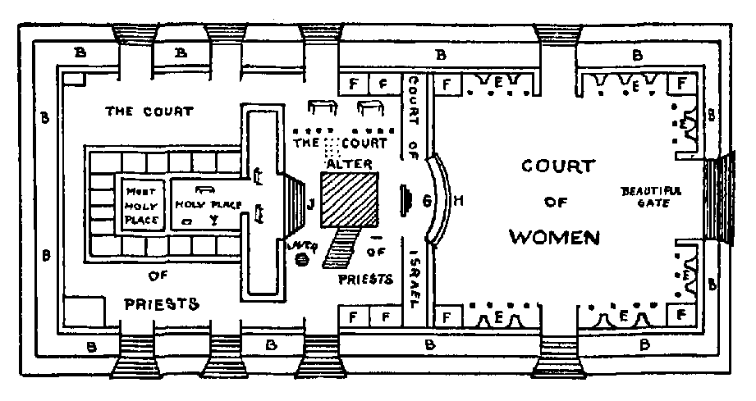
TEMPLE FLOOR PLAN
R

Slide 6
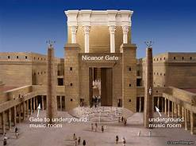
NICANOR (BEAUTIFUL) GATE

Slide 7
RENEWAL IN ACTION
Acts 4:23-29 When they had been released, they went to their own companions and reported all that the chief priests and the elders had said to them. And when they heard this, they lifted their voices to God with one accord and said, "O Lord, it is You who MADE THE HEAVEN AND THE EARTH AND THE SEA, AND ALL THAT IS IN THEM, who by the Holy Spirit, through the mouth of our father David Your servant, said, 'WHY DID THE GENTILES RAGE, AND THE PEOPLES DEVISE FUTILE THINGS? 'THE KINGS OF THE EARTH TOOK THEIR STAND, AND THE RULERS WERE GATHERED TOGETHER AGAINST THE LORD AND AGAINST HIS CHRIST.’ For truly in this city there were gathered together against Your holy servant Jesus, whom You anointed, both Herod and Pontius Pilate, along with the Gentiles and the peoples of Israel, to do whatever Your hand and Your purpose predestined to occur. And now, Lord, take note of their threats, and grant that Your bond-servants may speak Your word with all confidence…

Slide 8
PRAYER ASSUMES GOD’S CONTROL
If God isn’t sovereign, why pray?
Satan wants us to focus on our past failures, our current problems, or other diversions that he plants in our minds
God wants us to focus on good things and press on
Philippians 3:12-14 Not that I have already obtained it or have already become perfect, but I press on so that I may lay hold of that for which also I was laid hold of by Christ Jesus. Brethren, I do not regard myself as having laid hold of it yet; but one thing I do: forgetting what lies behind and reaching forward to what lies ahead, I press on toward the goal for the prize of the upward call of God in Christ Jesus.
Isaiah 43:25 "I, even I, am the one who wipes out your transgressions for My own sake, And I will not remember your sins.”
Remember: zakar: to mark down; call to mind

Slide 9
A GOOD SCREEN SAVER!
2 Corinthians 10:3-5 For though we walk in the flesh, we do not war according to the flesh, for the weapons of our warfare are not of the flesh, but divinely powerful for the destruction of fortresses. We are destroying speculations and every lofty thing raised up against the knowledge of God, and we are taking every thought captive to the obedience of Christ…
If we could only use human means to fight against the enemy, we would be in big trouble!
We have the power of the Holy Spirit working in us
dunata to theo: powerful through God
Fortresses: ochuroma: strongholds, arguments; often those created by faulty logic or incorrect facts
Speculations: logismos: things that people imagine or believe that are not true

Slide 10
OUTWARD APPEARANCES
2 Corinthians 10:7, 10 You are looking at things as they are outwardly. If anyone is confident in himself that he is Christ's, let him consider this again within himself, that just as he is Christ's, so also are we…For they say, "His letters are weighty and strong, but his personal presence is unimpressive and his speech contemptible."
Focus on accusations or physical appearance? Focus on purpose given by God?
Satan wants to establish strongholds in our minds; it is our responsibility to stop him with weaponry provided by God
1 Samuel 16:7 But the LORD said to Samuel, "Do not look at his appearance or at the height of his stature, because I have rejected him; for God sees not as man sees, for man looks at the outward appearance, but the LORD looks at the heart."

Slide 11
HERE I AM; SEND ME
Nehemiah 1:1-4 The words of Nehemiah the son of Hacaliah. Now it happened in the month Chislev, in the twentieth year, while I was in Susa the capitol, that Hanani, one of my brothers, and some men from Judah came; and I asked them concerning the Jews who had escaped and had survived the captivity, and about Jerusalem. They said to me, "The remnant there in the province who survived the captivity are in great distress and reproach, and the wall of Jerusalem is broken down and its gates are burned with fire.” When I heard these words, I sat down and wept and mourned for days; and I was fasting and praying before the God of heaven.
Date: around 444 BC; Ezra has returned 10 years earlier; the first exiles returned around 537 BC; work on temple began in 535 BC but was stopped; finally completed 516 BC; in 445 BC the wall of Jerusalem was still in ruins

Slide 12
NEHEMIAH’S POSITION
Nehemiah 1:11 "O Lord, I beseech You, may Your ear be attentive to the prayer of Your servant and the prayer of Your servants who delight to revere Your name, and make Your servant successful today and grant him compassion before this man." Now I was the cupbearer to the king.
The cupbearer usually also carried the king’s signet ring and was a financial advisor to the king’s household
Nehemiah 2:1 And it came about in the month Nisan, in the twentieth year of King Artaxerxes, that wine was before him, and I took up the wine and gave it to the king. Now I had not been sad in his presence.
Nehemiah 2:4-6 Then the king said to me, "What would you request?" So I prayed to the God of heaven. I said to the king, "If it please the king, and if your servant has found favor before you, send me to Judah, to the city of my fathers' tombs, that I may rebuild it."

Slide 13
NEHEMIAH’S SUCCESS
Nehemiah 3 details those who made repairs to the various gates and wall portions of the city
When Sanballat became concerned and raised objections, things became dangerous
Nehemiah 4:2-3 He spoke in the presence of his brothers and the wealthy men of Samaria and said, "What are these feeble Jews doing? Are they going to restore it for them-selves? Can they offer sacrifices? Can they finish in a day? Can they revive the stones from the dusty rubble even the burned ones?” Now Tobiah the Ammonite was near him and he said, "Even what they are building—if a fox should jump on it, he would break their stone wall down!"
The workers were being demoralized
The project was being threatened
The wall was completed while weapons were held in one hand and work went on with another

Slide 14
UNDERSTANDING REALITY
In difficult circumstances, we must seek God’s will and think things through with renewed minds so that we see the truth
1 Chronicles 5:18-20 The sons of Reuben and the Gadites and the half-tribe of Manasseh, consisting of valiant men, men who bore shield and sword and shot with bow and were skillful in battle, were 44,760, who went to war.
They made war against the Hagrites, Jetur, Naphish and Nodab. They were helped against them, and the Hagrites and all who were with them were given into their hand; for they cried out to God in the battle, and He answered their prayers because they trusted in Him.
Knowing our part and knowing God’s part is crucial
In critical times, prayer acknowledges our belief in God’s sovereignty and our dependence on His agape love
God’s expectation is that we will take responsibility to use the means that God has provided for us

