Slide 1
A question of character lesson 5
jOlYNN GOWER
Spring 2021
217/493-6151
JGOWER@GUARDINGTHETRUTH.ORG

Slide 2
WORD FOR THE JOURNEY
James 1:21-22 Therefore, putting aside all filthiness and all that remains of wickedness, in humility receive the word implanted, which is able to save your souls. But prove yourselves doers of the word, and not merely hearers who delude themselves.
Doers: poietai: a performer; especially a poet
Hearers: akroatai: those who listen without participation
LEARNING GOAL FOR THIS CLASS:
Learning to hear God and respond to Him in such a way that His purposes can be fulfilled in us
PEOPLE WHO HAVE NO FEAR OF GOD
HAVE NO FEAR OF PERSECUTING HIS PEOPLE

Slide 3
THE DEADLY D’s
Distraction, deception, disappointment,dejection, discouragement, despair, demoralization
Ecclesiastes 4:1 Then I looked again at all the acts of oppression which were being done under the sun. And behold I saw the tears of the oppressed and that they had no one to comfort them; and on the side of their oppressors was power, but they had no one to comfort them.
Ecclesiastes 4:2-3 So I congratulated the dead who are already dead more than the living who are still living. But better off than both of them is the one who has never existed, who has never seen the evil activity that is done under the sun.
Ecclesiastes 5:2 Do not be hasty in word or impulsive in thought to bring up a matter in the presence of God. For God is in heaven and you are on the earth; therefore let your words be few.

Slide 4
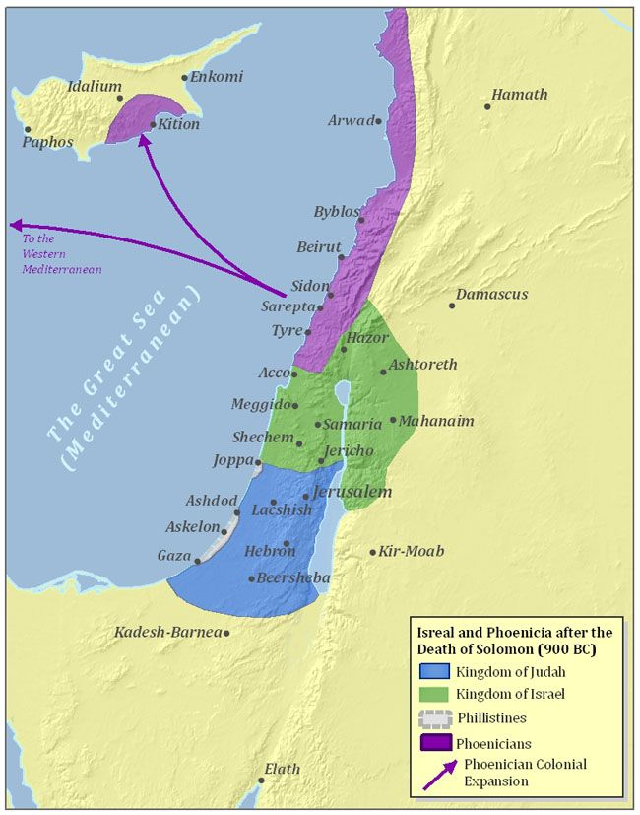

Slide 5
WHAT HAPPENED TO SOLOMON?
2 Chronicles 6:12-14 Then he stood before the altar of the LORD in the presence of all the assembly of Israel and spread out his hands. Now Solomon had made a bronze platform, five cubits long, five cubits wide and three cubits high, and had set it in the midst of the court; and he stood on it, knelt on his knees in the presence of all the assembly of Israel and spread out his hands toward heaven. He said, "O LORD, the God of Israel, there is no god like You in heaven or on earth, keeping covenant and showing loving kindness to Your servants..
700 wives; 300 concubines; many daughters; son Rehoboam
1 Kings 11:6-8 Solomon did what was evil in the sight of the LORD, and did not follow the LORD fully, as David his father had done. Then Solomon built a high place for Chemosh the detestable idol of Moab, on the mountain which is east of Jerusalem, and for Molech the detestable idol of the sons of Ammon. Thus also he did for all his foreign wives, who burned incense and sacrificed to their gods.

Slide 6
THOUGHTS ON SOVEREIGNTY
Sovereign: dunastes: from dunamai: one who has power or ability (in God: to do anything at any time)
Jeremiah 32:17 'Ah Lord GOD! Behold, You have made the heavens and the earth by Your great power and by Your outstretched arm! Nothing is too difficult for You…
Lord GOD: adon YHWH: sovereign controller
We cannot acknowledge or trust God’s sovereignty unless we have understood his heart, character, and attributes
In the refining process, it is important to keep our eyes on the refiner and the work He is doing through the refining process; Solomon took his eyes off of God
CAN YOU TRUST GOD?
CAN YOU TRUST GOD?

Slide 7
GOD’S ATTRIBUTES
An attribute is a property intrinsic to its subject and by which the subject is distinguished or identified
Some attributes belong only to God (omniscience); some belong to God and people (although in a more limited way)
Simplicity: God is indivisible
Unity: God is one
Infinite: God has no beginning or end
Eternal: free from succession of time
Immutable: God is unchanging and unchangeable
Omnipresent: God is everywhere (not in everything)
Omniscience: God knows all actual and possible things
Omnipotence: God is all powerful
Just: moral equity; same standards for all
Love: seeking the highest good within His will

Slide 8
EXALTING HIS ATTRIBUTES
Psalm 103:17-22…the lovingkindness of the LORD is from everlasting to everlasting on those who fear Him, and His righteousness to children's children, to those who keep His covenant and remember His precepts to do them. The LORD has established His throne in the heavens; His sov-ereignty rules over all. Bless the LORD, you His angels, mighty in strength, who perform His word, obeying the voice of His word! Bless the LORD, all you His hosts, you
Him, doing His will. Bless the LORD, all you works of His, in all places of His dominion; Bless the LORD, O my soul!
Hosts: tsaba: armies (Greek equivalent: stratia)
Angels: malak: messengers (Greek equivalent: aggelos)
God’s armies seem to have structure and purpose just like earthly armies do
CREATED BEINGS WHO ENFORCE GOD’S SOVEREIGNTY

Slide 9
ANGELIC ORGANIZATION
Colossians 1:16 For by Him all things were created, both in the heavens and on earth, visible and invisible, whether thrones or dominions or rulers or authorities—all things have been created through Him and for Him.
Ephesians 3:8-10 To me, the very least of all saints, this grace was given, to preach to the Gentiles the unfathomable riches of Christ, and to bring to light what is the administration of the mystery which for ages has been hidden in God who created all things; so that the manifold wisdom of God might now be made known through the church to the rulers and the authorities in the heavenly places.
Ephesians 6:12 For our struggle is not against flesh and blood, but against the rulers, against the powers, against the world forces of this darkness, against the spiritual forces of wickedness in the heavenly places.

Slide 10
Power struggle
Daniel 10:11-13 He said to me, "O Daniel, man of high esteem, understand the words that I am about to tell you and stand upright, for I have now been sent to you." And when he had spoken this word to me, I stood up trembling. Then he said to me, "Do not be afraid, Daniel, for from the first day that you set your heart on understanding this and on humbling yourself before your God, your words were heard, and I have come in response to your words. But the prince of the kingdom of Persia was withstanding me for twenty-one days; then behold, Michael, one of the chief princes, came to help me, for I had been left there with the kings of Persia.
Michael is the only archangel identified in scripture
Jewish traditional literature says there are seven; but the list of seven isn’t always the same names: Gabriel is in all lists; Tobit 12:15 lists Raphael; Esdras 4 lists Uriel

Slide 11
THOUGHTS FROM THE EARLY CHURCH
Acts 2:22-24 "Men of Israel, listen to these words: Jesus the Nazarene, a man attested to you by God with miracles and wonders and signs which God performed through Him in your midst, just as you yourselves know— this Man, delivered over by the predetermined plan and foreknowledge of God, you nailed to a cross by the hands of godless men and put Him to death. But God raised Him up again, putting an end to the agony of death, since it was impossible for Him to be held in its power.
Predetermined: horizo: marked off by boundaries, limit
Acts 4:27-29 "For truly in this city there were gathered together against Your holy servant Jesus, whom You anointed, both Herod and Pontius Pilate, along with the Gentiles and the peoples of Israel, to do whatever Your hand and Your purpose predestined to occur.
Predestined: proorizo: to limit in advance

Slide 12
WE LIVE IN THE MYSTERY
Ecclesiastes 7:13-14 Consider the work of God, for who is able to straighten what He has bent? In the day of prosperity be happy, but in the day of adversity consider— God has made the one as well as the other so that man will not discover anything that will be after him.
1 Corinthians 2:7 …but we speak God's wisdom in a mystery, the hidden wisdom which God predestined before the ages to our glory;
Ephesians 3:3-5…that by revelation there was made known to me the mystery, as I wrote before in brief. By referring to this, when you read you can understand my insight into the mystery of Christ, which in other generations was not made known to the sons of men, as it has now been revealed to His holy apostles and prophets in the Spirit;
Revelation 10:7…but in the days of the voice of the seventh angel, when he is about to sound, then the mystery of God is finished, as He preached to His servants the prophets.

Slide 13
ALL THAT WE SEE AND KNOW…
In God’s sovereignty, He is working out His plan for the ages
We are living in the working out of God’s plan
A sovereign God could be a dictator (God is not)
A sovereign God could abdicate the use of his powers (God has not)
God will not do anything that would deny His character
2 Timothy 2:13 If we are faithless, He remains faithful, for He cannot deny Himself.
God will not contradict Himself
God will not forgive sin without payment being made
God will not force anyone to love Him or receive Christ
Evil cannot appeal to God’s nature
God knows how to use his omniscience wisely
God is holy: there is no moral impurity at all in Him

