Slide 1
A question of character
Lesson 3
jOlYNN GOWER
Spring 2021
217/493-6151
JGOWER@GUARDINGTHETRUTH.ORG

Slide 2
WORD FOR THE JOURNEY
James 1:21-22 Therefore, putting aside all filthiness and all that remains of wickedness, in humility receive the word implanted, which is able to save your souls. But prove yourselves doers of the word, and not merely hearers who delude themselves.
Doers: poietai: a performer; especially a poet
Hearers: akroatai: those who listen without participation
LEARNING GOAL FOR THIS CLASS:
Learning to hear God and respond to Him in such a way that His purposes can be fulfilled in us
THERE WILL BE A REFINING AND TRANSFORMING
PROCESS SPRINGING FROM MIND RENEWAL
THE RESULT SHOULD INCLUDE MEEKNESS

Slide 3
Proving the will of god
Romans 12:1-2 Therefore I urge you, brethren, by the mercies of God, to present your bodies a living and holy sacrifice, acceptable to God, which is your spiritual service of worship. And do not be conformed to this world, but be transformed by the renewing of your mind, so that you may prove what the will of God is, that which is good and acceptable and perfect.
Transformed: metamorphoo: fundamental change of who you are into something different (passive voice)
Renewing: anakainosis: renovation, regeneration
Our part: presenting our body, the unredeemed part of us
God’s part: the transformational process
The result: dross of sin removed; will of God becomes more and more apparent to us

Slide 4
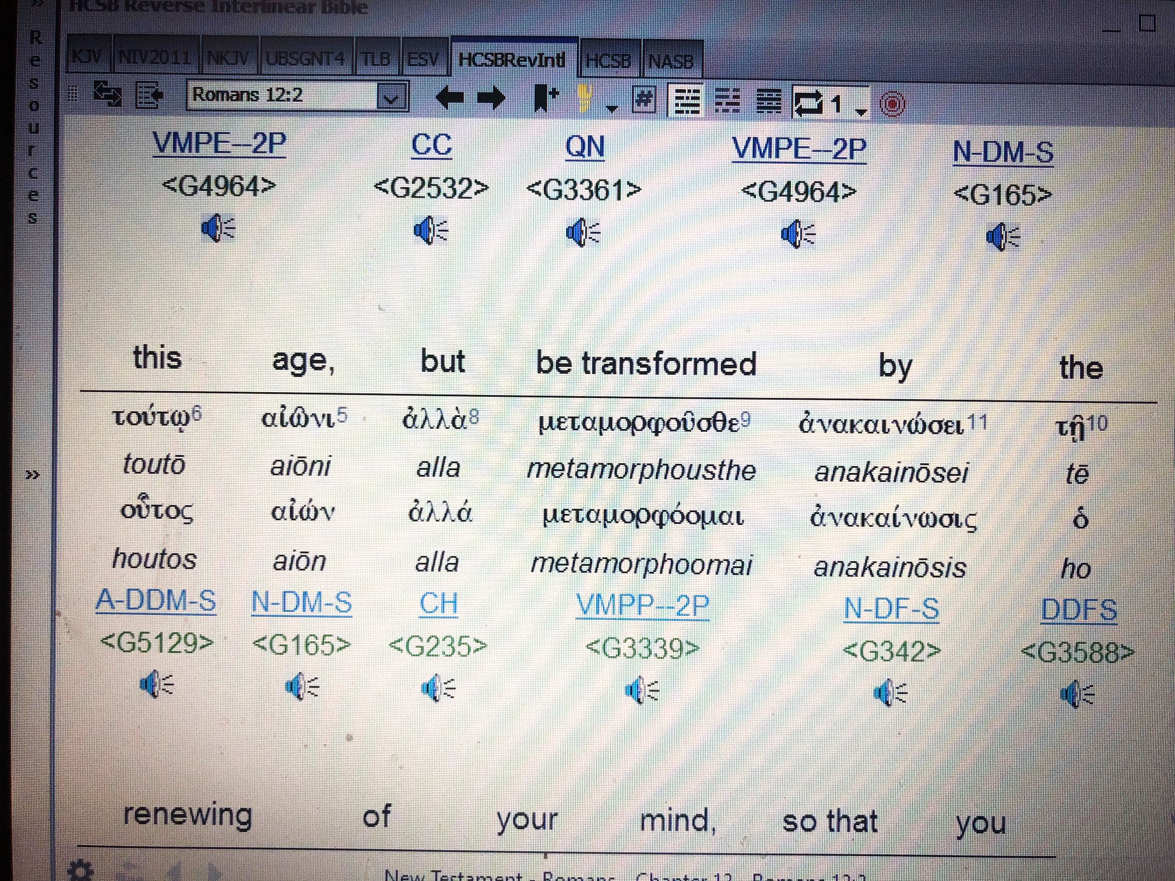

Slide 5
THE VALUE OF TRIALS
God uses trials to remove the dross of sin
Psalm 119:67 Before I was afflicted I went astray, but now I keep Your word.
Afflicted: anah: to be bowed down; to be humbled
Wrong thinking results in sin; the dross obscures the pure will of God
Proverbs 23:6-7 Do not eat the bread of a selfish man, or desire his delicacies; For as he thinks within himself, so he is. He says to you, "Eat and drink!" But his heart is not with you.
Ezekiel 22:17-18 And the word of the LORD came to me, saying, "Son of man, the house of Israel has become dross to Me; all of them are bronze and tin and iron and lead in the furnace; they are the dross of silver.
Proverbs 25:4 Take away the dross from the silver, and there comes out a vessel for the smith;

Slide 6
LEARNING MEEKNESS
Matthew 11:28-30 "Come to Me, all who are weary and heavy-laden, and I will give you rest. Take My yoke upon you and learn from Me, for I am gentle and humble in heart, and YOU WILL FIND REST FOR YOUR SOULS. For My yoke is easy and My burden is light."
Gentle: praus: meek; strength under control
To be gentle or meek doesn’t mean that you are a doormat or a wimp
Jesus called out those who were wrong
Matthew 23:27 "Woe to you, scribes and Pharisees, hypocrites! For you are like whitewashed tombs which on the outside appear beautiful, but inside they are full of dead men's bones and all uncleanness.
Galatians 5:22-23 But the fruit of the Spirit is love, joy, peace, patience, kindness, goodness, faithfulness,
gentleness, self-control; against such things there is no law.

Slide 7
LEARNING OBEDIENCE
Hebrews 5:7-8 In the days of His flesh, He offered up both prayers and supplications with loud crying and tears to the One able to save Him from death, and He was heard because of His piety. Although He was a Son, He learned obedience from the things which He suffered.
Obedience: ten hupokoen: those things which are heard (and therefore processed and learned) under
Colossians 3:9-12 Do not lie to one another, since you laid aside the old self with its evil practices, and have put on the new self who is being renewed to a true knowledge according to the image of the One who created him— a renewal in which there is no distinction between Greek and Jew, circumcised and uncircumcised, barbarian, Scythian, slave and freeman, but Christ is all, and in all. So, as those who have been chosen of God, holy and beloved, put on a heart of compassion, kindness, humility, gentleness and patience;

Slide 8
MORE ON THE MIND
Humility: tapeinophrosune: tapeinos: humble, meek;
phren: dealing with the mind and thoughts
Psalm 50:10-11 “For every beast of the forest is Mine, the cattle on a thousand hills. I know every bird of the mountains, and everything that moves in the field is Mine.”
1 Timothy 6:6 But godliness actually is a means of great gain when accompanied by contentment.
Contentment: autarkeia: self-satisfaction; self-sufficiency;
being at peace within yourself
1 Timothy 6:7-8 For we have brought nothing into the world, so we cannot take anything out of it either. If we have food and covering, with these we shall be content.
Content: arkeo: recognition of sufficiency
HEARSE PULLING A UHAUL?

Slide 9
ABOUT MONEY
1 Timothy 6:9-11 But those who want to get rich fall into temptation and a snare and many foolish and harmful desires which plunge men into ruin and destruction. For the love of money is a root of all sorts of evil, and some by longing for it have wandered away from the faith and pierced themselves with many griefs. But flee from these things, you man of God, and pursue righteousness, godliness, faith, love, perseverance and gentleness.
Love of money: philargurea: avarice
Matthew 6:24 “No one can serve two masters; for either he will hate the one and love the other, or he will be devoted to one and despise the other. You cannot serve God and wealth.”
Wealth: mamonas (mammon): wealth personified; avarice deified

Slide 10
Acting, not reacting
Psalm 25:8-13 Good and upright is the LORD; Therefore He instructs sinners in the way. He leads the humble in justice, and He teaches the humble His way. All the paths of the LORD are lovingkindness and truth to those who keep His covenant and His testimonies. For Your name's sake, O LORD, pardon my iniquity, for it is great. Who is the man who fears the LORD? He will instruct him in the way he should choose. His soul will abide in prosperity, and his descendants will inherit the land.
OUR PART GOD’S PART
HUMBLE CREATING HUMILITY IN US
TEACHABLE TEACHING US
COVENANT KEEPING DETERMINING COVENANT
TESTIMONY KEEPING
GOD FEARING

Slide 11
Who I am—HOW I ACT
1 John 5:1 Whoever believes that Jesus is the Christ is born of God, and whoever loves the Father loves the child born of Him.
Romans 8:16-17 The Spirit Himself testifies with our spirit that we are children of God, and if children, heirs also, heirs of God and fellow heirs with Christ, if indeed we suffer with Him so that we may also be glorified with Him.
When we have realized God’s purpose for us, then we can act in the way God desires
John 3:35-36 "The Father loves the Son and has given all things into His hand. He who believes in the Son has eternal life; but he who does not obey the Son will not see life, but the wrath of God abides on him." John the Baptist
A LOOK AT HUMILITY

Slide 12
GETTING IT RIGHT
John 1:6-8 There came a man sent from God, whose name was John. He came as a witness, to testify about the Light, so that all might believe through him. He was not the Light, but he came to testify about the Light.
John 1:19-23 This is the testimony of John, when the Jews sent to him priests and Levites from Jerusalem to ask him, "Who are you?” And he confessed and did not deny, but confessed, "I am not the Christ.” They asked him, "What then? Are you Elijah?" And he said, "I am not." "Are you the Prophet?" And he answered, "No.” Then they said to him, "Who are you, so that we may give an answer to those who sent us? What do you say about yourself?” He said, "I am A VOICE OF ONE CRYING IN THE WILDERNESS, 'MAKE STRAIGHT THE WAY OF THE LORD,' as Isaiah the prophet said."

Slide 13
HE MUST INCREASE
John 3:25-30 Therefore there arose a discussion on the part of John's disciples with a Jew about purification. And they came to John and said to him, "Rabbi, He who was with you beyond the Jordan, to whom you have testified, behold, He is baptizing and all are coming to Him.” John answered and said, "A man can receive nothing unless it has been given him from heaven. You yourselves are my witnesses that I said, 'I am not the Christ,' but, 'I have been sent ahead of Him.’ He who has the bride is the bridegroom; but the friend of the bridegroom, who stands and hears him, rejoices greatly because of the bridegroom's voice. So this joy of mine has been made full. He must increase, but I must decrease.”
Redemption model: Jesus=bridegroom; church= bride
In the wedding model, the friend of the bridegroom announces the coming of the bridegroom

