Slide 1
A QUESTION OF CHARACTER
jOlYNN GOWER
Spring 2021
217/493-6151
JGOWER@GUARDINGTHETRUTH.ORG

Slide 2
ABOUT THIS CLASS
YOU WILL NEED:
Workbook
A good Bible translation or device that contains one
A concordance or device that contains one
A willingness to study and learn
HELPFUL THINGS
A Bible atlas, TDNT and TWOT or TDOT, Bible dictionary
Recommended: a good Bible study program
Online: guardingthetruth.org

Slide 3
WORD FOR THE JOURNEY
Romans 12:1-2 Therefore I urge you, brethren, by the mercies of God, to present your bodies a living and holy sacrifice, acceptable to God, which is your spiritual service of worship. And do not be conformed to this world, but be transformed by the renewing of your mind, so that you may prove what the will of God is, that which is good and acceptable and perfect.
Prove: dokimazo: to assay, test, or approve by refining
LEARNING GOAL FOR THIS CLASS:
Learning to hear God and respond to Him in such a way that His purposes can be fulfilled in us
THIS IS AN INNER COURT EXPERIENCE
The outer court represents salvation: this is a free gift
The inner courts represent discipleship: this isn’t free

Slide 4
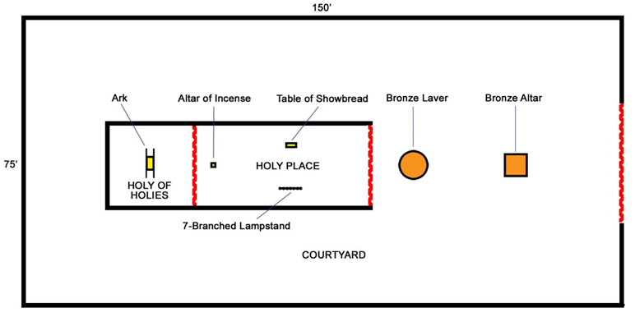
TYPOLOGY OF THE TABERNACLE
THE GATE,
THE WAY OR
THE NARROW
GATE
THE VEIL (OF LIFE)
THE DOOR (OF TRUTH)
Romans 8:28 And we know that God causes all things
to work together for good to those who love God, to those
who are called according to His purpose.
purpose: prothesis: showbread; knowledge of God’s will

Slide 5
COUNTING THE COST
Luke 14:27-33 "Whoever does not carry his own cross and come after Me cannot be My disciple. For which one of you, when he wants to build a tower, does not first sit down and calculate the cost to see if he has enough to complete it? Otherwise, when he has laid a foundation and is not able to finish, all who observe it begin to ridicule him, saying, 'This man began to build and was not able to finish.’ Or what king, when he sets out to meet another king in battle, will not first sit down and consider whether he is strong enough with ten thousand men to encounter the one coming against him with twenty thousand? Or else, while the other is still far away, he sends a delegation and asks for terms of peace. So then, none of you can be My disciple who does not give up all his own possessions.”

Slide 6
GOD AS THE REFINER
1 Corinthians 9:26-27 Therefore I run in such a way, as not without aim; I box in such a way, as not beating the air; but I discipline my body and make it my slave, so that, after I have preached to others, I myself will not be disqualified.
Disqualified: adokimos: not approved; not standing the test
James 1:2-3 Consider it all joy, my brethren, when you encounter various trials, knowing that the testing of your faith produces endurance.
Testing: dokimion: prove, approve
Jeremiah 6:28-30 All of them are stubbornly rebellious, going about as a talebearer. They are bronze and iron; They, all of them, are corrupt. The bellows blow fiercely, the lead is consumed by the fire; In vain the refining goes on, but the wicked are not separated. They call them rejected silver, Because the LORD has rejected them.
Rejected: maas: turned away as useless or unworthy

Slide 7
TWO PARTS OF DISCIPLESHIP
Personal:
The way I carry out the purpose God has
uniquely for me and how I function within the larger body
of Christ
Corporate:
The way the body of Christ operates as a unified whole
within our country and the world
Can an individual Christian fully function in a nation/world
that has largely abandoned God?
How does the godlessness of a nation impact the ability of
a believer to live the life of discipleship that God desires?
When a nation turns from God, believers frequently suffer
persecution and deprivation; is this the life that God
desires for them?

Slide 8
LOOKING AT FAITHLESSNESS
Jeremiah 3:6-10 Then the LORD said to me in the days of Josiah the king, "Have you seen what faithless Israel did? She went up on every high hill and under every green tree, and she was a harlot there. I thought, 'After she has done all these things she will return to Me'; but she did not return, and her treacherous sister Judah saw it. And I saw that for all the adulteries of faithless Israel, I had sent her away and given her a writ of divorce, yet her treacherous sister Judah did not fear; but she went and was a harlot also. Because of the lightness of her harlotry, she polluted the land and committed adultery with stones and trees. Yet in spite of all this her treacherous sister Judah did not return to Me with all her heart, but rather in deception," declares the LORD.

Slide 9
GOD’S VIEW OF DISOBEDIENCE
Jeremiah 25:4 "And the LORD has sent to you all His servants the prophets again and again, but you have not listened nor inclined your ear to hear…
Jeremiah 5:7 "Why should I pardon you? Your sons have forsaken Me and sworn by those who are not gods. When I had fed them to the full, they committed adultery and trooped to the harlot's house.
Amos 3:7 Surely the Lord GOD does nothing unless He reveals His secret counsel to His servants the prophets.
James 4:17 Therefore, to one who knows the right thing to do and does not do it, to him it is sin.
GOD SPEAKS TO HIS PEOPLE
HE EXPECTS THEM TO LISTEN (akroatai)
AND ACT (do: poietai)

Slide 10
Opportunity to repent
Jeremiah 7:1-7 The word that came to Jeremiah from the LORD, saying, "Stand in the gate of the LORD'S house and proclaim there this word and say, 'Hear the word of the LORD, all you of Judah, who enter by these gates to worship the LORD!’” Thus says the LORD of hosts, the God of Israel, "Amend your ways and your deeds, and I will let you dwell in this place. Do not trust in deceptive words, saying, 'This is the temple of the LORD, the temple of the LORD, the temple of the LORD.’ For if you truly amend your ways and your deeds, if you truly practice justice between a man and his neighbor, if you do not oppress the alien, the orphan, or the widow, and do not shed innocent blood in this place, nor walk after other gods to your own ruin, then I will let you dwell in this place, in the land that I gave to your fathers forever and ever.”

Slide 11
REPENTANCE AND TRIALS
God sometimes uses trials to lead us to repentance
James 1:2-4 Consider it all joy, my brethren, when you encounter various trials, knowing that the testing of your faith produces endurance. And let endurance have its perfect result, so that you may be perfect and complete, lacking in nothing.
Testing: dokimion: refining
Endurance: hupomone from hupomeno: patient, hopeful continuance
Romans 5:3-4 And not only this, but we also exult in our tribulations, knowing that tribulation brings about perseverance; and perseverance, proven character; and proven character, hope;

Slide 12
CAN I TRUST GOD; CAN I TRUST GOD
Hebrews 13:20-21 Now the God of peace, who brought up from the dead the great Shepherd of the sheep through the blood of the eternal covenant, even Jesus our Lord, equip you in every good thing to do His will, working in us that which is pleasing in His sight, through Jesus Christ, to whom be the glory forever and ever. Amen.
When we see what God is doing, we should do whatever is necessary to make His purpose our purpose
We should ask God to bring relevant passages of scripture to our attention and pray seeking God’s will
We should remember lessons learned in past trials
We should desire to grow in holiness, recognizing our inability to do anything righteous apart from God

Slide 13
THE QUESTION
A flood of ungodliness is being unleashed worldwide at unprecedented levels. As a mighty tide of humankind turns away from God, how can we see a mightier tide stirring in His people?
What do you see God doing?
What has He called us to do?
What has He called me to do?

