Slide 1
A question of character
Lesson 11
jOlYNN GOWER
Spring 2021
217/493-6151
JGOWER@GUARDINGTHETRUTH.ORG

Slide 2
WORD FOR THE JOURNEY
James 1:21-22 Therefore, putting aside all filthiness and all that remains of wickedness, in humility receive the word implanted, which is able to save your souls. But prove yourselves doers of the word, and not merely hearers who delude themselves.
Doers: poietai: a performer; especially a poet
Hearers: akroatai: those who listen without participation
LEARNING GOAL FOR THIS CLASS:
Learning to hear God and respond to Him in such a way that His purposes can be fulfilled in us
We play an active role in the renewal of our minds
Spiritual warfare requires enemy reconnaissance

Slide 3
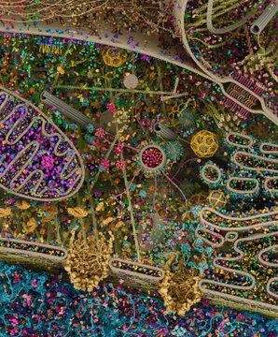
Cellular landscape cross-section through a eukaryotic cell.”
This is the most
detailed model of
a human cell to
date, obtained
using x-ray, NMR
and cryoelectron
microscopy
datasets.

Slide 4
SATAN’S FIRST APPEARANCE
Genesis 3:1-5 Now the serpent was more crafty than any beast of the field which the LORD God had made. And he said to the woman, "Indeed, has God said, 'You shall not eat from any tree of the garden'?” The woman said to the serpent, "From the fruit of the trees of the garden we may eat; but from the fruit of the tree which is in the middle of the garden, God has said, 'You shall not eat from it or touch it, or you will die.’ The serpent said to the woman, "You surely will not die! For God knows that in the day you eat from it your eyes will be opened, and you will be like God, knowing good and evil."
Revelation 12:7-9 And there was war in heaven, Michael and his angels waging war with the dragon. The dragon and his angels waged war, and they were not strong enough, and there was no longer a place found for them in heaven. And the great dragon was thrown down, the serpent of old who is called the devil and Satan, who deceives the whole world; he was thrown down to the earth, and his angels were thrown down with him

Slide 5
WHO WAS SATAN?
Ezekiel 28:13-16 "You were in Eden, the garden of God; every precious stone was your covering: the ruby, the topaz and the diamond; the beryl, the onyx and the jasper; the lapis lazuli, the turquoise and the emerald; and the gold, the workmanship of your settings and sockets, was in you. the day that you were created they were prepared. You were the anointed cherub who covers, and I placed you there. You were on the holy mountain of God; you walked in the midst of the stones of fire. You were blameless in your ways from the day you were created until unrighteousness was found in you. By the abundance of your trade you were internally filled with violence, and you sinned; Therefore I have cast you as profane from the mountain of God. And I have destroyed you, O covering cherub, from the midst of the stones of fire.”

Slide 6
SATAN TEMPTED JESUS
Matthew 4:3-4 And the tempter came and said to Him, "If You are the Son of God, command that these stones become bread.” But He answered and said, "It is written, 'MAN SHALL NOT LIVE ON BREAD ALONE, BUT ON EVERY WORD THAT PROCEEDS OUT OF THE MOUTH OF GOD." Deut 8:3
LUST OF THE FLESH: JESUS WAS HUNGRY AFTER FASTING
Matthew 4:5-7 Then the devil took Him into the holy city and had Him stand on the pinnacle of the temple, and *said to Him, "If You are the Son of God, throw Yourself down; for it is written, 'HE WILL COMMAND HIS ANGELS CONCERNING YOU'; and 'ON their HANDS THEY WILL BEAR YOU UP, SO THAT YOU WILL NOT STRIKE YOUR FOOT AGAINST A STONE.” Ps 91:11
Jesus said to him, "On the other hand, it is written, 'YOU SHALL NOT PUT THE LORD YOUR GOD TO THE TEST." Deut 6:16
BOASTFUL PRIDE OF LIFE: you will seem important to everyone

Slide 7
TEMPTATION OF JESUS (2)
Matthew 4:8-11 Again, the devil took Him to a very high mountain and showed Him all the kingdoms of the world and their glory; and he said to Him, "All these things I will give You, if You fall down and worship me.” Then Jesus said to him, "Go, Satan! For it is written, 'YOU SHALL WORSHIP THE LORD YOUR GOD, AND SERVE HIM ONLY.” Then the devil left Him; and behold, angels came and began to minister to Him.
LUST OF THE EYES: EVERYTHING YOU SEE!
Genesis 3:6 When the woman saw that the tree was good for food, and that it was a delight to the eyes, and that the tree was desirable to make one wise, she took from its fruit and ate; she gave also to her husband with her, and he ate.
1 John 2:15-17 Do not love the world nor the things in the world. If anyone loves the world, the love of the Father is not in him. For all that is in the world, the lust of the flesh and the lust of the eyes and the boastful pride of life, is not from the Father, but is from the world.

Slide 8
WHAT IF JESUS FAILED THE TEST?
He would have committed intentional sin: He knew why
He came and what His purpose was
The perfect ga’al had to be sinless
1 John 4:1-4 Beloved, do not believe every spirit, but test the spirits to see whether they are from God, because many false prophets have gone out into the world. By this you know the Spirit of God: every spirit that confesses that Jesus Christ has come in the flesh is from God; and every spirit that does not confess Jesus is not from God; this is the spirit of the antichrist, of which you have heard that it is coming, and now it is already in the world. You are from God, little children, and have overcome them; because greater is He who is in you than he who is in the world.
SATAN IS A CREATED BEING; HE DOES
NOT HAVE THE ATTRIBUTES OF GOD

Slide 9
WARFARE WEAPONRY
Ephesians 6:10-11 Finally, be strong in the Lord and in the strength of His might. Put on the full armor of God, so that you will be able to stand firm against the schemes of the devil.
Armor: panoplia: armament; items used for warfare
Isaiah 42:13 The LORD will go forth like a warrior, He will arouse His zeal like a man of war. He will utter a shout, yes, He will raise a war cry. He will prevail against His enemies.
1 Samuel 17:45 Then David said to the Philistine, "You come to me with a sword, a spear, and a javelin, but I come to you in the name of the LORD of hosts, the God of the armies of Israel, whom you have taunted.
Ephesians 6:12 For our struggle is not against flesh and blood, but against the rulers, against the powers, against the world forces of this darkness, against the spiritual forces of wickedness in the heavenly places.

Slide 10
COVENANT AND ARMOR
1 Samuel 18:3-4 Then Jonathan made a covenant with David because he loved him as himself. Jonathan stripped himself of the robe that was on him and gave it to David, with his armor, including his sword and his bow and his belt.
Robe: put on my covering; I will go with you
Armor: I will protect you
Weaponry: I will fight for you
Romans 13:14 But put on the Lord Jesus Christ and
Make no provision for the flesh in regard to its lusts
Ephesians 6:13 Therefore, take up the full armor of God so that you will be able to resist in the evil day, and having done everything, to stand firm.
Take up: analambano: to lift up, to raise

Slide 11
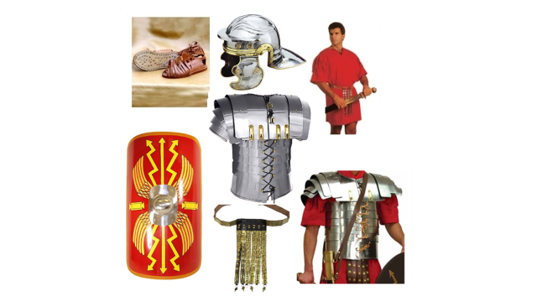
ROMAN SOLDIER ARMOR

Slide 12
THE ARMOR
Ephesians 6:14 Stand firm therefore, HAVING GIRDED YOUR LOINS WITH TRUTH, and HAVING PUT ON THE BREASTPLATE OF RIGHTEOUSNESS,
The belt held two other pieces of armor: the breastplate and the shield (which could be detached)
The truth protects your heart and goes before you as a shield
Ephesians 6:15 …and having shod YOUR FEET WITH THE PREPARATION OF THE GOSPEL OF PEACE;
Preparation: hetoimasia: readiness; advance planning
Stand firm: histemi: take a stand
Ephesians 6:16 …in addition to all, taking up the shield of faith with which you will be able to extinguish all the flaming arrows of the evil one.

Slide 13
THE SEDER
Luke 22:19 And when He had taken some bread and given thanks, He broke it and gave it to them, saying, "This is My body which is given for you; do this in remembrance of Me.“
Luke 22:20 And in the same way He took the cup after they had eaten, saying, "This cup which is poured out for you is the new covenant in My blood.
John 14:3 If I go and prepare a place for you, I will come again and receive you to Myself…
Jewish marriage: covenant cup, bridegroom left to prepare a place in his father’s house; gifts left for the bride; groom returns with a friend, a trumpet, and a shout to his bride
1 Thessalonians 4:16-17 For the Lord Himself will descend from heaven with a shout, with the voice of the archangel and with the trumpet of God, and the dead in Christ will rise first. Then we who are alive and remain will be caught up together with them in the clouds to meet the Lord in the air

Slide 14
KNOW GOD – KNOW HIS WORD
2 Timothy 3:16-17 All Scripture is inspired by God and profitable for teaching, for reproof, for correction, for training in righteousness; so that the man of God may be adequate, equipped for every good work.
Equipped: exartizo: fully prepared; the preparation of the gospel of peace comes from the word of God
1 Samuel 17:46-47 "This day the LORD will deliver you up into my hands, and I will strike you down and remove your head from you. And I will give the dead bodies of the army of the Philistines this day to the birds of the sky and the wild beasts of the earth, that all the earth may know that there is a God in Israel, and that all this assembly may know that the LORD does not deliver by sword or by spear; for the battle is the LORD'S and He will give you into our hands."

