Slide 1
ADVANCED BIBLE STUDY Using Tools
Dr. JoLynn Gower
Christian Resource Center
jgower@guardingthetruth.org
217-493-6151

Slide 2
TRANSLATION
Not all translations have tools that are keyed to
them; it is important to choose a translation wisely

Slide 3
BASIC DEFINITIONS
Exegesis: to bring out of the text what was originally meant; answers the question: “what does it say?”
Hermeneutics: to interpret; answers the question, “what did it originally mean?”
Principlization: takes the information from the first two and forms permanent principles from it
Application: applies conclusions about how the permanent principles apply in a given situation
Lexicon: an alphabetical listing of words in the vocabulary of a particular language, along with meanings

Slide 4
BASIC DEFINITIONS
Concordance: alphabetical list of words with numbers
Book (EXAMPLE)
βιβλίον biblion <G975> 29
βίβλος biblos <G976> 13
‏סֵפֶר‎ sēper <H5612> 138
‏סְפַרsepar <H5609> 4
Some concordances will list every scripture where the word occurs
Book: (EXAMPLE)
Luke 3:4 biblos G976
Revelation 5:1 blblion G975

Slide 5
BASIC DEFINITIONS
Bible Dictionary (EXAMPLE)
Greek Strong's Number: 976
Greek Word: βίβλος
Transliteration: biblos
Phonetic Pronunciation: bib'-los
Root: primitive root
Cross Reference: TDNT - 1:615,106
Part of Speech: n n
Vine's Words: Book
Usage Notes:
English Words used in KJV:[Total Count: 13]
properly the inner bark of the papyrus plant, i.e. (by implication) a sheet or scroll of writing: a book.

Slide 6
NUMBERING SYSTEMS
There are three main systems that number lemmas; a lemma is the basic dictionary form of the word you are researching:
Strongs (NASB, ESV, HCSB)
Louw-Nida (Logos software)
Goodrick/Kohlenberger (NIV/Laridian software)
You will choose your Bible translation and concordance and dictionary based on the numbering system you are using or are required to use
This is less of a problem when you are using a program and have multiple Bibles and tools downloaded

Slide 7
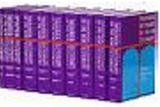
THEOLOGICAL DICTIONARY OF THE NEW TESTAMENT
Known as the TDNT or “Kittel”
10 volumes; Abridged , Little Kittle comes/several software programs
Treats more than 2,300 theologically significant New Testament words, including the more important prepositions and numbers as well as many proper names from the Old Testament. Presenting the words in the order of the Greek alphabet, TDNT typically discusses the following for each word: its secular Greek background, its role in the Old Testament, its use in extrabiblical Jewish literature, and its varied uses in the New Testament.

Slide 8
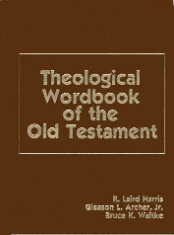
THEOLOGICAL WORDBOOK OF THE OLD TESTAMENT
One or Two volumes
This extensive, scholarly work includes discussions of every Hebrew word of theological significance in the Old Testament plus brief definitions of all other words found in Brown, Driver and Briggs Hebrew Lexicon. Keyed to Strong's Concordance, this book has been a longtime favorite of Bible scholars
Features: More than 1,400 articles written by 43 Old Testament scholars; 400 sub-entries giving definitions only; Special section of Aramaic words used in the Old Testament

Slide 9
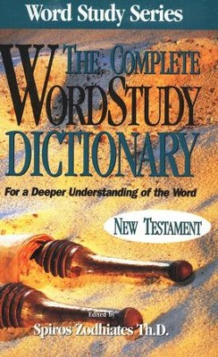
COMPLETE WORD STUDY DICTIONARY
One volume
Explore the idioms and nuances of the original text of the New Testament without learning Greek! This detailed study tool arranges every word by Strong's numbering system. Each entry gives the word's derivation; history and etymology; an exegetical commentary; and synonyms and antonyms. Includes an English word index.

Slide 10
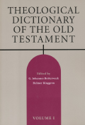
THEOLOGICAL DICTIONARY OF THE OLD TESTAMENT (REV) 15 VOLUMES
Starting from the more general, everyday senses and building to an understanding of theologically significant concepts, The TDOT avoids artificially restricting the focus of the articles, considering under each keyword the larger groups of words that are related linguistically or semantically. The lexical work includes detailed surveys of a word’s occurrences, not only in biblical material but also in other ancient Near Eastern writings. Sumerian, Akkadian, Egyptian, Ethiopic, Ugaritic, and Northwest Semitic sources are surveyed, among others, as well as the Qumran texts and the Septuagint; and in cultures where no cognate word exists, the authors often consider cognate ideas.

Slide 11
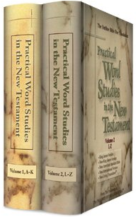
PRACTICAL WORD STUDIES IN THE NEW TESTAMENT
This two-volume set is a practical, efficient way to study over 4,000 New Testament words in their original Greek language. If you've ever wondered what certain words in Scripture meant to persons living at that time, you'll appreciate this user-friendly set.

Slide 12
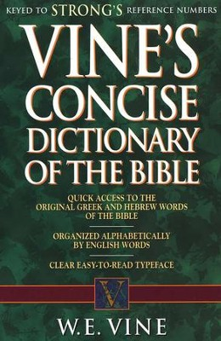
VINE’S CONCISE DICTIONARY OF THE BIBLE
Fast access to thousands of biblical word definitions. Dig into the meanings of the words used by the original bible authors--quickly and easily. Keyed to Strong's reference numbers, each entry includes how the word is used, key occurrences in the Bible, the English transliteration (the original word represented with English letters for pronunciation), and definitions of its various used in the Old and New Testament.

Slide 13
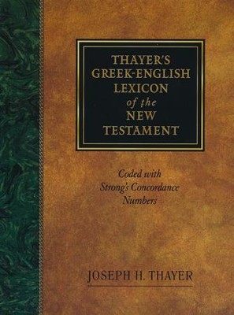
THAYER’S GREEK- ENGLISH LEXICON
One of the best New Testament lexicons available for any student of New Testament Greek. This lexicon provides dictionary definitions for each word and relates each word to its New Testament usage and categorizes its nuances of meaning. It also offers exhaustive coverage of New Testament Greek words, as well as extensive quotation of extra-biblical word usage and background sources consulted and quoted. This lexicon is coded to Strong's for those with little or no Greek knowledge.

Slide 14
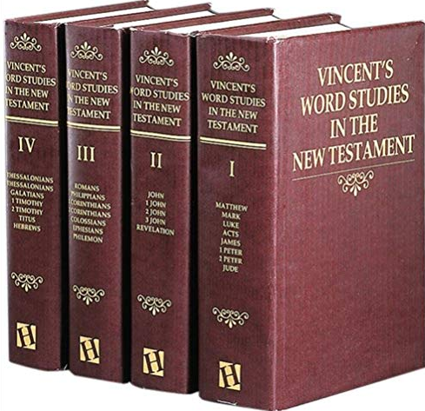
VINCENTS WORD STUDIES IN THE NEW TESTAMENT
Readers need no formal language training to use this book in unlocking for themselves the riches of the New Testament. Vincent’s lists each significant word in the New Testament with its meaning, derivation, idioms, and uses in verse-by-verse form. Sold as a 4 volume set

Slide 15
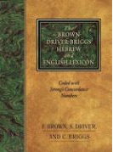
BROWN-DRIVER-BRIGGS HEBREW-ENGLISH LEXICON
Since it first appeared in the early part of the twentieth century, BDB has been considered the finest and most comprehensive Hebrew lexicon available to the English-speaking student. Based on the classic work of Wilhelm Gesenius, the "father of modern Hebrew lexicography," BDB gives not only dictionary definitions for each word, but relates each word to its Old Testament usage and categorizes its nuances of meaning. BDB's exhaustive coverage of Old Testament Hebrew words, as well as its unparalleled usage of cognate languages and the wealth of background sources consulted and quoted, render BDB and invaluable resource for all students of the Bible.

Slide 16
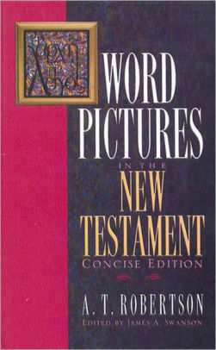
WORD PICTURES IN THE NEW TESTAMENT
For over seventy-five years Word Pictures in the New Testament has been a cornerstone of Bible scholarship. Now, the classic six-volume set has been condensed into a one- volume edition to make in-depth New Testament study accessible and enjoyable to a wider audience than ever. Each New Testament book is carefully examined, chapter by chapter, and accompanied by the unique and unmistakable commentary of A.T. Robertson, a leading authority on the Greek New Testament.

Slide 17
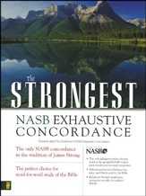
THE BASICS
NASB DICTIONARY
STRONGS TALKING GREEK-HEBREW DICTIONARY

